Slide 1
Alternative Fuel’s Best Kept Secrets:
Frequently Un-Asked Questions and Answers You Need to Know
Jeff Stewart
President
Blue Star Gas

Slide 2
"Let this be our national goal: At the end of this decade, in the year 1980, the United States will not be dependent on any other country for the energy we need to provide our jobs, to heat our homes, and to keep our transportation moving."
Excerpt from Richard Nixon’s State of the Union address given Jan. 30, 1974.

Slide 3
"We are now paying out $25 billion a year for foreign oil. Five years ago we paid out only $3 billion annually. Five years from now, if we do nothing, who knows how many more billions will be flowing out of the United States. These are not just American dollars, these are American jobs."
Excerpt from Gerald Ford’s “Address on Energy Policy” given May 27, 1975

Slide 4
"The nation's growing reliance on imports of oil ... threatens the nation's security."
Excerpt from President Clinton’s “Statement on Energy Security given Feb. 16, 1995.

Slide 5
“We cannot keep going from shock to trance on the issue of energy security.”
President Obama, March 30, 2011.

Slide 6
Step 1: “Increase Demand”
Step 2: “Reduce Supply”
Step 3: “Buy all the rest of what we need from people that hate us.”
Peter Schwartz GBN

Slide 8
Four Premises
One: “Alternative Fuels” to gasoline and diesel fuel.
Two: Our addiction to foreign oil places our national security at risk
Three: Transportation is a good place to look for alternatives and find remedies.
Four: Since the PROBLEM is HERE TODAY we must consider technologies that are HERE TODAY.

Slide 9
Deutche Bank Economic Study - 2010
“For every one cent increase in gas cost there's an annual $1.4 billion dollar loss in Consumer spending. ”

Slide 10
?

Slide 11
THERE IS NO “ONE SIZE FITS ALL”
ALTERNATIVE FUEL CHOICE

Slide 12
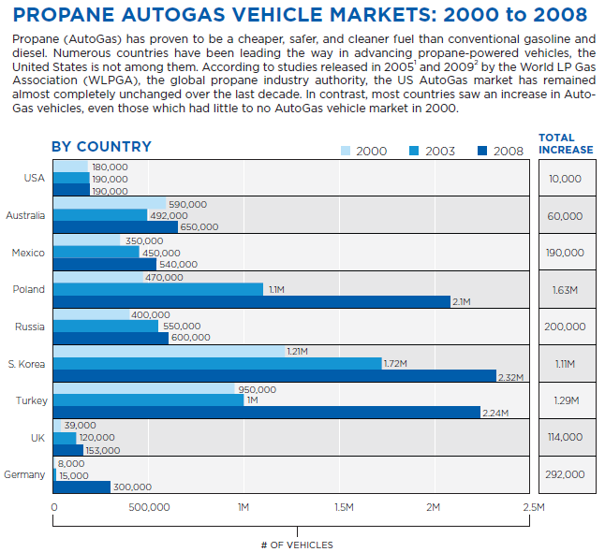
What is Propane Autogas Doing Around the World?

Slide 13
Seven Criteria for Alt Fuel Considerations
Emissions Reductions
Fuel Cost Savings
Cost of Fuel Infrastructure
Implications of Operating Pressures
Incremental Cost of Vehicle Equipment
Vehicle Range
Vehicle Payload

Slide 14
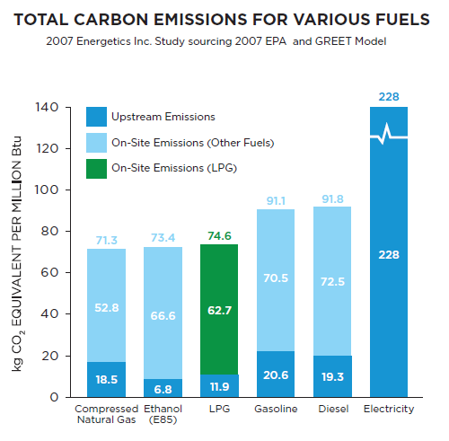

Slide 15
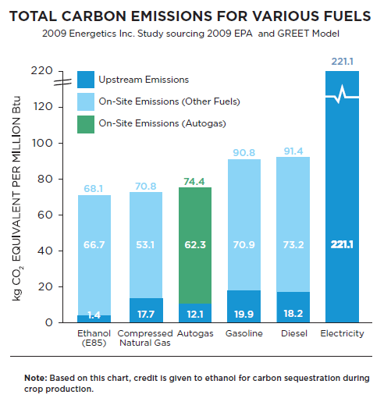

Slide 16
FUEL SAVINGS COMPARISON | AUTOGAS | CNG | ETHANOL | ELECTRIC
Fuel price per gallon (GGE) | $2.54 | $2.24 | $3.53 | $3.08
Fuel savings per gallon (GGE) | $1.10 | $1.26 | $0.30 | $0.55
(Based on $3.85/gal gasoline)
GHG emissions reduction | 23% | 28% | None | 25%
(lifecycle emissions vs. gasoline vehicles)
Notes:
Make Electric column be PLUG In EV

Slide 17
What About Infrastructure?
INFRASTRUCTURE COMPARISON | AUTOGAS | CNG | ETHANOL | ELECTRIC
Rated Storage Pressure | 250 psi | 3600 psi | N/A | N/A
Fueling Station | $20,000-$60,000 | $400,000-$1.7M | $120,000 | $50,000
 |  |  |  | Fast Charge Station
Tank Fill Time | 10-12 gals/min | 6-8 gals/min | 8-10 gals/min | 30 Minutes

Slide 18
What About Cost, Range and Payload?
COST, PAYLOAD, RANGE COMPARISON | AUTOGAS | CNG | ETHANOL | ELECTRIC
Additional cost per vehicle | $6,000 | $12-15,000 | $0 | $10-$15,000
Payload Capacity | -6% | -16% | No Change | N/A
Driving range vs. gasoline vehicles | 90% | 60% | 75% | Under 90 miles

Slide 20
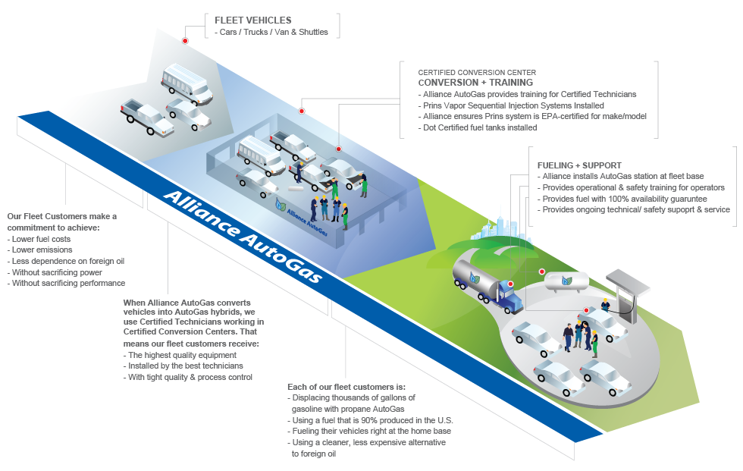
Integrated Solution

Slide 21
FUEL SAVINGS COMPARISON | AUTOGAS | CNG | ETHANOL | ELECTRIC
Fuel price per gallon (GGE) | $2.54 | $2.24 | $3.53 | $3.08
Fuel savings per gallon (GGE) | $1.10 | $1.26 | $0.30 | $0.55
(Based on $3.85/gal gasoline)
GHG emissions reduction | 23% | 28% | None | 25%
(lifecycle emissions vs. gasoline vehicles)
Notes:
Make Electric column be PLUG In EV

Slide 22
Question & Answers
www.allianceautogas.com
www.bluestargas.com
Jeff Stewart
President
Blue Star Gas
jstewart@bluestargas.com

Slide 23
Company Locations
Oregon
Salem, Oregon
McMinnville, Oregon
Eugene, Oregon
Grants Pass, Oregon
Medford, Oregon
Brookings, Oregon
Washington
Seattle, Washington
California
Santa Rosa, California
Mt. Shasta, California
Redding, California
Crescent City, California
Garberville, California
Clear Lake, California

