Slide 1
Natural Gas: Has the Cleantech Game Changed?
April 5, 2012
Kirt Montague, NewPath Energy Capital
Dan Kirschner, Northwest Gas Association
Jim Mothersbaugh, WaterTectonics
Garret Alpers, World CNG
Jim Hansen, Ravenna Capital Management

Slide 2
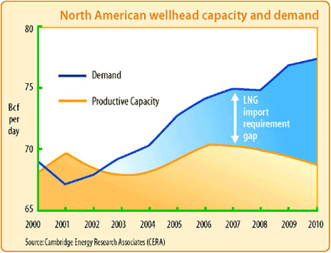
Fundamental Shift in Energy Sector
May 10, 2010
Shale Gas Will Rock the World
Huge discoveries of natural gas promise to shake up the energy markets and that’s just for starters.
2003
2010

Slide 3
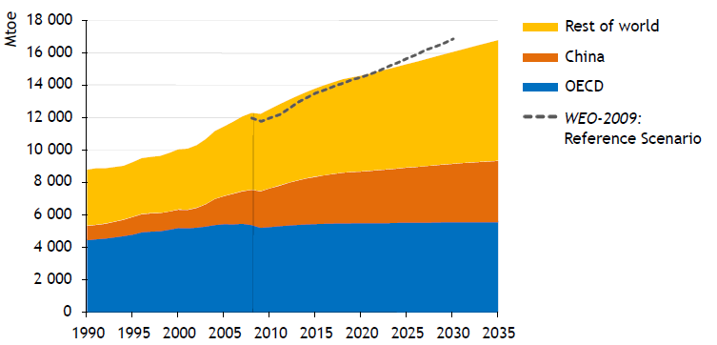
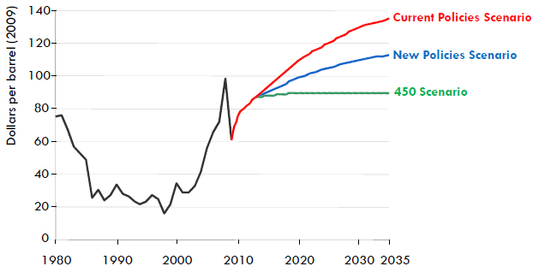
Oil—Increasing Demand, Increasing Prices
World Primary Energy Demand
(Million Tons Oil Equivalent)
Increasing Demand
International Energy Agency (IEA) World Energy Outlook forecasts increased energy demand with non OECD countries (primarily China) leading the way.
International Crude Oil Price Estimates ($/Barrel)
Increasing Prices
IEA forecasts increased oil prices as the world economy recovers and global demand grows. Various estimates exist but in general the trend is for flat to increasing prices from the present $80/barrel
Source: International Energy Agency (IEA) World Energy Outlook 2010

Slide 4
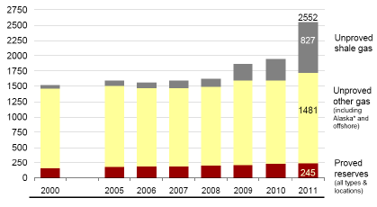
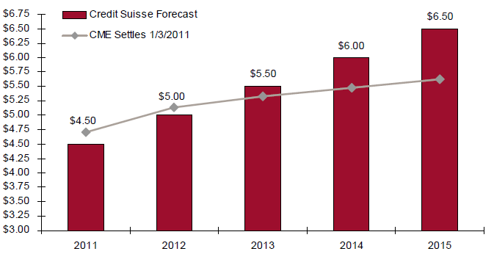
Natural Gas—Increasing Supply, Flat or Stable Pricing
Increasing Supply
US Energy Industry Associates (EIA) Early 2011 Outlook estimates 120+ years of gas reserves in the US and doubled their estimate from last year of recoverable unproved shale gas from 319 to 827 trillion ft³ trillion.
Flat or Stable Pricing
Credit Suisse Commodity Group predicts that the substantial low-cost natural gas reserves will keep natural gas prices in check.

Slide 5
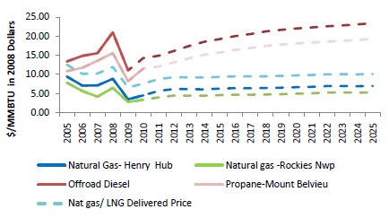
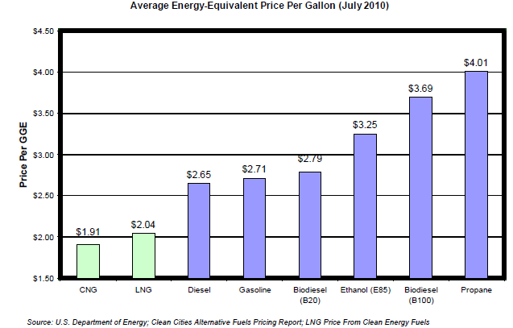
Increasing Price Gap
Forecasted Fuel Price Differential – $/mmBTU
A significant gap / arbitrage exists between CNG and LNG compared to diesel or propane.
CNG, on average, costs 42% less than diesel fuel on an energy equivalent basis and is expected to cost 50% less by 2035.
Notes:
Historical diesel price is No 2 distillate U.S average
Diesel future price is estimated using the historic basis differential to crude oil, as applied to forward crude prices

Slide 6
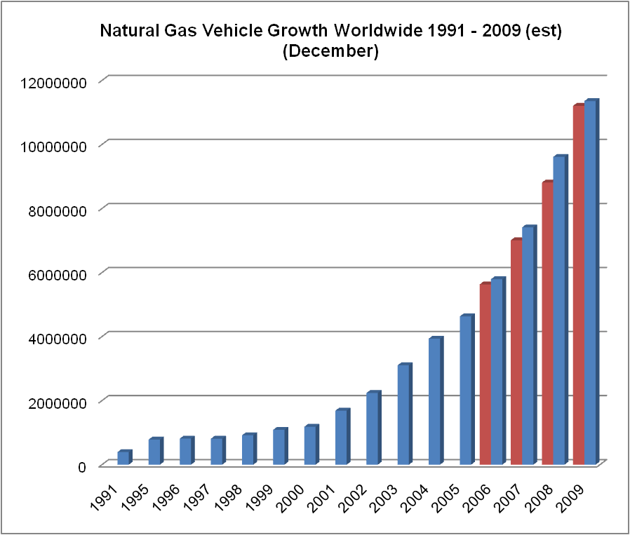
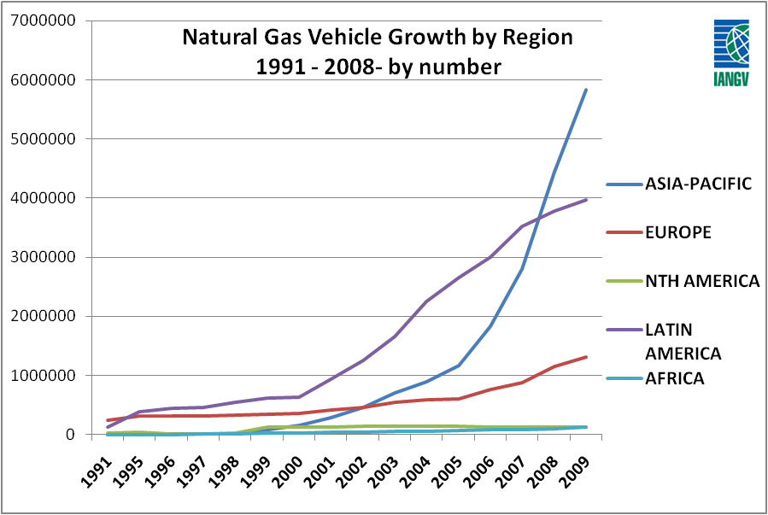
Growing Natural Gas Vehicle Market
US has110,000 NGVs on roads today. Over 12 million operating worldwide
~1,000 NGV fueling stations exist in the U.S., only about half of which are open to the public.
Transit buses account for about 66% of all vehicular natural gas use. Waste collection and transfer vehicles account for about 11 percent and are the fastest growing NGV segment.
EIA predicts the amount of natural gas consumed in the US for vehicle use more than doubled between 2000 and 2009, now displacing more than 300 million diesel gallon equivalents each year.
The International Association of Natural Gas Vehicles estimates that there will be more than 50 million natural gas vehicles worldwide within the next 10 years, or about 9 percent of the world transportation fleets.
Despite global growth trends, the US still lags the global market for overall penetration of natural gas vehicles due in part to the lack of developed refueling infrastructure.
Source: International Association of Natural Gas Vehicles
Blue bars represent total growth since 2000 (21% p.a.)
Red Bars denote projected growth from 2006
Source: International Association of Natural Gas Vehicles
Note 1: Natural Gas Vehicle Association (http://www.ngvc.org)
Note 2: International Association of Natural Gas Vehicles

Slide 7
Our thanks to Dorsey & Whitney for their support!
Contact WCTA for information on Membership, Committees, and Sponsorship opportunities at (206) 389-8655, or visit www.wacleantech.org .
Thank you and see you at our next event on May 3rd

