Slide 1
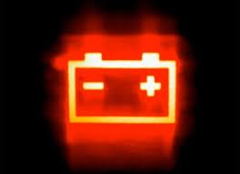
Energy Storage

Slide 2
Grid Energy Storage
Storage is a potentially useful tool across a wide range of both energy and power needs
Variable energy resource integration
Peak shaving
Volt/VAR support
Infrastructure upgrade deferral
Frequency regulation
Etc.
Large scale hydro and pumped hydro storage facilities have dominated the storage landscape
Batteries are beginning to enable smaller and more modular/scalable energy storage systems

Slide 3
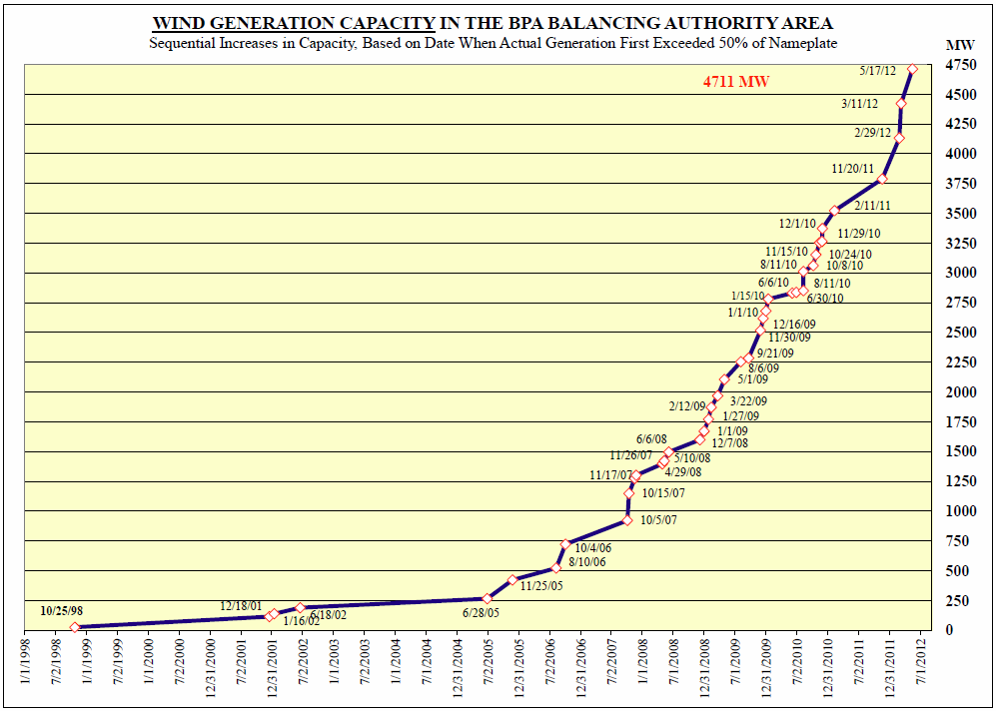
Growth of Wind

Slide 4
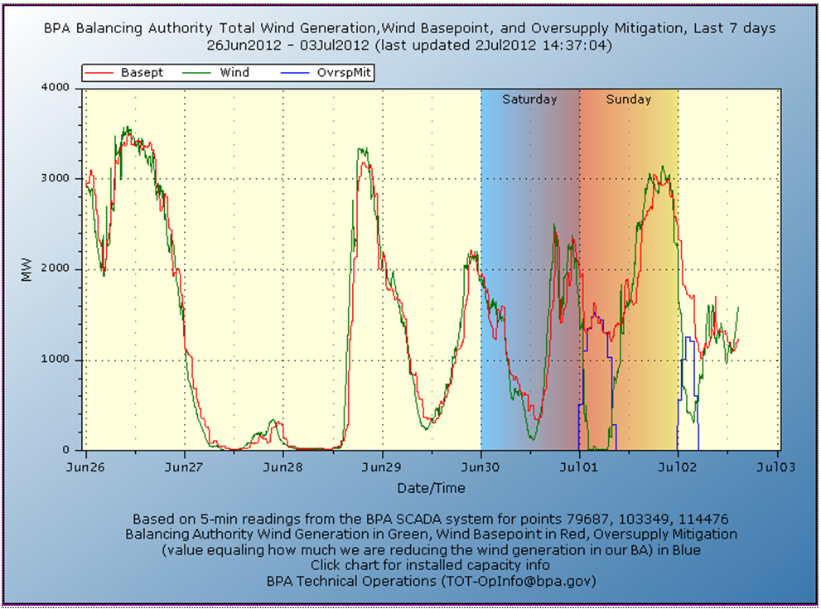
Variability of Wind

Slide 5
Wind Oversupply Management
Northwest Wind Integration Forum
Recommended continuing analysis of potential improvements to the John Keys Pump-Generating Plant (Banks Lake hydro storage)
Evaluated the costs of other energy storage options to be too high, particularly given the narrow spread between on and off peak power in recent years (~$10/MWh)

Slide 6
