Slide 2
Who is WRSI Consulting Group
Established 1998 as Waste Recovery Seattle International LLC
  Logical Solution
  WTE as a better alternative to Landfilling
  Focus on BAT/BACT – Model MVR, Hamburg
  Technology Focused
  Fact Focused
  Creates Jobs

Slide 3
Who is WRSI Consulting Group
2010 Change to:
WRSI Consulting Group LLC
  Creation of Jobs
  Shift from Waste Management to Resource Recovery
  International Group of Experts: Technology, Policy, Politics, Education, Science, Financial
  Advise/Assist/Help Municipalities, Vendors, etc to establish a sound shift from wasting resources in landfills via avoidance, recycling and recovery
  Focus on sustainability and minimizing ecological footprint through Resource Recovery
  Technology Independent
  Holistic approach
  Changing Perception and Paradigm Shift
  2010: WRSI Consulting Group
  International Group of Waste Management & Renewable Energy experts
  Advise/Assist/Help Municipalities, Vendors, etc to establish a sound waste management
  Focus on minimizing landfilling and maximizing sustainability and environmental protection while minimizing environmental footprint
  Creation of Jobs
  Technology Independent
  Holistic approach

Slide 4
Experience/Advantages
Decades of hands on/real life experience -> specifically recent 20 years
Seattle headquartered company with thorough local & regional knowledge and experience – West Coast Focus
“European Experience” & Network (incl. numerous Study & Trade Missions)
Well advanced Waste Management Concepts -> i.e. Hamburg Green City of Europe 2011 (includes waste and waste water management/treatment – energy and material recovery)
Green Concept – well respected European Concepts/EU Guidelines and Regulations including German Green Party
Most advanced LCA’s ISO 14040 and ISO 14044

Slide 5
Definition Waste:
Litter*: Garbage, Trash, Rubbish
Leftover*: Excess, Surplus, Unused, Unwanted, Discarded, Remaining, Spare
*English Thesaurus
Through Away/Consumer Oriented Society…
Zero Waste? …or - What is really going on?

Slide 6
1990
GERMANY
65,000 landfills
70% landfilled
20% recycled
10% WTE*
*WTE – Waste to Energy
US
20,000 landfills
70% landfilled
15% recycled
15% WTE*

Slide 7
2011
GERMANY
Less than 200 landfills
Less than 1% landfilled
Nearly 70% recycled
30 % WTE* Added state of the art technology – new and replacement of old facilities)
*WTE – Waste to Energy
USA
Approx 3,000 landfills
More than 60% landfilled
32% recycled
8% WTE* (Shut down facilities, no new ones …but…)

Slide 8
Translates into landfilling enough to fill over 1 million football fields 6 feet deep every year!

Slide 9
Above all other reasoning, due to the depletion of our natural resources:
Resource Recovery is a necessary part of an economical integral part of a sustainable and environmentally responsible waste management solution

Slide 10
Redefining Waste… as a Resource?

Slide 11
95% of Pacific Northwest’s waste is landfilled!
  Least Sustainable Solution
  Minimal GHG reductions (even if best practices are used)
  Very limited energy recovery (and short term – only)
  Limited recycling (if any)
  Release of toxins (just a matter of time)
  Groundwater contamination (just a matter of time)
  Escalating costs (fees now – tax money later)
  Limited Jobs

Slide 12
Translates into
100s of bypassed jobs
Long term liability
1,000,000s of MW Lost
10^{s} of thousands of tons of metals lost
…

Slide 13
Zero Waste
=
Utopian Concept
Zero Waste to Landfill
=
Achievable
(Germany 2020)

Slide 14
Germany 1990-2011
Added >300,000 Jobs
Annual Turnover of 70 Billion Euro
GHG Reductions of 30-60 million tons annually
Built on Foundation:
Strong Political Will,
Focus on Science and Long Term Economic and Environmental Modeling
Protection of (and investment in) Assets & doing something about growing Liability

Slide 15
Germany’s System to Resource Recovery
EPR for batteries, WEEE
Light weight
packaging
total: 68%
32%
digestion
connected
Slide – Courtesy of Dr. Helmut Schnurer - EU

Slide 16
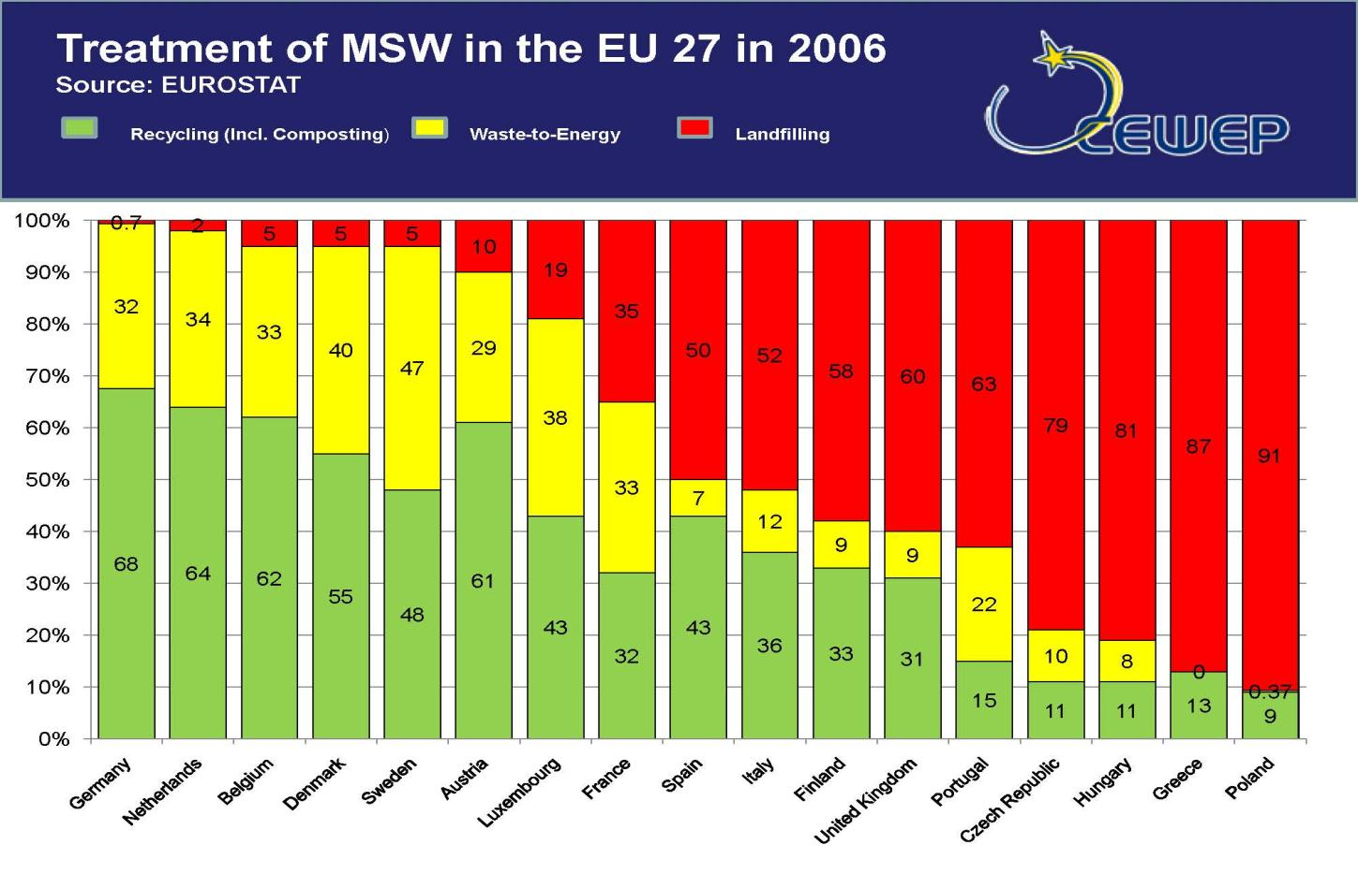

Slide 17
Alternatives to Landfilling:
Waste Avoidance
  Producing Less Waste -> higher quality Products which last longer
  Buying Less/Consuming Less ->Economic Challenge (Jobs)
Recycling
  Need Buyers -> Quality & Quantity
  Sustainable Balance (Cost, Environmental impact)
Composting
  Quality (Contamination/Purity)
  Market
Energy and Material Recovery
  Upfront Cost -> Risk Factor (Technology used)
  Recovery of Energy, Materials, GHG reduction

Slide 18
Proven (!), state of the art Resource Recovery solutions offer:
Household type garbage in → >99% Marketable products out!
→ Landfill diversion of 100%
EX: City/State of Hamburg Zero Landfill since 1999

Slide 19
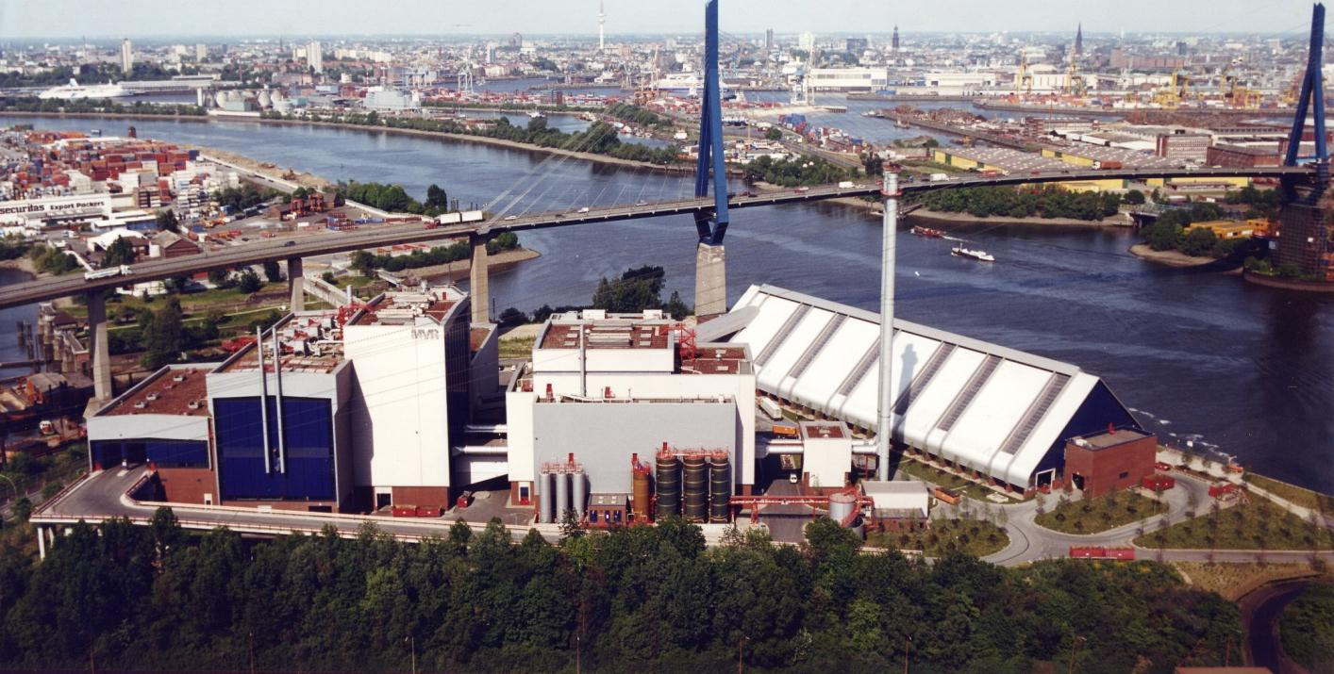
Example Facility, MVR, Hamburg, Germany:
State of the Art Resource Recovery

Slide 20
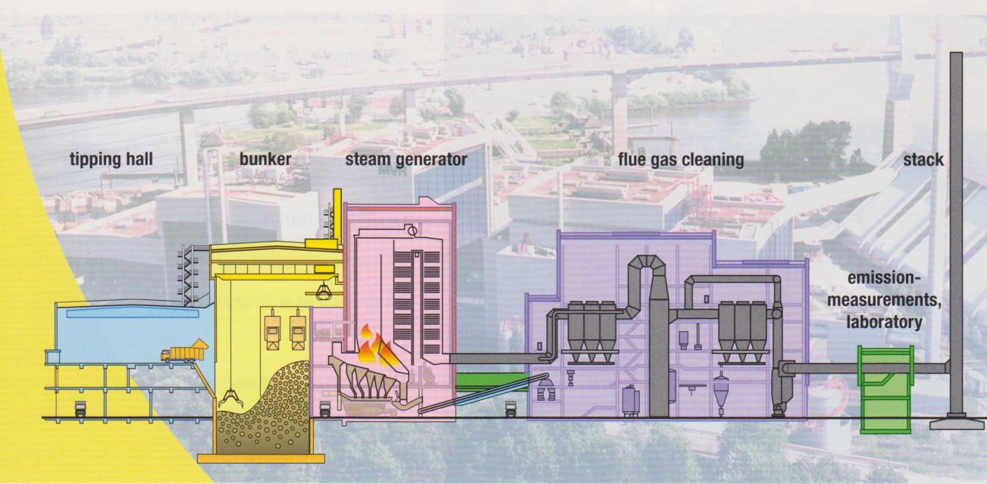
State of the Art Resource Recovery cont.:
Waste
Delivery
Waste
Storage
Grate/
Furnace
Bag House
I
Wet HCl-
Scrubber
Wet SO2-
Scrubber
Bag House
II

Slide 21
Identified Improvements of MVR Concept cont.:
Improvement Bottom Ash Treatment
Improvement of Bottom Ash Treatment
● External bottom ash
washing (to replace
integrated washing
in bottom ash
extracter) is more
effective
● Recovery of glass
(approx. 3% of waste
input) possible
plus
improved metal
recovery
● No ageing of bottom
ash required
● Better quality of
bottom ash
Notes:
21

Slide 22
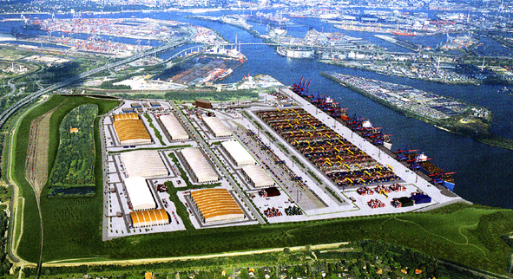
Container-Terminal Altenwerder, Hamburg (3 million TEUs annually)

Slide 23
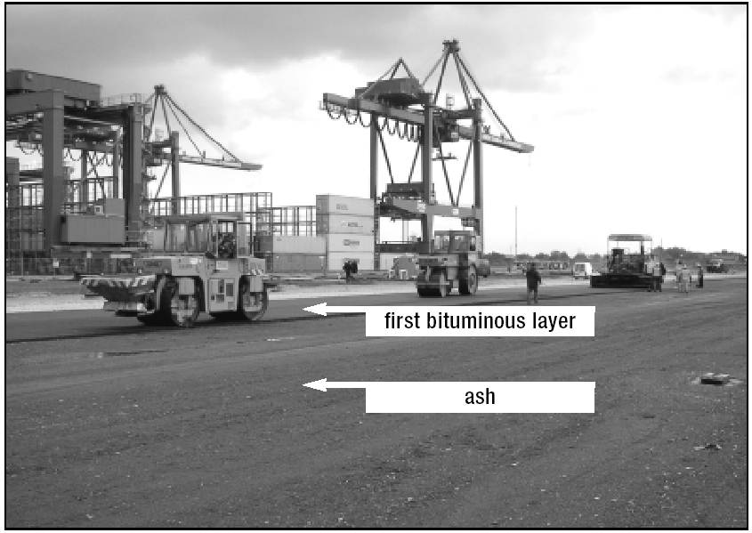
Application of ash (450,000 metric tons) utilized

Slide 24
Environmental & Economic Facts of State of the Art Resource Recovery:
No competition with recycling √
No competition with Waste Avoidance √
Protection of land and air:
  Zero landfilling √
  Zero Water discharge √
  Significant Greenhouse Gas reduction √
  Considerable emission reduction √

Slide 25
Following EU example and classifying waste as a resource (currently under EPA consideration by growing demand but “lack of funding”) will:
Create substantially more jobs
Create substantially more revenues
Move us from liability to asset
Respect the rights and existence of future generations

Slide 26
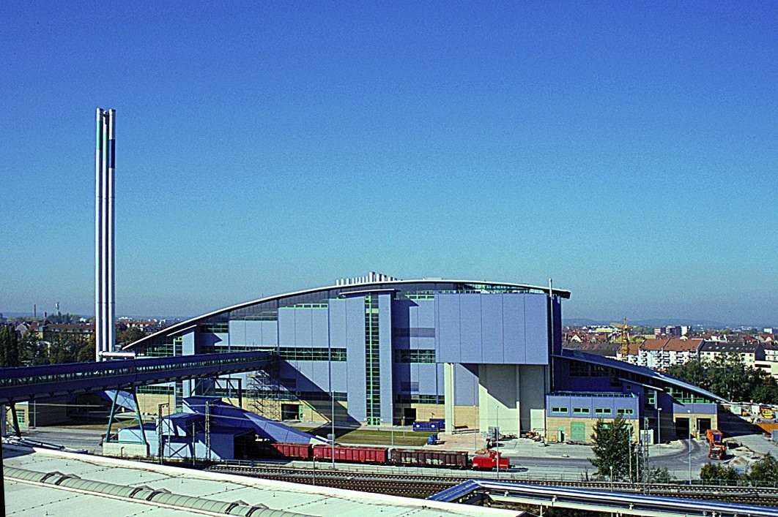
Resource Recovery in Nuremberg:
Close to the city
Very low emissions
Heat for district heating and industrial purpose
Transport of waste by truck and rail
Modern architecture = better public acceptance
Slide – Courtesy of Dr. Helmut Schnurer - EU

Slide 27
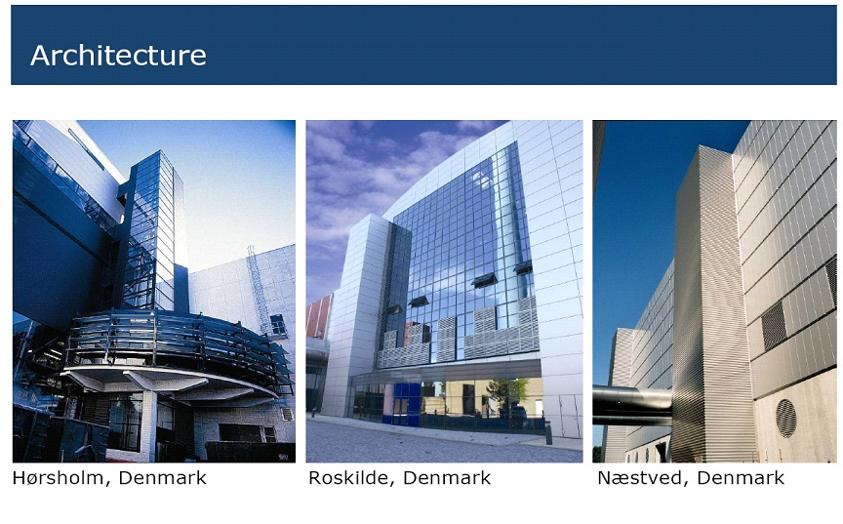

Slide 28
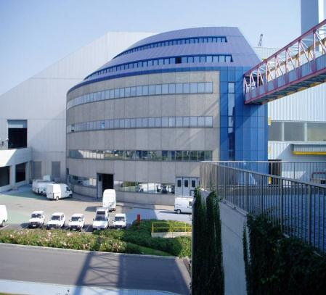
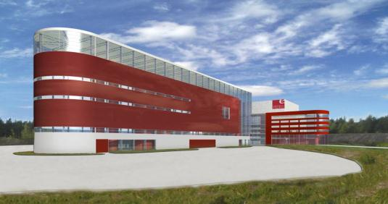
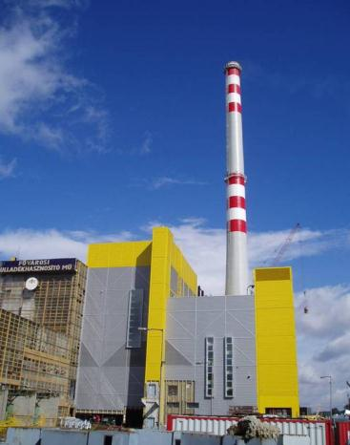
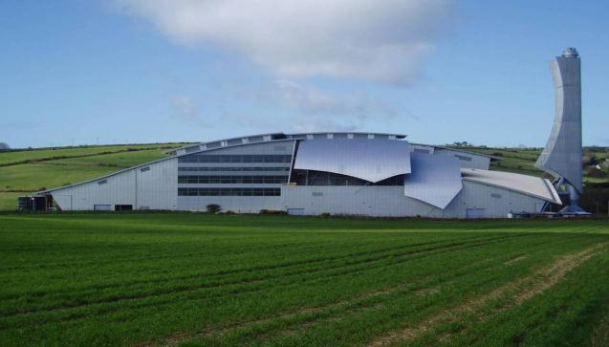
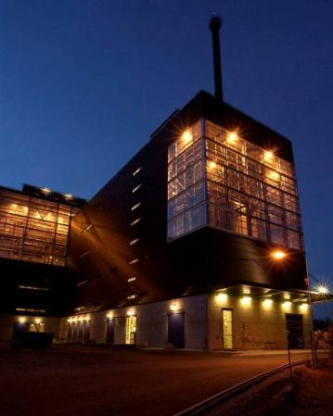
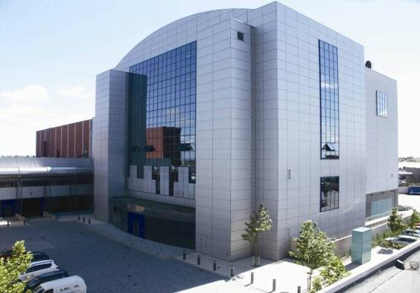
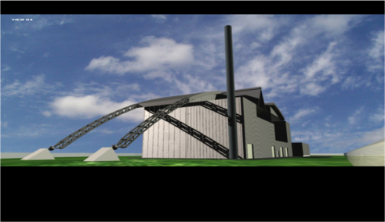
Resource Recovery is safe and clean …
Notes:
28

Slide 29
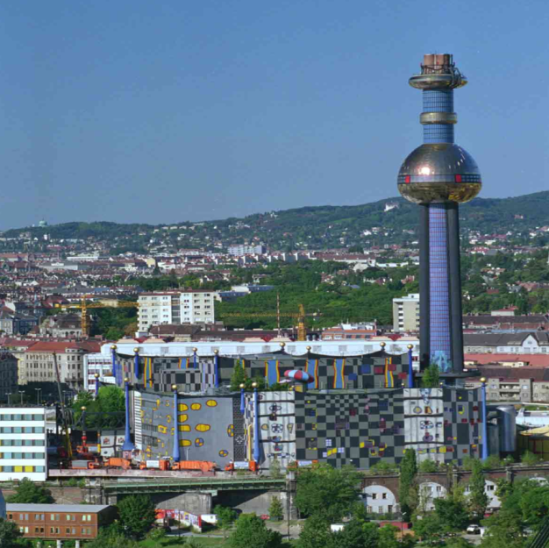
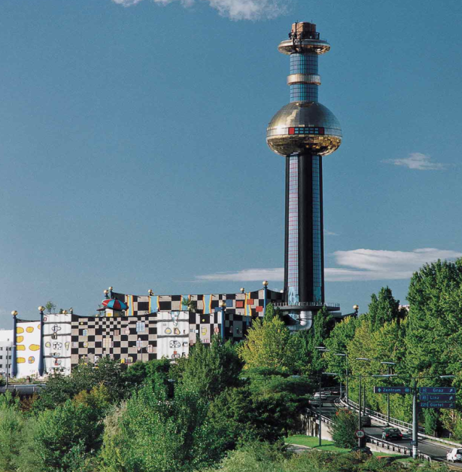
Greenpeace, 1999: ”...The Austrian incineration plants have a high environmental standard as far as air and water emissions are concerned…”
WTE facility Spittelau, Vienna, Austria

Slide 30
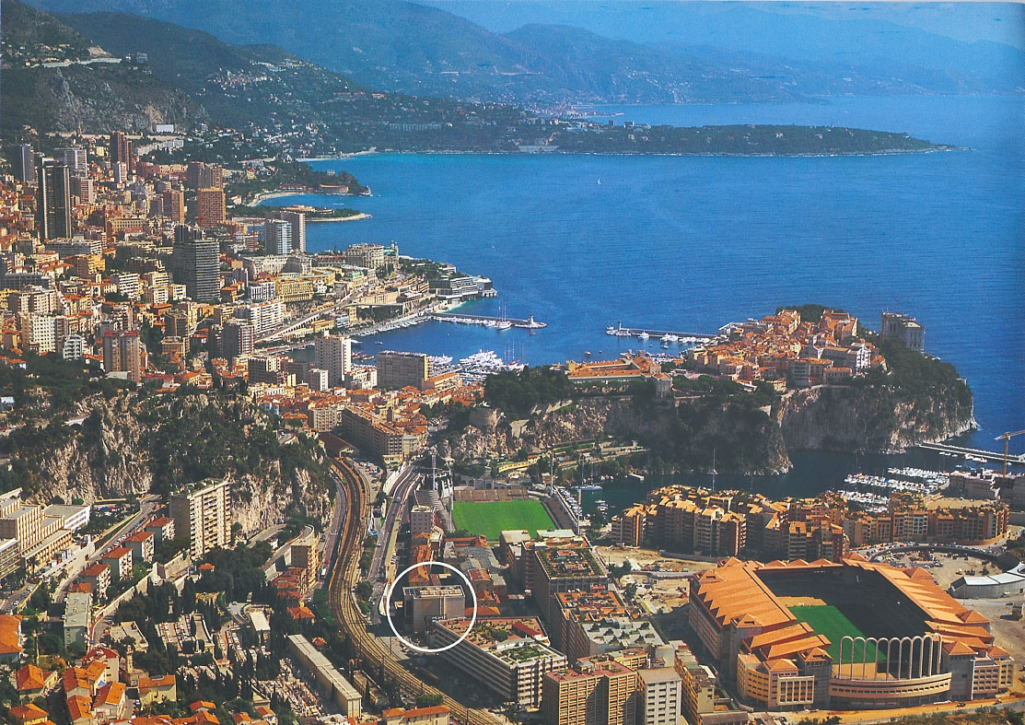
Spot the WtE Plant!
City of Monaco
CEWEP

Slide 31
World Economic Forum in Davos, Switzerland January 2009 identified Eight Emerging Large-Scale Clean Energy Sectors
The four-year surge in investment activity in clean energy has spanned all sectors, all geographies and all asset classes. What has begun to emerge as a result is the overall shape of the new lower-carbon energy infrastructure. No one can describe with certainty what he world’s energy system will look like in 2050.
A substantial proportion of our energy will undoubtedly still be supplied by fossil fuels, but we can now be fairly certain that a future low-carbon energy system will include a meaningful contribution from the following eight renewable energy sources:
1. Onshore Wind
2. Offshore Wind
3. Solar Photovoltaic (PV)
4. Solar Thermal Electricity Generation (STEG)
5. Municipal Solid Waste-to-Energy (MSW)
6. Sugar-based Ethanol
7. Cellulosic and Next Generation Biofuels
8. Geothermal Power

Slide 32
Challenges
Misconception
False use of data & Distortion of facts
Unmatched lobby by the ”competition” (landfill industry) and opposition
Scare and fear tactics toward Politicians & Public
Lack of knowledge & education or information overload
No base or concept to move forward from
(>5X)
➲ distorted perception  avoidance of subject

Slide 33
The ‘way’ we do business in the US:
2011:
  2 companies manage 80% of the volume of waste and
  Same 2 companies manage substantially more than 50% of our recycling
  Why:
  Influence by special interest lobby
  Science takes secondary role behind lobby
  Lack of political will/ability (hands are tied)
  Lack of Accountability (if any)

Slide 34
Slide – Courtesy of the German Green Party
Lessons learned from decades of experience
Waste avoidance and recycling quotas are not the solution, they are just a part of it!
Even recycled products become waste after use!
Using best available technology for the incineration of residual waste means less impact to environment and to climate than landfilling!
  Note: Although many members of the green party started their “career” in action groups against incineration plants, incineration with low emission levels, energy and material recovery is accepted today.
Notes:
34

Slide 35
Without Accountability:
  Long term liability left to us and our heirs
  ‘Wasting’ our natural resources
  Setting Bad example for future generations
  We lose out on vital job opportunities and
  We miss/lack competitive edge…
  We spend (waste) millions of dollars unnecessarily … shift on time axis…delaying the inevitable…

Slide 36
 | WTE | Landfilling | Composting
Regulations - current North American | One of the most regulated overall | Very limited – Slow process (Lobby efforts) | Very limited – Slow process (green perception)
Going in versus Coming out | Measurable to <1ng, Renewable Energy & Material recovery, 100% landfill diversion possible (RR) | Subjective i.e.: CH₄ <50% recovery, leaks up and down, 2000+ toxic chemicals in air, | NO₂ – 298 times CO₂, CH₄ – 25 times CO₂, water, air (smell), noise,

Slide 37
Shouldn’t our money/taxes be spent on more important matters than cleaning up what could have been prevented in the first place?

Slide 38
Especially considering our economic situation
&
We are in dire need of Jobs
&
We need to invest in our future
Notes:
38

Slide 39
Light on the horizon
Palm Beach, FL (3,000 tons per day)*
Baltimore, MD (4,000 tons per day)*
  1200+ construction jobs – period over 3 years
  Creation of over 180 permanent jobs
  160 MW Electricity
Los Angeles, CA (1,000 per day) “WRSI”
Frederick County, MD*
  *Power with Authorities compared to counties or cities - more interest in economic development and less politically driven

Slide 40
Job Potential for Washington
Example Waste-to-Energy only scenario:
700+ operating jobs (additional!)
4,000+ Construction Jobs
1000s of secondary Jobs
Economies of Scale make this very feasible
More Jobs if Diversity/Integrated Approach including Recycling, Composting and Avoidance

Slide 41
Example King County
  King County’s Draft 2009 Solid Waste Plan notes the gas recovery-reuse system in place at Cedar Hills landfill avoids CO2e emissions equal to 22,000 passenger cars
  But using the County’s 2008 disposal volume at Cedar Hills, 930,000 tons, and an average of one ton of CO2e avoided per ton of MSW processed at a WTE facility vs. landfilled, the resulting GHG reduction is equivalent to removing 195,000 passenger cars from King County’s roads, or about one car in six
  Resource Recovery facility GHG reduction considerably higher!

Slide 42
Resource
Waste =
=
=
=>
Resource
Economic Value
Renewable Resource
Environmental Value
Environmental Value
Quality of Life

Slide 43
Resource
Waste =
=
=
=>
Resource Recovery
Jobs!!!
Sustainable Jobs
Economic Opportunity
Economic Opportunity
Local, Regional and Global Competitiveness

Slide 44
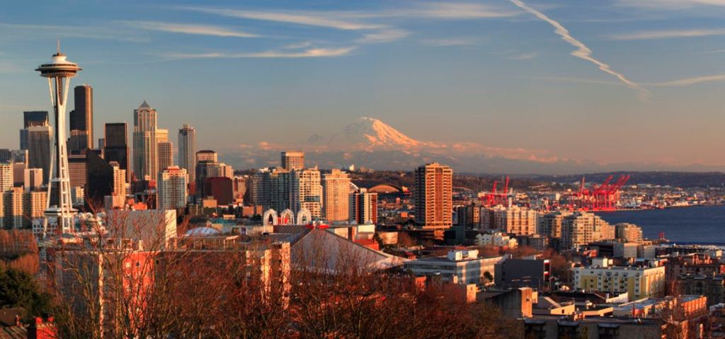
King County/Seattle 2015?

Slide 45
www.resourcewaste.com

