Slide 1
Wave Energy: Building an Industry
Jason Busch, Executive Director OWET/POET
Promoting Responsible Development of Ocean Energy

Slide 2
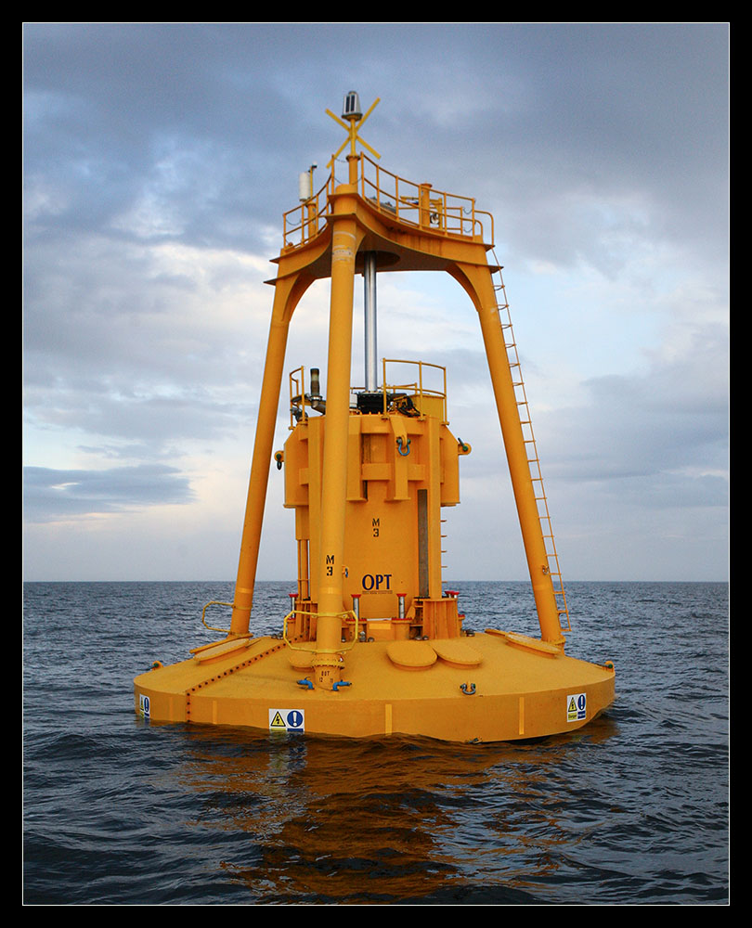
Notes:
2
2

Slide 3
Oregon Wave Energy Trust (OWET)
Nonprofit public-private partnership funded by the Oregon Business Development Department through the Oregon Innovation Council
Mission: to support the responsible development of wave energy in Oregon

Slide 4
Pacific Ocean Energy Trust (POET)
Created by OWET
Seeks to promote a Pacific Northwest regional expertise in ocean energy
Wave, tidal, offshore wind, in-stream hydro

Slide 5
Elements of the Industry
Environmental Assessment and Site Selection
Public Participation
Technology Research and Development
Regulatory and Policy Support
Utility Markets
Notes:
5
5

Slide 6
State of the Industry
1st Generation Companies – bridging commercialization
2nd Generation Companies – race to be 2nd
3rd Generation Companies – better mousetrap
Notes:
6
6

Slide 7
Bridging the Valley of Death
DOE
DOD
European utilities
Conventional industries:
Lockheed Martin
Chevron
Google
Notes:
7
7

Slide 8
The Crystal Ball
Feds?
Economy?
5 years of R&D
Demonstration projects 5-10
Commercial development 10 years
Notes:
8
8

Slide 9
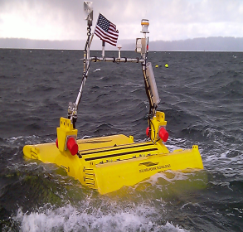
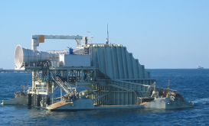
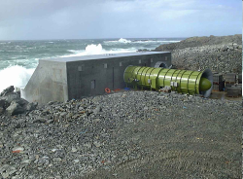
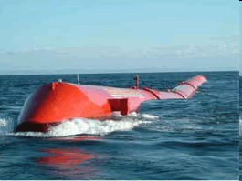
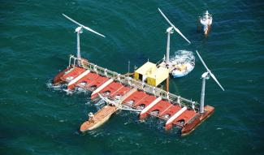
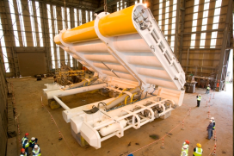
The Technologies
Diversity: power take off, siting, size

Slide 10
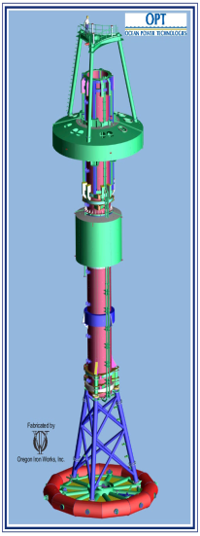
Ocean Power Technologies
Reedsport
Phase 1 - 150 KW device
Phase 2 - 1.5 MW: license application filed
Will be first grid connected array in North America
32 NW companies involved in the construction
Phase 3 – 50 MW
Coos Bay
Proposed 100 MW

Slide 11
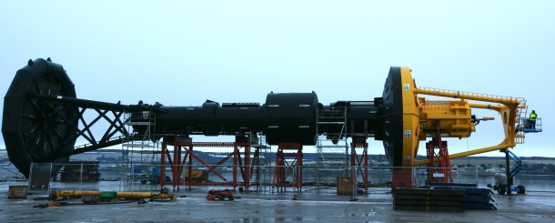
Notes:
11
11

Slide 12
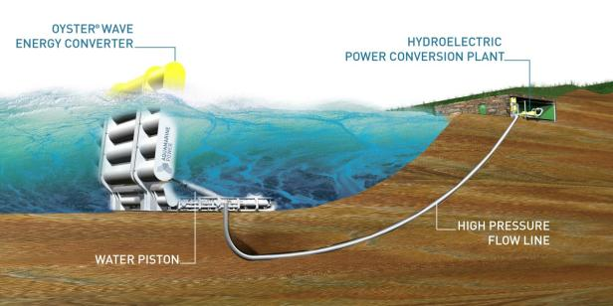
Aquamarine Power
Large mechanical ‘flap’ moves back and forth with motion of waves
Two hydraulic pistons pump high pressure water via pipeline to shore
Conventional hydro-electric generator located onshore
Secured to seabed at depths of 8 – 16m (33-55 feet mean water depth)
Located nearshore, typically 500 – 800m from shoreline
Suitable for installation on any type of seabed (sand, clay or rock)
12

Slide 13
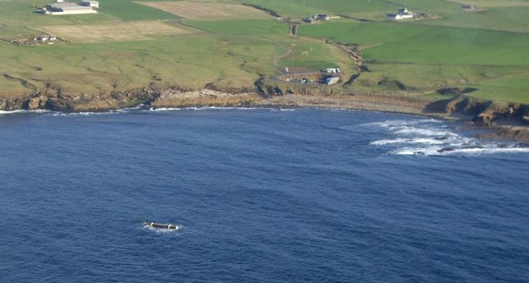

Slide 14
14

Slide 15
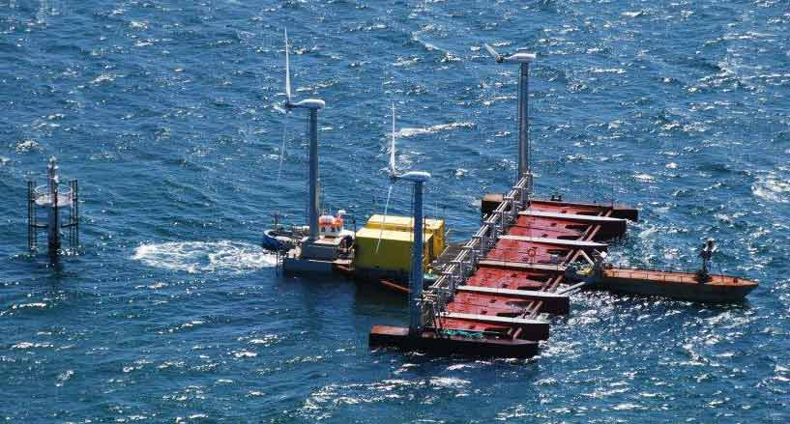
Floating Power Plant – Poseiden 37

Slide 16
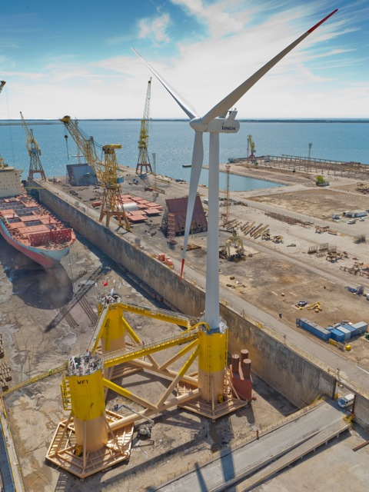

Slide 17
Projects/Companies in Oregon
Newport/OSU Testing Site
Ocean Power Technologies
Aquamarine
Wavegen
Columbia Power Technologies
WaveEnergy AS
Principle Power
Floating Power Plant
M3 Energy
Neptune Power
Ocean Kinetics
OWHAP

Slide 18
Questions?
www.oregonwave.org
POET Executive Director Jason Busch
jbusch@oregonwave.org
Notes:
18

