Slide 1
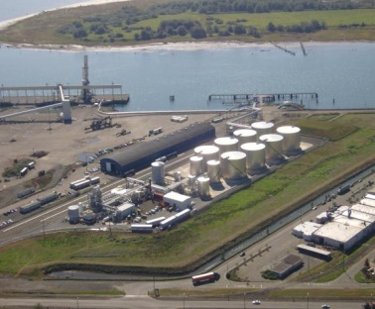
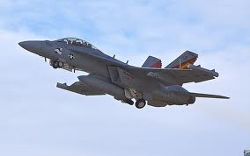
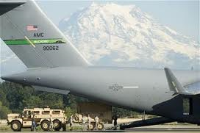
Imperium Renewables, Inc
INNOVATING RENEWABLES FOR THE FUTURE:
WCTA - Dec 7th, 2011
John Plaza
President and Founder
Chief Executive Officer
john@imperiumrenewables.com

Slide 2
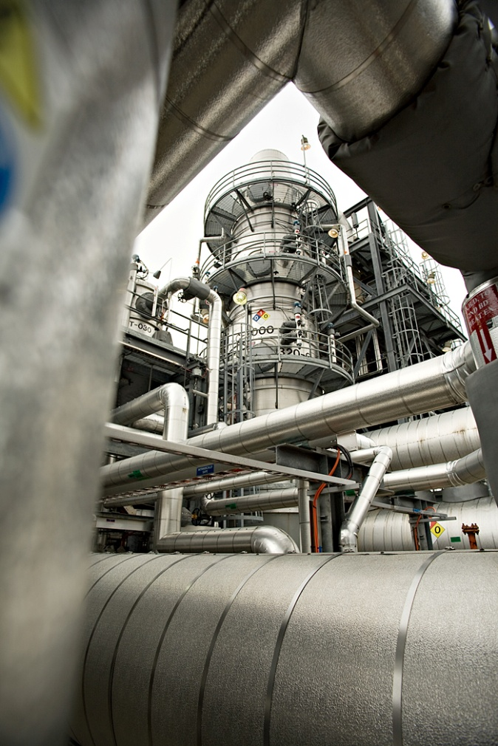
Imperium Renewables Inc.
Company founded in 2004
$255M in capital raised since 2005
Debt free since 2008
Focused on innovation and practical commercialization efforts for scale
49 employees in locations, Grays Harbor and Seattle
100 million gallons (378M Liters) of annual capacity
Profitable since Q4-’09
Strong foundation for growth in revenue, profit and new construction in 2012 and beyond
Long term stable business relationships with proven track record of high quality fuel and rateable supply

Slide 3
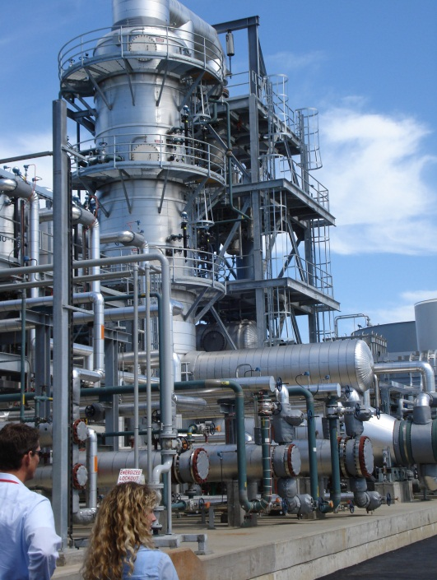
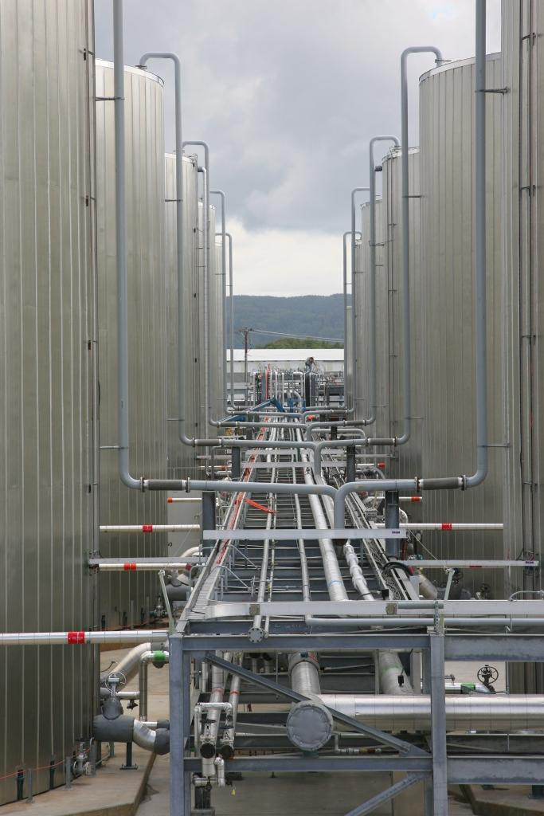
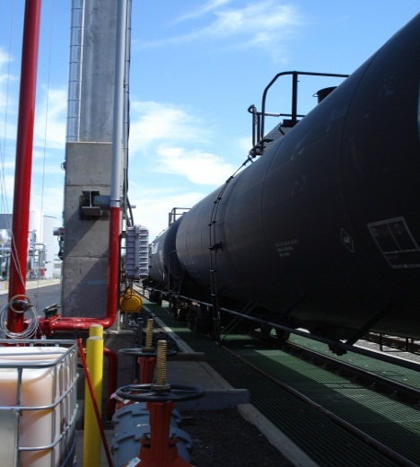
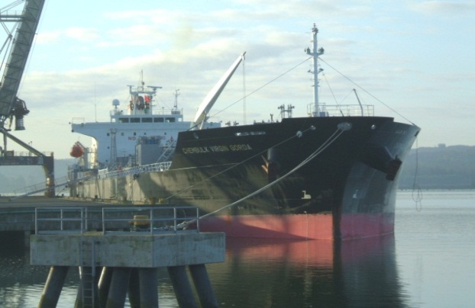
Imperium Grays Harbor Biodiesel Facility
FAME based distillation process
Biodiesel production sourced from 100% canola oil since 2007
Storage = 430,000 bbls
Significant rail infrastructure
75+ rail car load/unload facility
Storage for over 500 rail cars in local rail yard
Multiple truck racks
Marine - 41’ draft
750’ beam (Panamax capable)
100,000 bbl barge
Major supplier to US, Canada and Intl markets

Slide 4
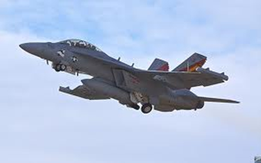
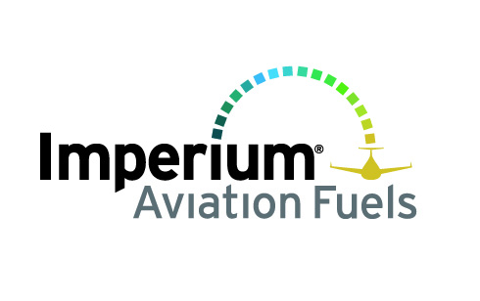
Drop-in Fuels of the future
Imperium Aviation Fuels
Biorefinery Project
New Facility to be co-located at existing biodiesel asset in Aberdeen
Will produce Renewable Aviation Fuels
Fuel is not biodiesel
Intend to supply HRJ to US DOD/Global Airline Industry

Slide 5
Advanced Biojet Refinery
100MGY facility/6,500 BBL per day
Output of HRJ = 25 – 40 MGY
No technology risk – EPC contract available for construction
Renewable Jet fuel/HRJ drop-in jet fuel
Renewable Diesel/HRD drop-in diesel fuel
Feedstocks would be current oilseed crops – canola, animal fats, UCO
Future oilseed crops such as camelina, algae, jatropha as available
Priority on establishing purchase commitments for financing of pipeline in the development pipeline
Advanced BioJet Refinery using oils/fats to produce:
“Drop-in” Fuels
Renewable Jet Fuel
Renewable Diesel
Diluent (Naptha)

Slide 6
IRI Alcohol to Jet Fuel (ATJ) Strategy
IRI proprietary development of technology for 3nd gen renewable jet fuel
In development with PNNL (Battelle Lab) for Alcohol to Jet fuel technology
Technology development focused on converting mixed alcohols into hydrocarbon equivalent “drop-in” fuels for aviation and other transportation fuels
Ethanol
Mixed alcohols
Allows for the use of feedstocks from existing biomass sources in PNW which are sustainable and economically viable in the long-term
Forest and agriculture wastes
Municipal solid waste
Research started in July 2010 with joint funding from IRI and Battelle
Sample of finished fuel for testing completed in December 2011
Boeing and Navy running “fit for purpose” testing regime
Have received $4M from DOE for biomass to jet fuel funding opportunity in collaboration with the following organizations

Slide 7
What is Needed for Biojet Success in WA
DOD purchase agreement
US Navy Initiative
Project Financing
Successful Project Execution
The 3 Steps to Success
“Partnership” with US Navy/DLA for long term purchase commitment
Innovative financing with Investment community
Similar to previous Imperium fund raising success in 2005-2007
$300M funding requirement
Imperium Team Successfully Executes Biojet Project
Permitting – 12 months
Construction – 24 months
Commissioning – 12 months
Green Strike Fleet volumes by 2016 for US Navy

