Slide 1
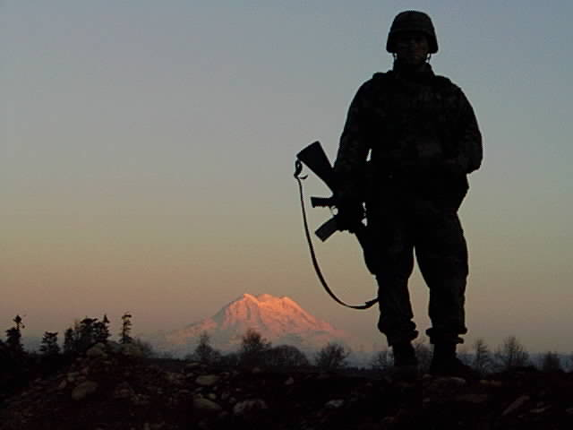
Joint Base Lewis-McChord Installation Sustainability Program
~ Net Zero Water, Waste and Energy
Paul Steucke, Jr.
Environmental Division Chief
Joint Base Lewis-McChord
7 December 2011

Slide 2
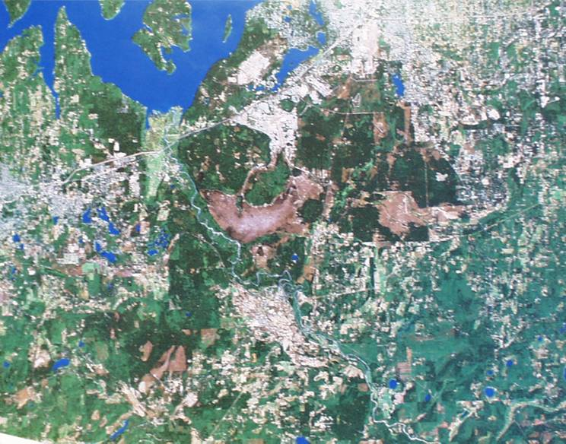
JBLM and Sustainability
Sustainability Program developed in 2002
Winner of the 2010 Sec Army and Sec Defense Sustainability Awards
Strategic and operational:
6 planning teams, working across all
7 “lines of effort” in the JBLM Strategic Plan, pursuing
8 aggressive goals, striving for military mission, community and environmental sustainability,
All overseen by the Installation Sustainability Board (ISB),
And driven by an ISO 14001 Environmental Management System
Designated as one of the Army’s Net Zero Installations for water and waste
Will compete for Net Zero Energy as well
Military members – 40,228
Civilian Workforce ~ 15,000
Family Members – 61,147
Industry – training & maintenance
Major utilities
Hospital (Madigan)
Housing - family and single soldiers
Notes:
1
Installation Sustainability Program
6 Strategic Planning Teams (Air, Water, Energy, Materials/Waste, Community and Training Land), plus YTC Sustainability Team
Installation Sustainability Board (strategic)
Update of Sustainability goals and milestones
Guidance and approval for operational changes provided by senior leadership & members
Installation EMS Management Review (operational)
EMS engages individual org. in support of strategic plans & vision
Quarterly Management Review updates GC on progress toward operational objectives and supporting actions
Installation Strategic Management Plan
Sustainability infused throughout the 7 Lines of Effort

Slide 3
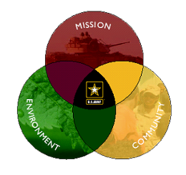
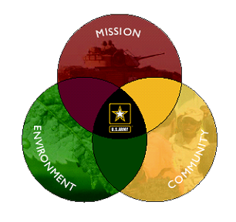
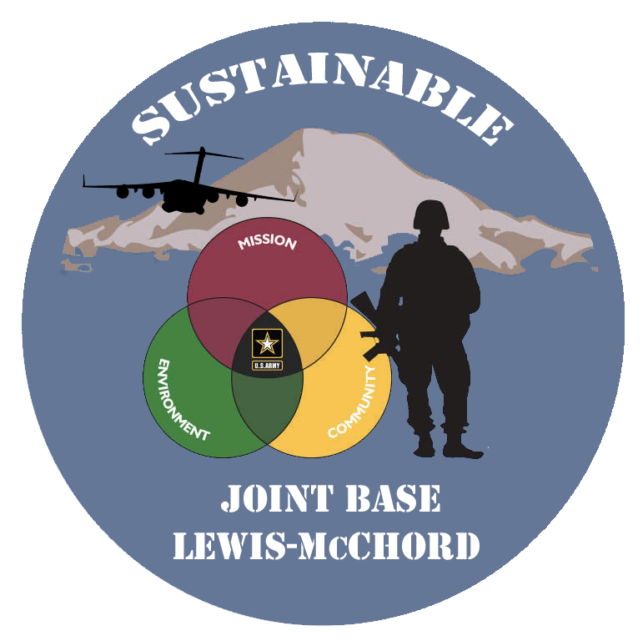
JBLM Sustainability Goals
Reduce installation stationary source and non-source motor vehicle air emissions 85% by 2025
2. NET ZERO ENERGY by 2020
ENERGY
WASTE
NET
0
3. Create sustainable neighborhoods for a livable JBLM community that enhances the Puget Sound Region
ENERGY
NET
0
WASTE
WATER
WATER
4. NET ZERO WASTE by 2020
5. Maintain the ability of JBLM to meet its current and future military missions without compromising the integrity of natural and cultural resources, both on the installation and regionally
6. Recover all listed and candidate federal species in the Puget Sound Region
7. NET ZERO WATER by 2020
Notes:
The eight JBLM strategic sustainability goals
These goals were originally set up to be achieved by 2025 and are broken out for planning into 6 distinct teams: Air Quality; Energy; Product and Material Management; Sustainable Community; Sustainable Training Lands; Water Resources.
The new net zero designations will push the Water, Waste (and Energy) teams to achieve NZ by 2020
These goals are meant to be aggressive and to push the technology envelope

Slide 4
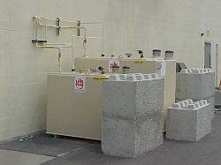
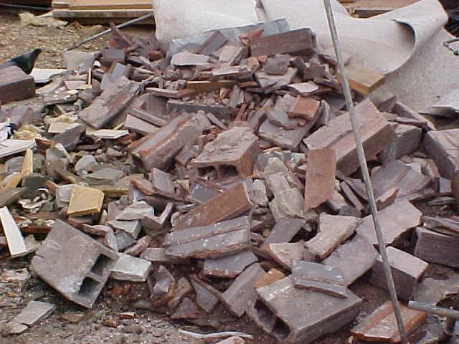
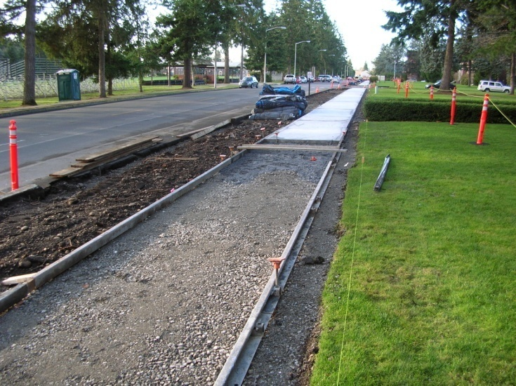
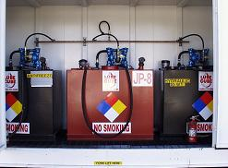
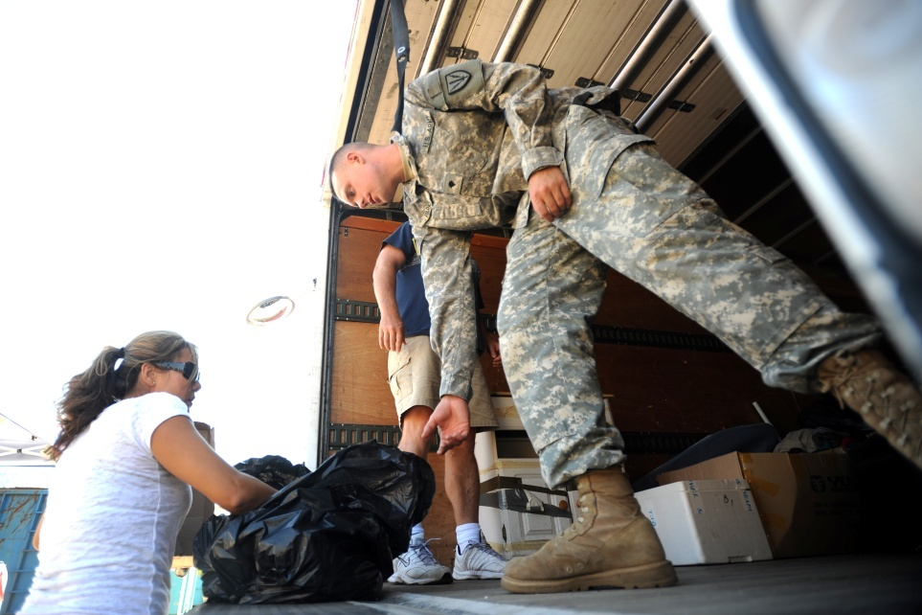
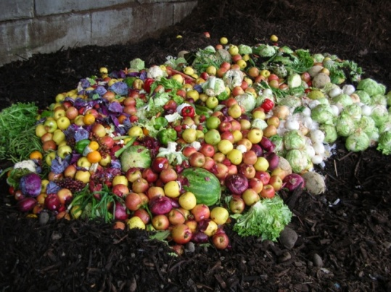
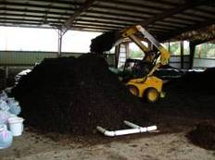
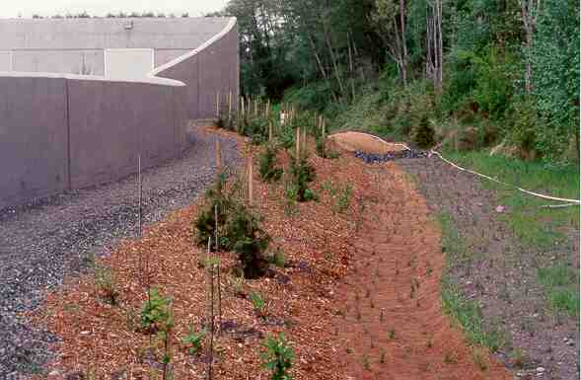
Achieve Net Zero Waste
The Strategy Involves Reduction and Diversion
~ Diverted in excess of 70% Solid Waste in 2010
~ Produced in excess of 15,000 tons of products
~ Saved over $1.6M
Recycled Content Products (Affirmative Procurement)
Water Efficient Products (WaterSense)
Energy Efficient Products (Energy Star, FEMP)
Biobased Products (Plant-Derived)
Recycle
Green Procurement
Hazardous Material Management
Repurpose
Compost
Notes:
4
Federally mandated program that affects the types of products and services purchased on the installation
Requires the purchase of products –
with recycled and bio-based content
energy and water conserving products; equipment and fixtures
Provides net basis for zero waste equation
Reduces the amount of virgin material consumed
Eliminates non-recyclable or reusable materials from entering the installation
Illegal Dumping Program implemented in 2005
A monetary claim is issued by the OJA Claims Office to cover all clean-up costs
3900+ illegal dump sites investigated; 1875 sites cleaned up
OJA claims = 490+; approx. 125+ claims filed annually
Cost avoidance averaging $125-150K/yr
JBLM is #1 in claims recovered in the Army

Slide 5
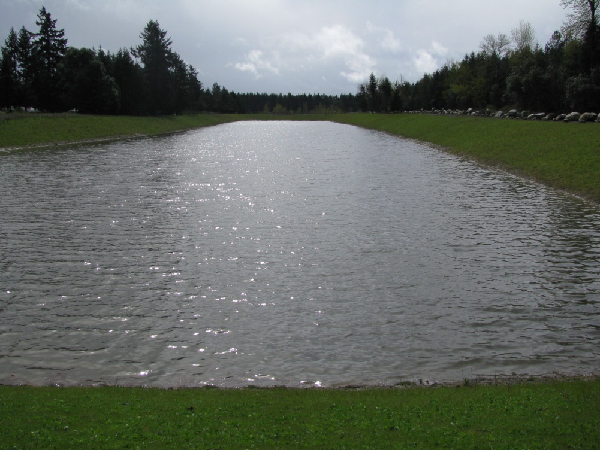
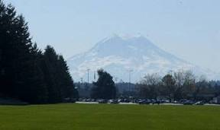
Achieve Net Zero Water
Treat all Wastewater Treatment Plant effluent to Class A reclaimed water standards and reuse
Stormwater diversion from JBLM North turns a former landfill borrow pit into a wetlands area and infiltrates runoff into the local aquifer
Current facility uses outdated technology
New facility will be capable of producing class A reclaimed water
Phase I (new plant) in the FY13 MCA program
Phase II (TBD) would convey treated water back upstream for reuse and infiltration into the aquifer
Manage storm water
Low Impact Development
Onsite infiltration
Stormwater reused to create wetlands
Reuse process water
Water from Superfund pump & treat site provides cooling water for Madigan HVAC system and infiltrates to groundwater
Irrigation of main parade field – prime opportunity for water reuse

Slide 6
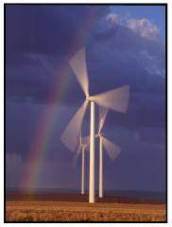
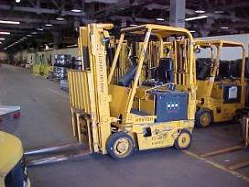
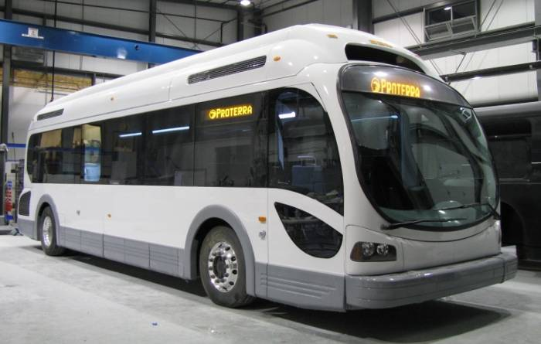
Achieve Net Zero Energy
Renewable Energy – transition from fossil fuels and fulfill energy needs via renewables
Renewable Energy Sources
JBLM potential – biomass and possibly others
JBLM Yakima potential – solar and wind
Innovative energy systems
Solar wall – preheats air flow into maintenance building
Wastewater treatment plant digester gas reformed into hydrogen and powering forklifts and a 37 foot shuttle bus
Energy Conservation - reduce demand by >30%
Partnership with Bonneville Power Admin - Utility Energy Services Contract (UESC)
Energy audits identified energy saving opportunities
$18M investment reaps $39M in improvements via rebates
Improve energy performance via MCA construction to LEED gold and platinum, or better
Notes:
6
UESC
$18M investment for $39M in improvements
~456K MBTU/yr savings and ~$4.3M/yr cost savings
~28% energy savings
Energy Audits
Lighting retrofits
HVAC repairs and controls modernization
Building insulation
Boiler and steam system repairs and upgrades

Slide 7
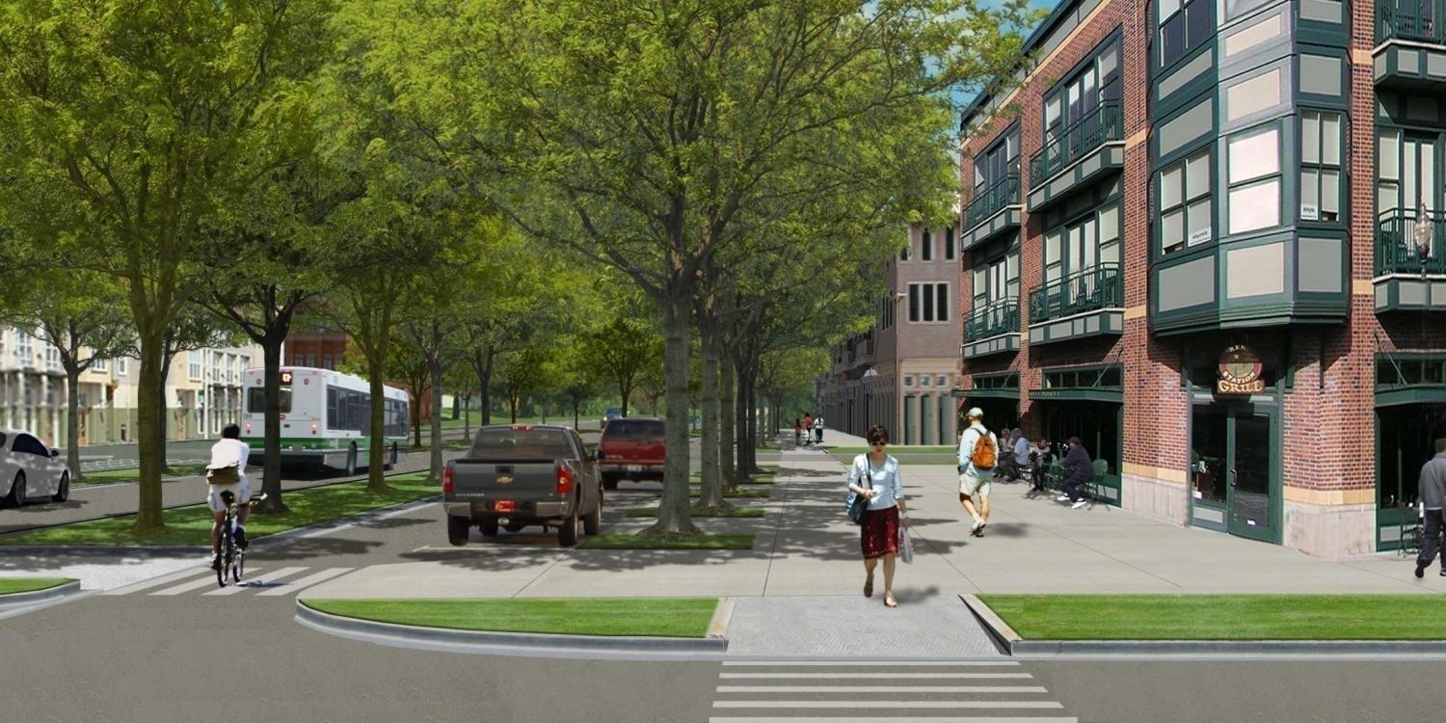
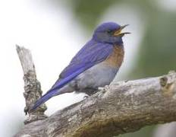
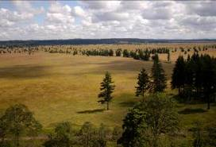
Other Team Activities
Air Quality ~ Reduce Air Emissions by 85%
Alternate Fuels (E85, Biodiesel, CNG)
Commute Trip Reduction program
Electric Vehicles
Sustainable Community
Sustainable Master Plan
Walkable neighborhoods, mixed use development, transportation options
Sustainable Training Lands
Army Compatible Use Buffer Program
Habitat preservation = training preservation
Notes:
7

Slide 8
Questions?
“Argue for your limitations, and sure enough, they are yours”
-Richard Bach
Paul Steucke
Environmental Division
Public Works, JBLM, WA
(253) 966-1760/6463
paul.steucke@us.army.mil

