Slide 1
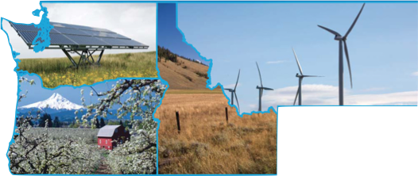
Keystone XL and Fossil Fuel Infrastructure
Washington Clean Technology Alliance -- May 3, 2012
Ross Macfarlane, Senior Advisor, Business Partnerships
ross@climatesolutions.org; 206-913-9800

Slide 2


Climate Solutions Mission
Accelerate practical, profitable solutions to global warming by:
  Galvanizing leadership
  Growing investment
  Bridging divides
  Make the Northwest a national and world leader in the clean energy economy
Notes:
2

Slide 3

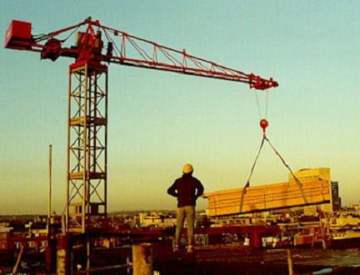
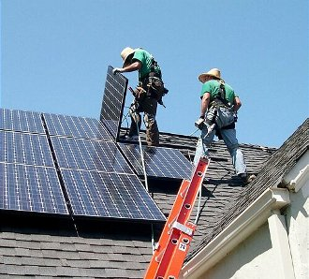
Clean Energy = Real Productivity
Clean Energy is about:
  “Building Things Right” – it’s exportable
  Excellence in clean, efficient energy, building
  Creating lasting 21st century businesses and sustainable clean energy jobs
Notes:
3
A lot of green jobs are building & trades jobs, simply redirected toward sustainable ends. Some examples of building trades jobs that can play a major role in the green economy: sheet metal workers, machinists, roofers, insulators, HVAC installers, electricians, electrical engineers, construction equipment operators, etc.

Slide 4
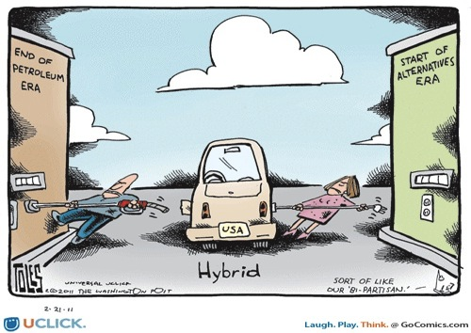

Slide 5


Notes:
We cannot let clean energy and the most important needs of our planet remain the hood ornament for an economy dominated by oil and coal.

Slide 6
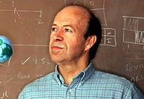
Global Climate Imperative
“Our global climate is nearing tipping points. Changes are beginning to appear, and there is a potential for explosive changes with effects that would be irreversible – if we do not rapidly slow fossil fuel emissions over the next few decades.”
Dr. James Hansen, Director, NASA’s Goddard Institute of Space Studies
Notes:
Dr. Hansen first scientist to warn of effects of greenhouse gases/global warming over two decades ago.

Slide 7
Global Climate Imperative
To stabilize climate “the principal requirement is that coal emissions must be phased out by 2030 and unconventional fossil fuels, such as tar sands, must be left in the ground.”
Keystone XL -- “Essentially game over for the climate”
- Dr. James Hansen, NASA Goddard Institute

Slide 8
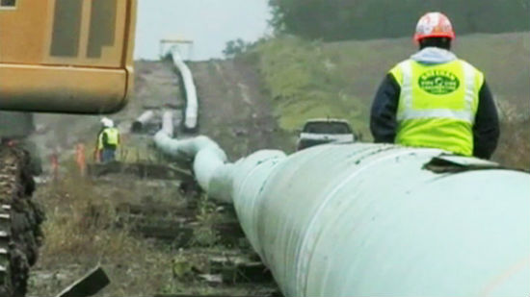
Climate and economic “lock-in”
IEA: Transition in next 5 years or “lose forever” the chance to avoid dangerous climate change.
The make or break issue: energy infrastructure investment in growing economies.

Slide 9
Climate and economic “lock-in”
Finite investment dollars for energy – fossil fuel or clean energy?
Clearly we need to make a long transition – it will take many years to win climate game, but we can lose it quickly

Slide 10
Tar Sands GHG Intensity
Source: “Upstream greenhouse gas (GHG) emissions from Canadian oil sands as a feedstock for
European refineries”, Adam Brandt, Stanford University

Slide 11
Alberta Tar Sand Production
• Tar sands production is more CO2 intensive than conventional drilling, and CO2 intensity has increased over the past six years
• CO2 emissions from disturbed peat bogs is only now being accounted for, and the effect is massive
• “The very weak regulatory environment for greenhouse gas management in Albert and Canada does not require substantial improvements in greenhouse gas emissions” - Simon Dyer, Pembina Institute

Slide 12
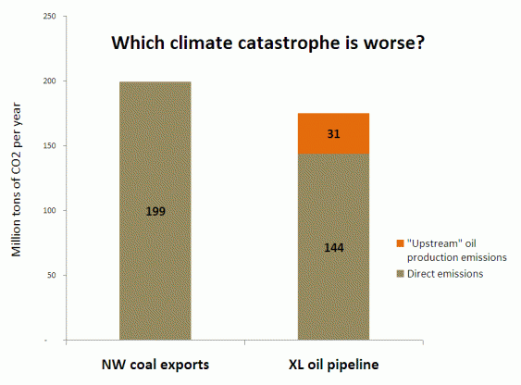
Source: Sightline Institute

Slide 13
Tar Sands Pipeline Boom

Slide 14
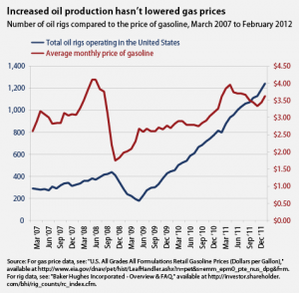
KXL Will Have No Impact on Domestic Prices
• Global Oil Market. Increased North American Oil Production has had no effect on oil prices
• Tar sands oil is very
expensive to produce
$70/bbl profitability
threshold
Increased “crack spread”
More expensive and
challenging to refine for
aviation
Notes:
New oil sands development is only economic when oil prices stay above $70/bbl : (The Canadian Energy Research Institute (CERI); St. Louis Fed)

Slide 15
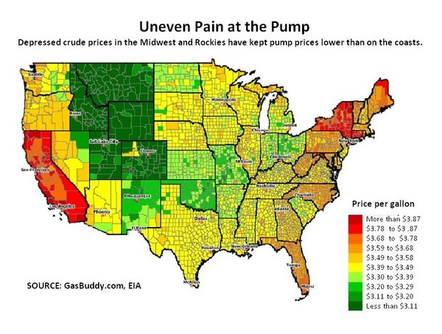
• Midwest gas prices are depressed due to surplus buildup in Cushing, OK
• More pipelines to export markets and coastal centers
may increase local prices

Slide 16
Keystone XL Will Have No Impact on Domestic Gas Prices
"Canadian oil in the U.S. trades at quite a discount … From a Canadian perspective, it doesn't maximize the return. That's why Keystone is so important.” Kevin Lynch, BMO Financial.
"Unless we get increased market access, like with Keystone XL, we're going to be stuck," Ralph Glass, AJM Petroleum Consultants.
Producers want to get oil to where they can get highest prices – export markets

Slide 17
Myth: KXL Will Be Major Job Creator
• Independent Cornell study estimates 2,500–4,650 temporary jobs
• 500-1,400 permanent jobs, mostly non-local

Slide 18
Myth: KXL Will Be Major Job Creator
• Fossil Fuel Job Claims in Context
Between 2005 – 2010, ExxonMobil, Chevron, Shell and BP:
  Made $546 Billion in profits
  Slashed US workforce by 11,000
    40% of payroll is minimum wage at gas stations

Slide 19
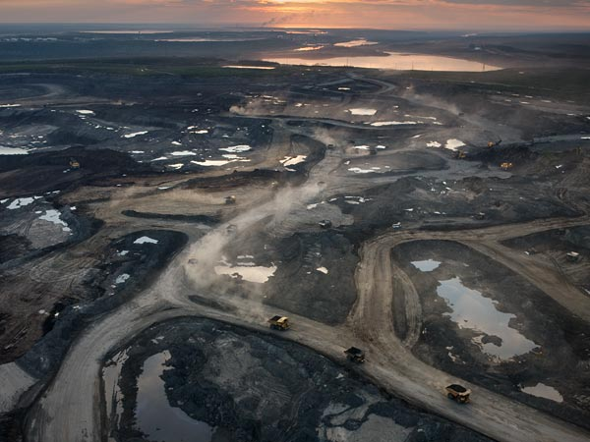
Local impacts are not so local
Extraction:
• 12bbls of water per bbl of oil
• Massive tailings ponds
• Boreal forest destruction

Slide 20
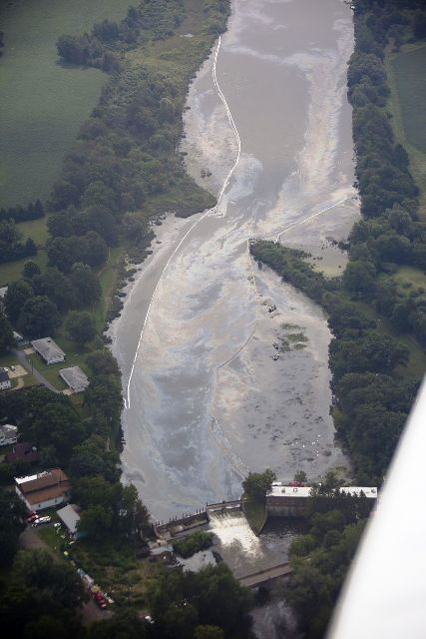
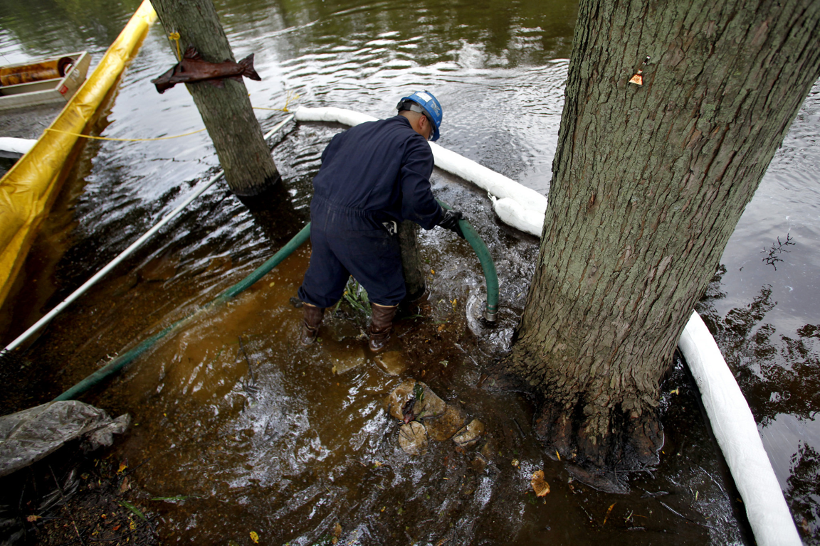
Pipeline Spills:
•Tar sands crude is like “sand paper”
•First Keystone pipeline spilled 14
times in first year alone
• 2010 Enbridge Kalamazoo River spill:
• 840,000 gal; $700m

Slide 21
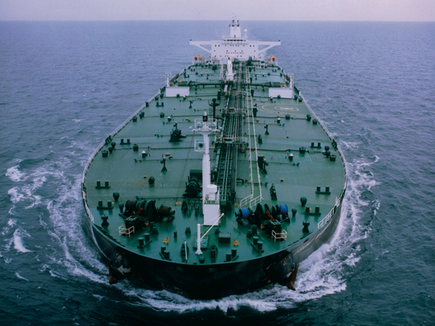
Export tanker spills
KXL =
Kinder Morgan/Northern Gateway =
• Increased traffic in the Douglas Channel, Kitimat, BC
• Strait of Juan de Fuca, Vancouver, BC
• Increased tanker trips in
Gulf of Mexico

Slide 22
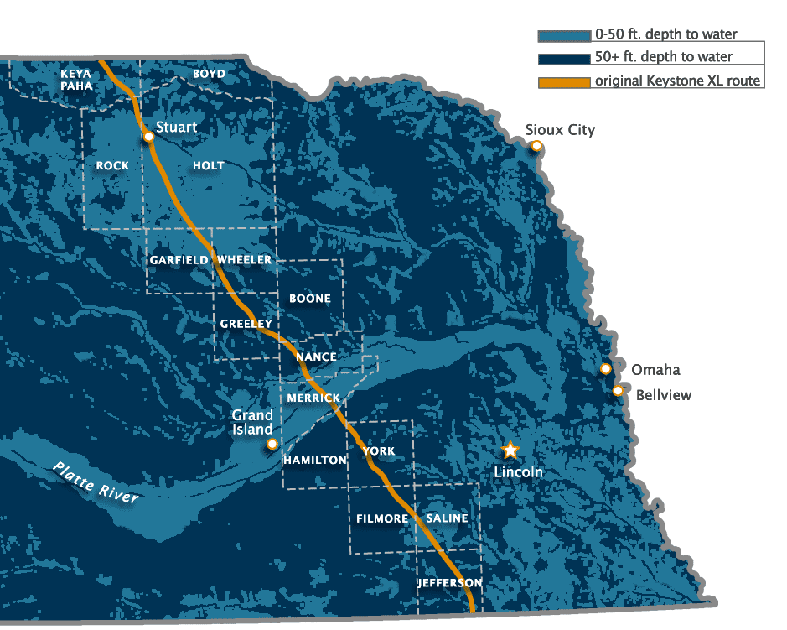
Ogallala Aquifer at risk
• Lifeblood of Midwest farming and communities
• Increased importance with Climate Change
• The Ogallala Aquifer is NOT a NIMBY issue
Even revised route proposal affects portions of Ogallala

Slide 23
“You are Just NIMBY Opponents”
NIMBY – “Not in my backyard”
  BANANA – “Build absolutely nothing anywhere near anybody.”
PIMBY for clean energy and sustainable development – “Please in my backyard”
NOPE for massive fossil fuel infrastructure – “Not on Planet Earth”

Slide 24
Choosing a Clean Energy Future

Slide 25
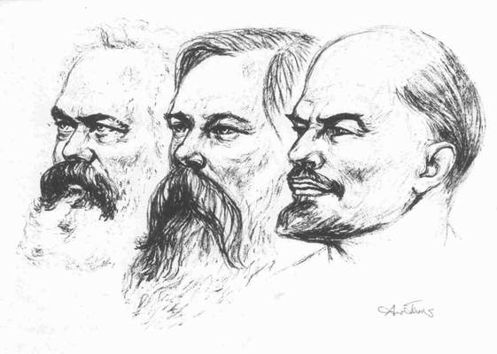

So You Say You Want A Revolution?

Slide 26
Keystone XL and Fossil Fuel Infrastructure
Washington Clean Technology Alliance -- May 3, 2012
Ross Macfarlane, Senior Advisor, Business Partnerships
ross@climatesolutions.org; 206-913-9800

