Slide 1
Zero Landfill
Solid Waste Alternatives
King County Councilmember Kathy Lambert

Slide 2
King County’s Garbage
More than 45 percent of municipal solid waste is recycled.
Cedar Hills landfill handles more than 800,000 tons of garbage annually.
At current rate, landfill will be full in 10-11 years. No new landfills allowed.

Slide 3
Environmental benefits of WTE
Waste-to-Energy provides a net greenhouse gas benefit
Eliminates or captures all methane emissions
Offsets fossil fuel energy with biomass
Net zero emissions
Reduces or eliminates the potential for groundwater contamination from the landfilling of raw garbage

Slide 4
Integrated Waste Management Hierarchy
  Reduction of waste, with product stewardship
    Recycling and reusing
      Energy recovery
          Landfilling

Slide 5
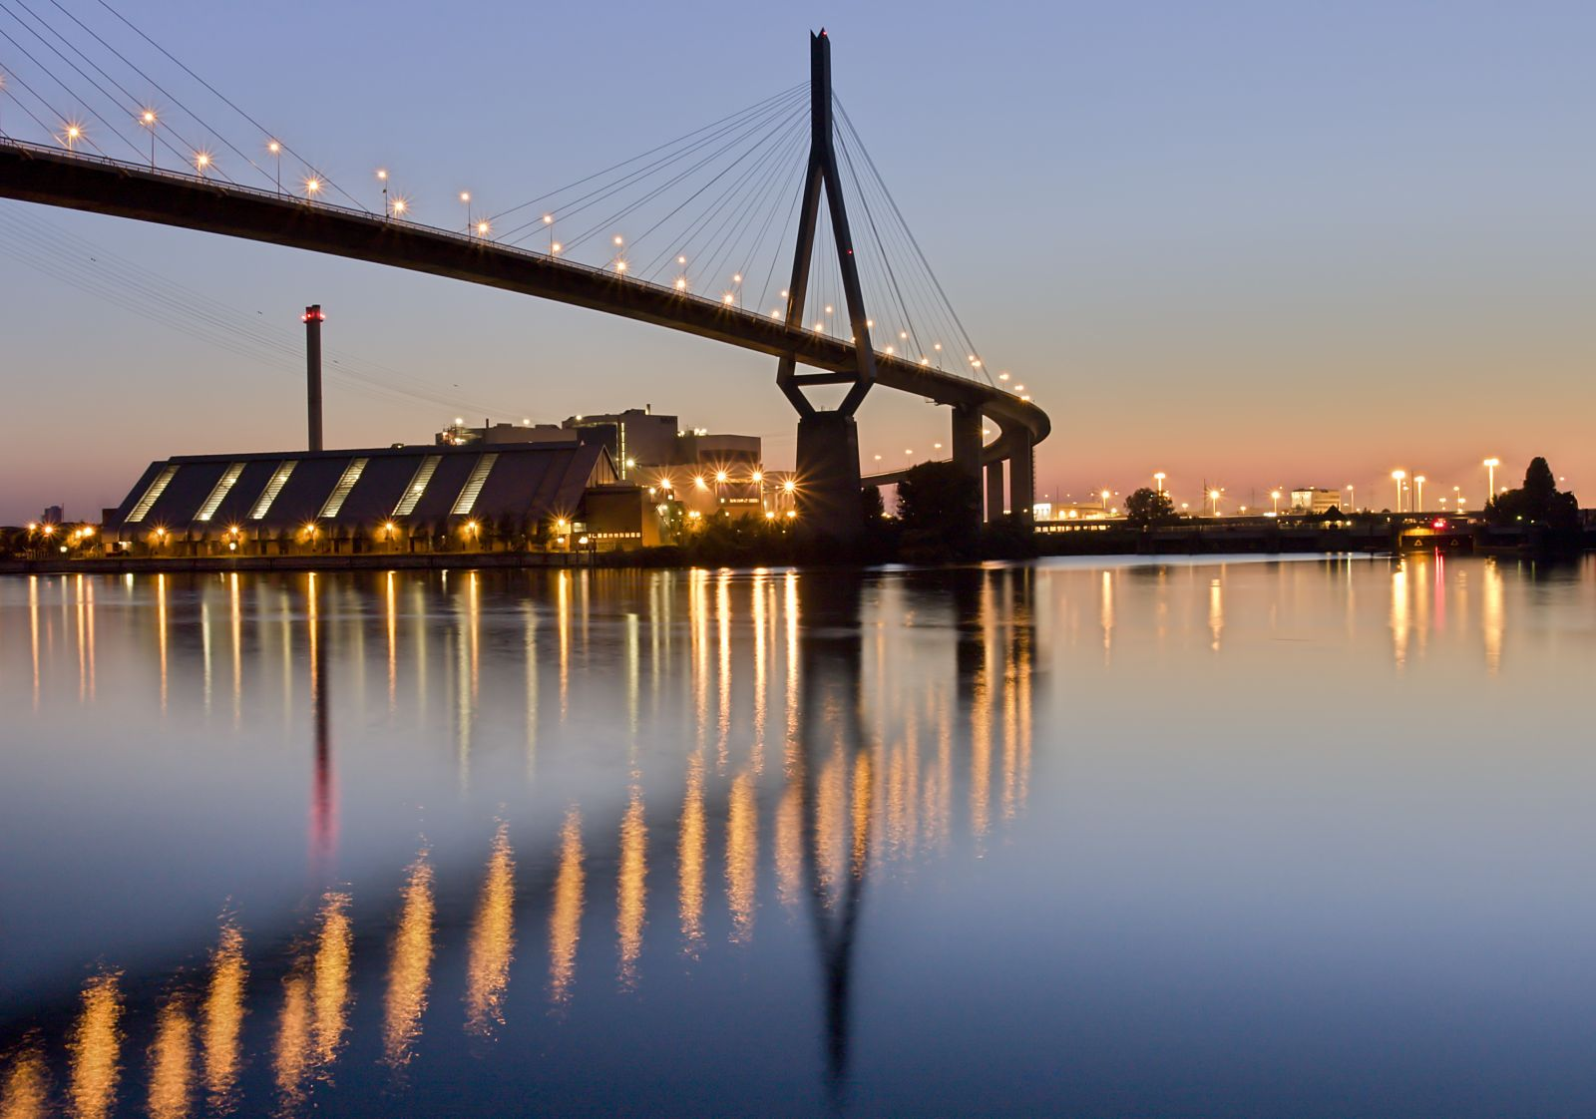
MVR Hamburg

Slide 6
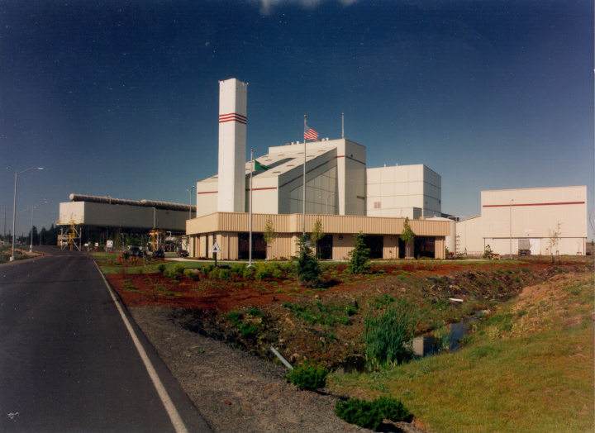
Spokane Waste to Energy Facility

