Slide 1
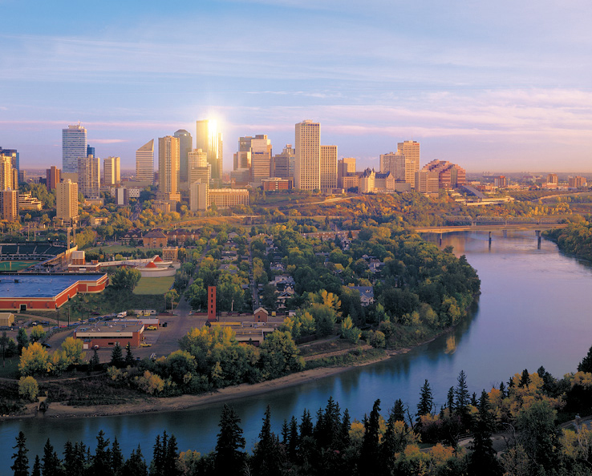
Edmonton, Alberta, Canada
Edmonton, Alberta, Canada
Mike Wo Jan, 2011
Executive Director
Economic Growth & Development
October, 2012 Greg Bainbridge
Manager, Industry Development
Economic Growth & Development

Slide 2
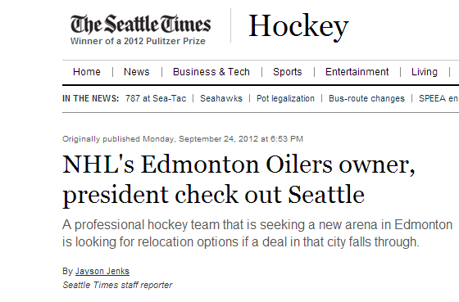

Slide 4

Edmonton, Alberta, Canada
Canada – Opportunities for Growth
2nd fastest economic growth of G7 (per OECD)
Best country for business (per Forbes)
#1 in G7 for surviving financial crisis (per IMD)
First G7 country to return to pre-crisis GDP levels
Mike Wo Jan, 2011
Executive Director
Economic Growth & Development

Slide 5
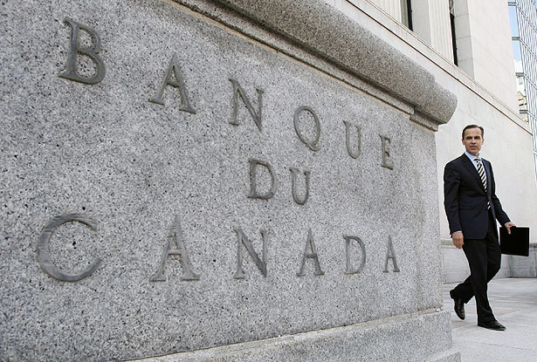
Edmonton, Alberta, Canada
Canada – Fiscal Stability
World’s soundest banking system (per World Economic Forum)
No Canadian bank or insurer required bailouts
7 of world’s 50
safest banks are
Canadian
(per Global Finance Magazine)
Mike Wo Jan, 2011
Executive Director
Economic Growth & Development

Slide 6

Edmonton, Alberta, Canada
Canada – Workforce
Highest proportion of post-secondary graduates in OECD
#4 in world for quality of management schools (per World Economic Forum)
> 200 languages
spoken (1 in 5 are
other than English
or French)
Mike Wo Jan, 2011
Executive Director
Economic Growth & Development

Slide 7
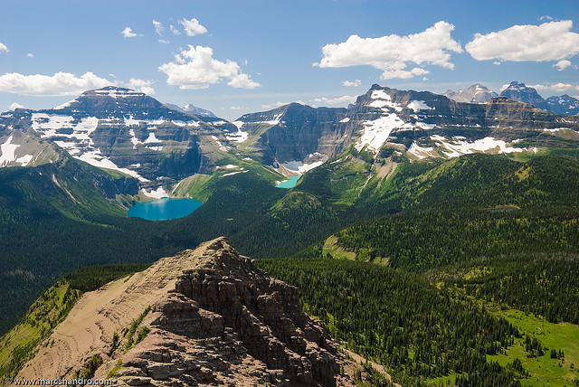
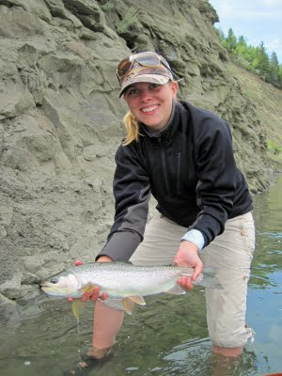
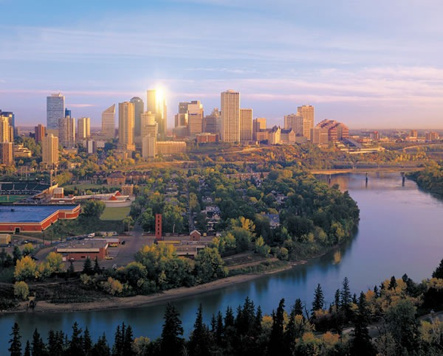
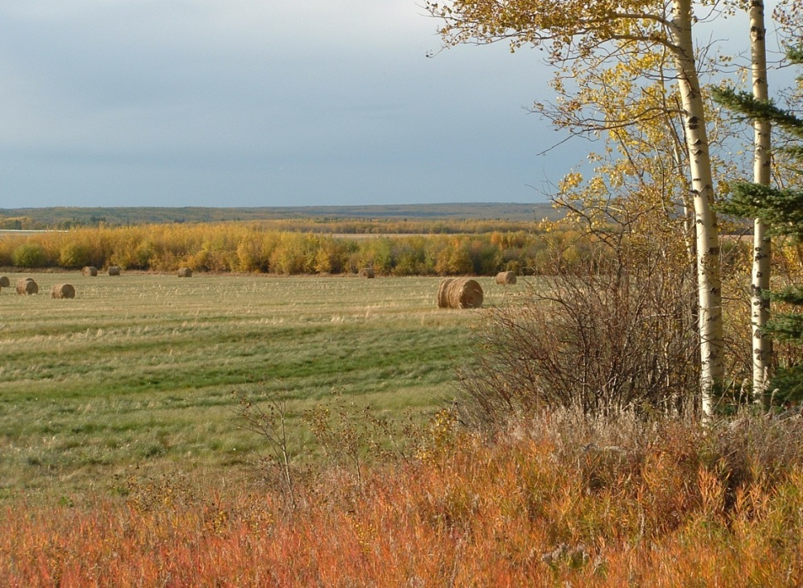
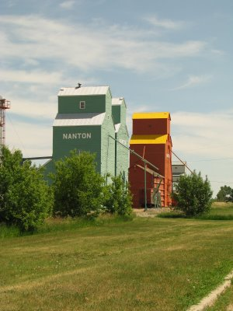
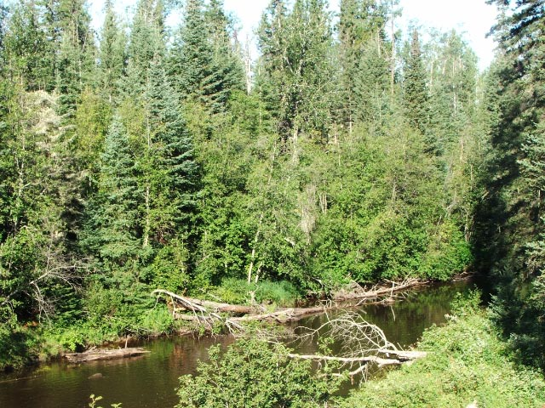
Edmonton, Alberta, Canada
Alberta
Mike Wo Jan, 2011
Executive Director
Economic Growth & Development

Slide 8

Edmonton, Alberta, Canada
Alberta
The lowest taxed province in the country
Mike Wo Jan, 2011
Executive Director
Economic Growth & Development

Slide 9
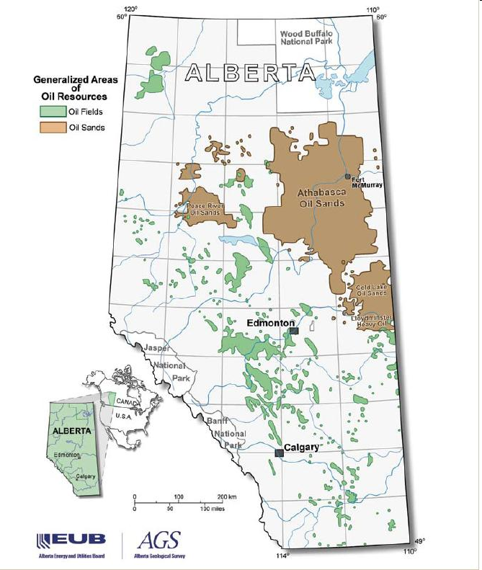
Edmonton
Quick Facts
Capital City for the Province of Alberta
Metro area population in excess of 1 million
Gateway to the North
Service centre for Alberta’s oil sands

Slide 10
Alberta - Energy
Source: Canadian Association of Petroleum Producers

Slide 11
Edmonton’s Economy
GDP: 4.6% Unemployment: 4.5% Inflation: 1.3%
Source: Conference Board of Canada

Slide 12
Capital Investment
Industry | Value in $ Millions | Percentage of Total
Agriculture & Related | $45.40 | 0.027%
Biofuels | $488.00 | 0.292%
Chemicals & Petrochemicals | $1,433.50 | 0.859%
Commercial/Retail | $655.30 | 0.392%
Commercial/Retail & Residential | $16.50 | 0.009%
Forestry & Related | $126.50 | 0.075%
Infrastructure | $10,067.80 | 6.034%
Institutional | $3,477.10 | 2.083%
Mining | $1,122.00 | 0.672%
Oil & Gas | $2,091.00 | 1.253%
Oil Sands | $129,673.00 | 77.718%
Other Industrial | $145.00 | 0.086%
Pipelines | $8,446.30 | 5.062%
Power | $6,059.00 | 3.631%
Residential | $1,042.50 | 0.624%
Telecommunications | $6.00 | 0.003%
Tourism/Recreation | $1,953.90 | 1.171%
Total | $166,848.80 | 100.00%

Slide 13
Labour
Source: Conference Board of Canada

Slide 14
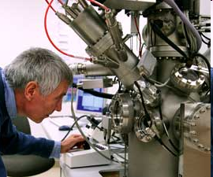
Research & Innovation
The first Centre of its kind in Canada, the Canadian Centre for Clean Coal, Carbon and Mineral Processing Technologies is a partnership of industry, government, and academia and is also a model of collaborative vision among leading researchers.
The University of Alberta has $500 million in sponsored research revenue committed which places it 2nd in Canada
Canada’s National Institute for Nanotechnology is a 20,000 square-meter building located on the University of Alberta campus.
The Carbon Capture and Emissions Management Corporation has funded close to $100 million dollars in 23 projects related to clean technologies and climate change.
Edmonton is home to over 17 research facilities predominately focused on enhanced recovery, carbon capture, and environmental issues.

Slide 15
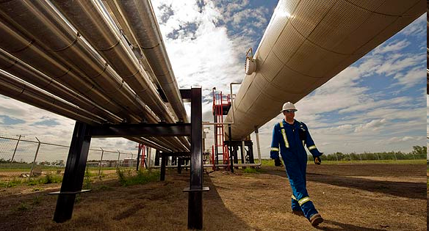
Research & Innovation
Carbon Capture and Sequestration
The Government of Alberta has invested $2 billion in 4 Carbon Capture and Sequestration projects in the Edmonton and Northern Alberta region.
Alberta Carbon Trunk Line – 240 Km pipeline transfering CO2 form various sources to oil fields for use in enhanced recovery wells.
Shell Quest – capture and storage of 1.2 million tonnes of CO2 annually
Swan Hills Synfuels – production of synethic gas from underground, un-mineable coal bed.
Project Pioneer – capture and storage of CO2 2,600 – 2,800 meters underground.

Slide 16
Environmental
Edmonton Waste Management Centre of Excellence
A one-stop resource for services in sustainable waste management. State-of-the-art research, demonstration, and education facilities are supported by the world-class expertise and waste management infrastructure of its members.
Clean Water Research
EPCOR has implemented a number of water cleaning technologies including UV disinfection and unidirectional flushing, and is undergoing membrane filter research at a facility capable of cleaning 40 million litres of water a day.
Enhanced Oil Recovery
The University of Alberta is the largest and oldest petroleum engineering program in Canada and focuses efforts on enhanced oil recovery techniques, including secondary recovery and thermal recovery.

Slide 17
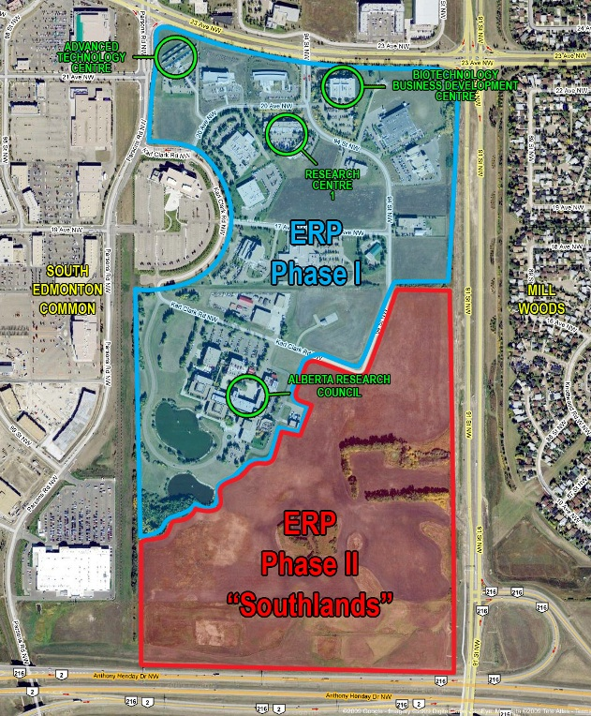
Edmonton Research Park
25 Startups
  3 year incubation program
  Shared services & amenities
  Sectors: ICT, Biotech, Oil & Gas, Nanotech
Research Centre One
  9 client companies
  Accelerator center – company development
  Lease terms 3-5 years
Biotechnology Business Development Centre
  6 client companies
  Accelerator – moving companies to market
  2nd stages Biotech companies – products but pre-revenue
  Lease terms 3-5 years

Slide 18
Edmonton, Alberta, Canada
For more information contact Greg Bainbridge:
gbainbridge@edmonton.com
Mike Wo Jan, 2011
Executive Director
Economic Growth & Development

