Slide 1
Cross Border Connections in Sustainable Waste Management
Washington Clean Technology Alliance
Oct. 4th, 2012

Slide 2
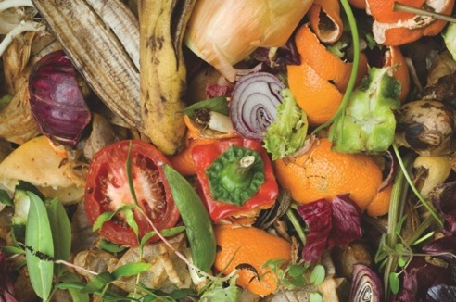
About Harvest
Harvest harnesses the maximum value from organic materials through the production of renewable energy and soils, mulches and natural fertilizers.
Corporate Profile
Operates 25 processing facilities in North America with more than 400 employees
Leads the industry managing more than 2 million tons of organic materials. Harvest is North America’s largest composter of organics.
By year-end 2012, will have the largest two commercial plants producing electricity from foodwaste in North America. (Vancouver, and Ontario). A third begins construction in August.
Sells more than 28 million bags and more than 1 million cubic yards of soils, mulches and natural fertilizers into retail, landscapers and ag markets.
Harvest’s investors include Kleiner Perkins Caulfield & Byers, True North Ventures, Generation IM, Munich Venture Partners, Waste Management, and others

Slide 3
Adding Value At Every Turn
Biogas & Energy
Organics Processing
Soils, Mulches and Natural Fertilizers
Harvest has three segments of its business: management of inbound organics, production of energy, and soil & fertilizer products

Slide 4
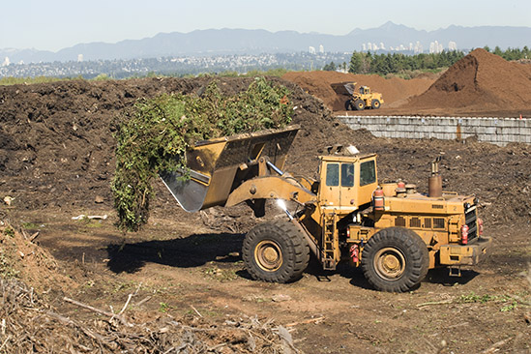
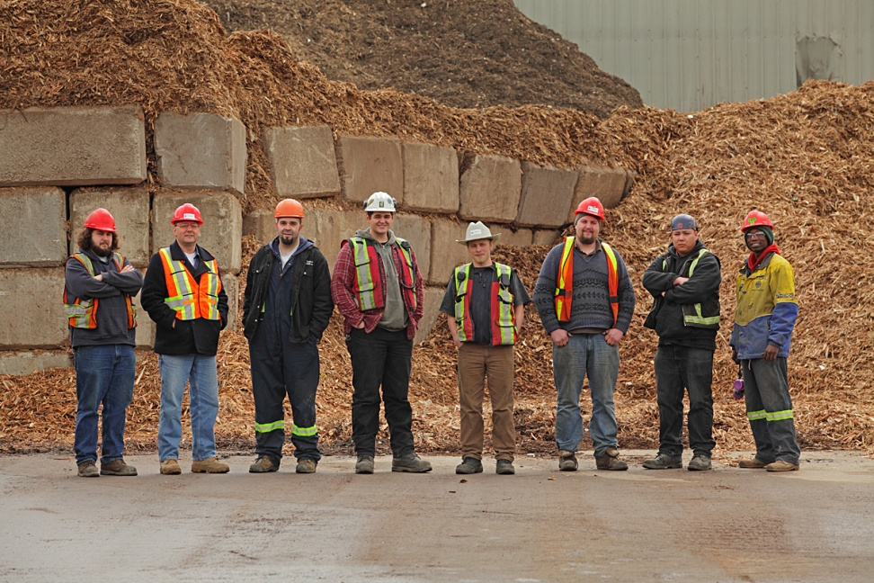
Harvest Power – British Columbia
Organic Waste Management
(Fraser Richmond Soil & Fibre)
C&D Waste Management
(Urban Wood Waste Recyclers)
Annually processes over 200,000 MT of food scraps, yard debris, wood
Sells over 300,000 CY of compost products annually
Service provider to Metro Vancouver and Lower Mainland munis
Processes over 200,000 MT of mixed C&D and wood waste each year
Recycles material on commodity markets and produces renewable fuel that is used to offset coal
Largest C&D recycler in Canada

Slide 5
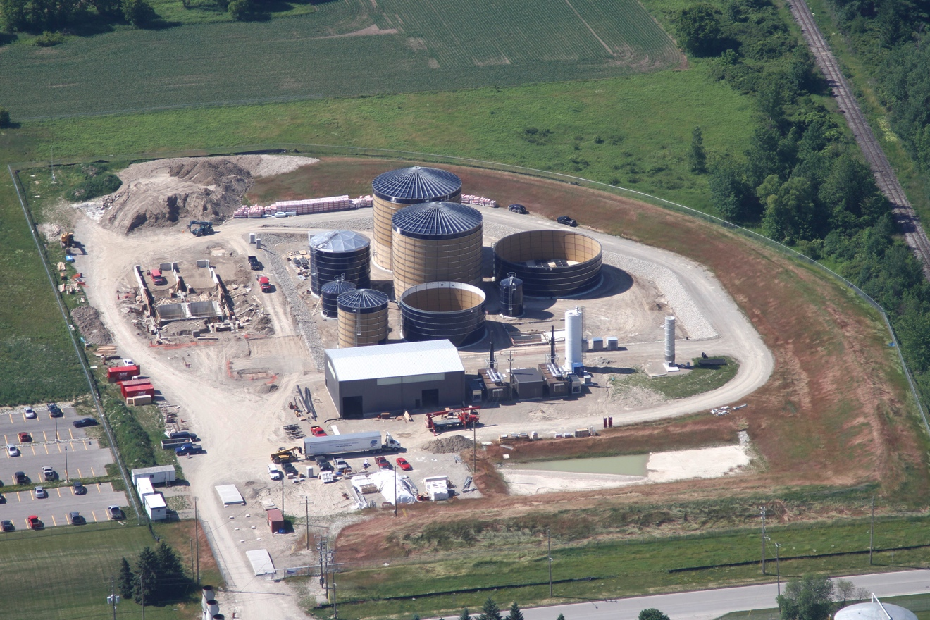
Harvest Energy Garden – London ON
Feedstock
65,000 MT of food and food processor waste
Partnerships and supply agreements primarily with haulers and grocery stores
Energy
2.8MW electricity (heat used onsite)
Selling to Ontario Power Authority
Fertilizer
Selling both granular and liquid fertilizer back to local farms and community
Permits
Fully permitted by ON MOE
The London facility is closely modelled on proven European biogas system

Slide 6
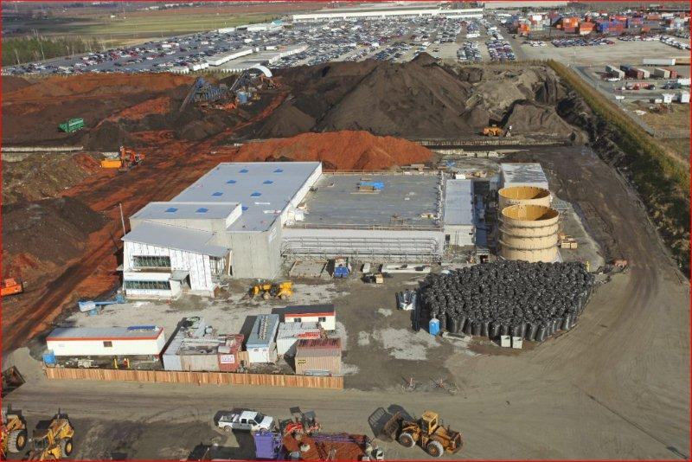
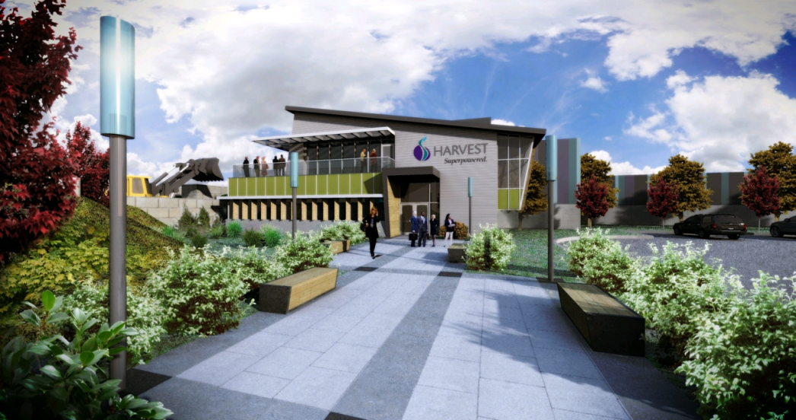
Case Study – Harvest Energy Garden, Richmond BC
Identifying a Need
Increasing waste diversion targets and bans
Green City Initiatives, GHG reduction targets
A Brand New System: High Solids Anaerobic Digestion
Feedstock
27,000 MT of food, curbside SSO, brush
Partnerships and supply agreements primarily with haulers and municipalities
Energy
1MW electricity

Slide 7
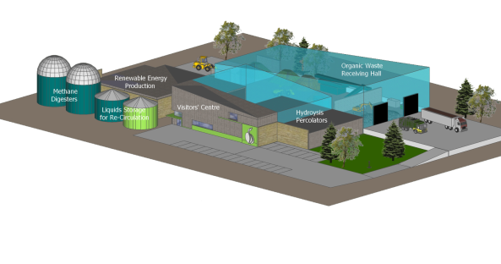
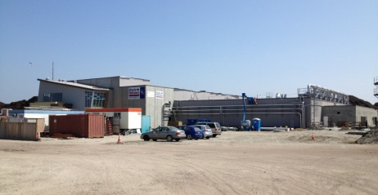
How Did We Get Here?
Permitting: Federal and regional permits required (atypical)
Design and construction: German technology and design, Canadian construction management, Canadian engineer
Finance: Canadian financial institutions, grants
NRCAN’s Clean Energy Fund – investing $795m in clean energy technology and demonstration over five years
BC BioEnergy Network – provincially-funded not for profit supporting acceleration of bioenergy development in BC
Energy Offtake: Electricity through BC Hydro’s Community Based Biomass Power program
Had option of selling renewable natural gas as well to private gas utility

Slide 8
What’s worked well and what, well…hasn’t?
Favorable regulatory climate for goods and services provided
Infrastructure in place to expand (a blessing and a curse)
Green $$$ vs. Green-washing
Eagerness to showcase new technology (host community and permitting agencies)
Actual permitting process a challenge, not streamlined
There is still an international border!
Previous efforts by others went bad
“Diversion” vs. “Disposal”

Slide 9
In Summary: The Triple Bottom Line…
Profit
Planet
People
Receptive to clean tech, innovation; in transition from status quo to next-generation
Policies and long-term goals value sustainable solutions; but regulations don’t always match up
Monetary incentives and willing financial partners looking for practical cost-effective solutions

Slide 10
Thank you!
Elizabeth Lowell
Project Development & Planning Manager
elowell@harvestpower.com
206.569.0348 (direct)
206.963.1286 (mobile)
www.harvestpower.com/bc - Lower Mainland, BC
www.harvestpower.com/on - London, ON
www.harvestpower.com

