Slide 1

Innovative Water Processing Solutions By Water Quality Management Professionals

Slide 2


OUTLINE
Overview of WaterTectonics
Canada Business Strategy
Three Project Case Studies
  Capital Equipment Sale
  Capital Equipment Lease
  Forming a Strategic Partnership
Valuable Resources
Notes:
-going to focus on electrocoagulation for today’s talk, see our website for all our other product/services

Slide 3
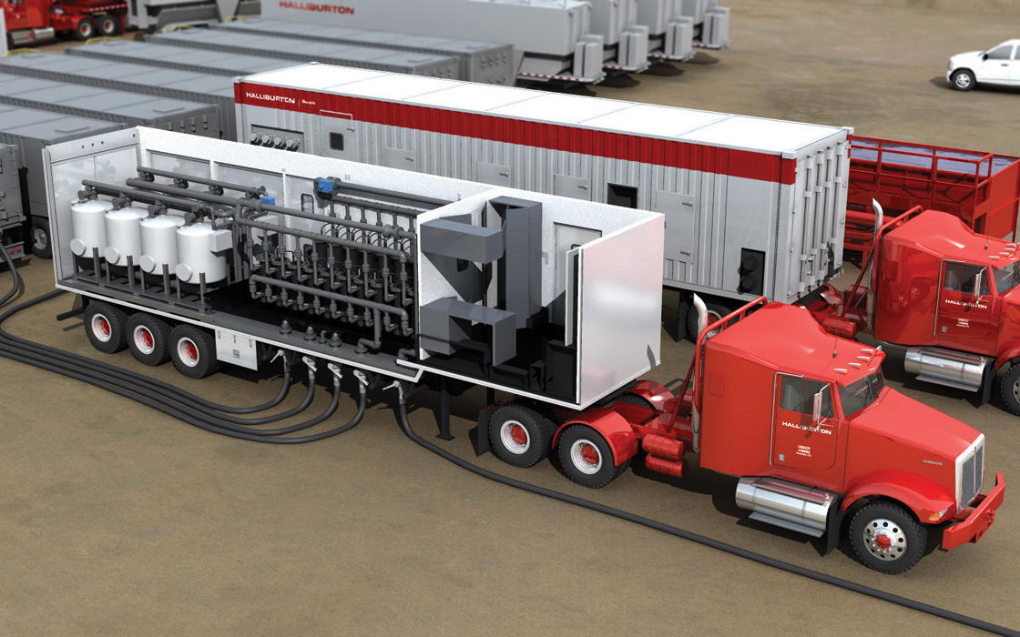
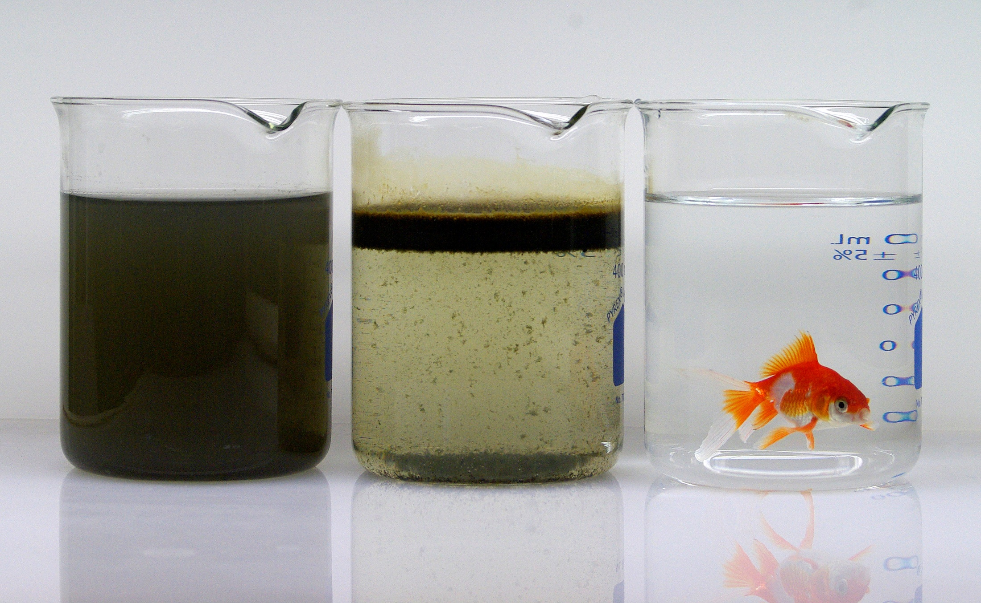
WATERTECTONICS
Established in 1999
Located in Everett, Washington
55+ Employees
Design, manufacture, deploy, and service water treatment systems internationally
Our focus is the development and commercialization of electrochemical water treatment methods
Executed a licensing agreement with Halliburton in 2010 for use of our technology in the natural gas space (CleanWave)
Notes:
-going to focus on electrocoagulation for today’s talk, see our website for all our other product/services

Slide 4
WATERTECTONICS
Notes:
-going to focus on electrocoagulation for today’s talk, see our website for all our other product/services

Slide 5
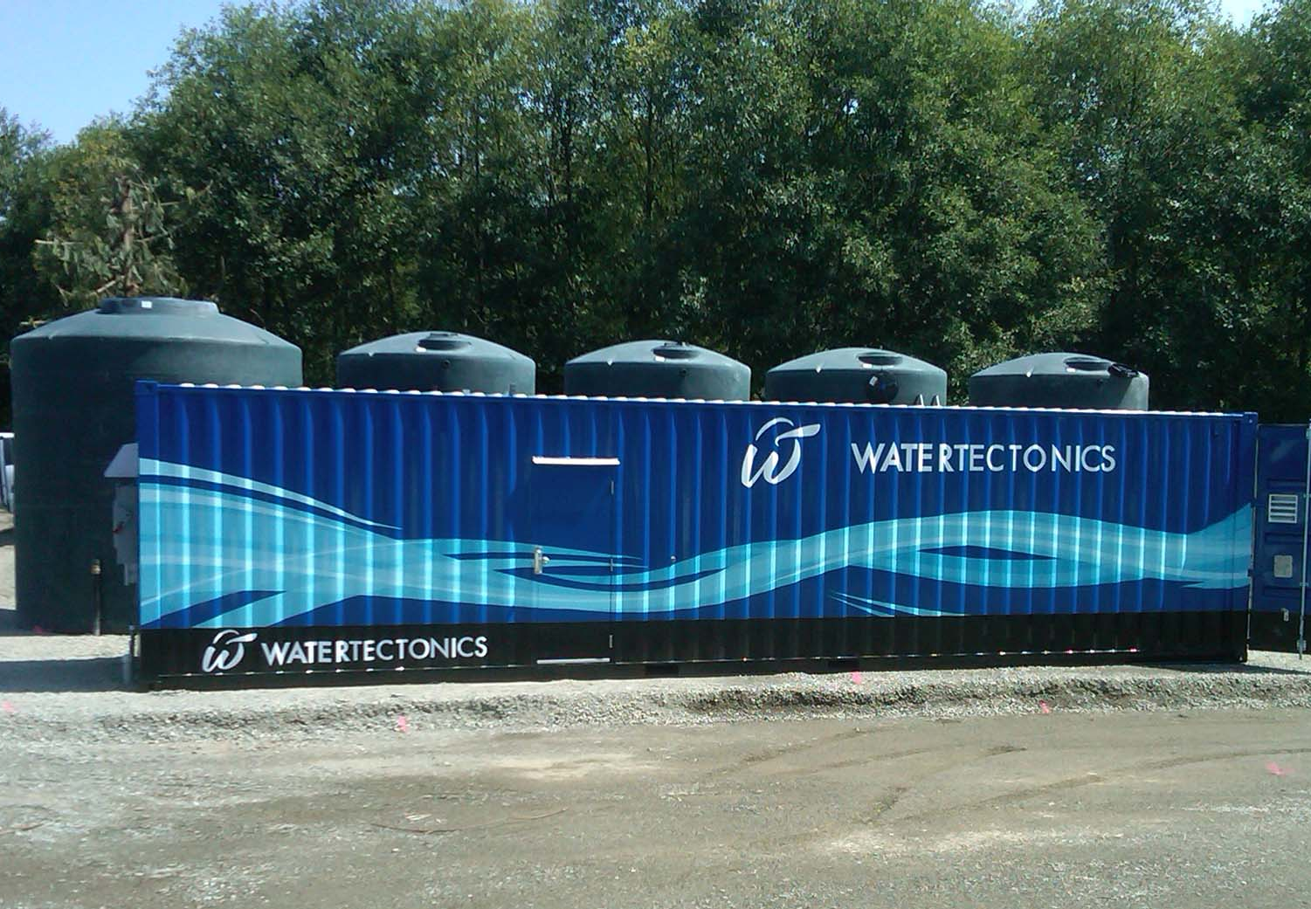
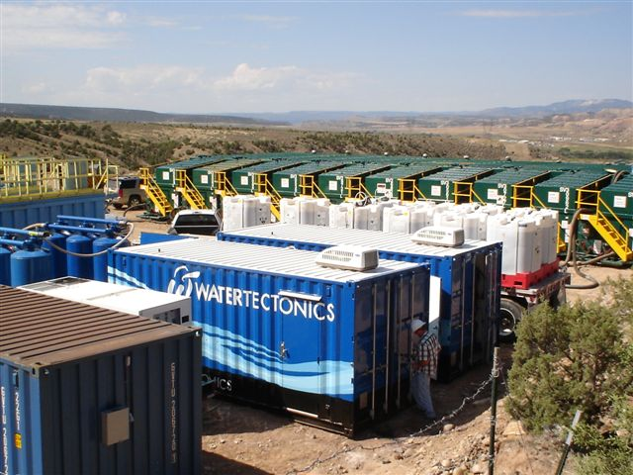
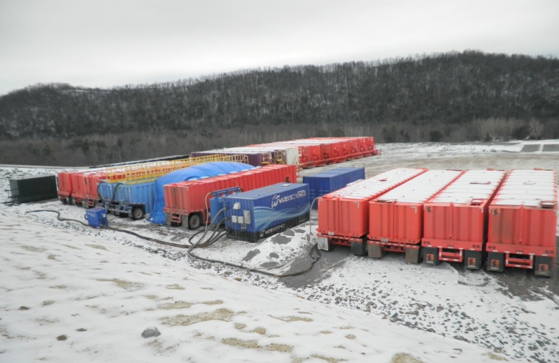
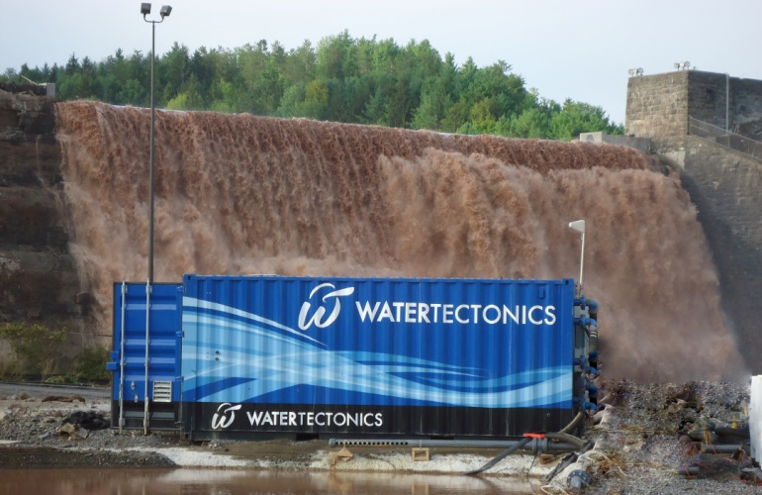
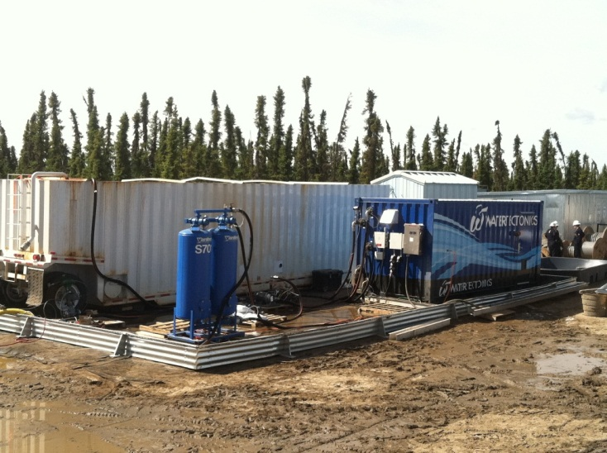
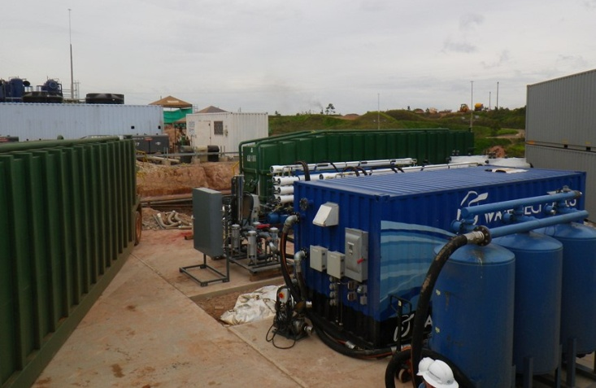
WATERTECTONICS
Colorado
Pennsylvania
Washington
Canada
Colombia
New York
Notes:
-going to focus on electrocoagulation for today’s talk, see our website for all our other product/services

Slide 6
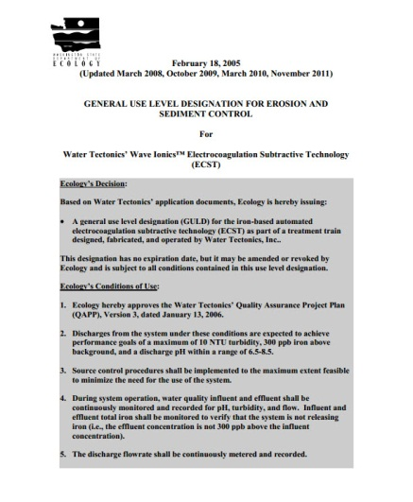

WHY DO WE TREAT WATER?
AND
Recycling (Cost Savings)
Regulations (Compliance)
Notes:
-going to focus on electrocoagulation for today’s talk, see our website for all our other product/services

Slide 7
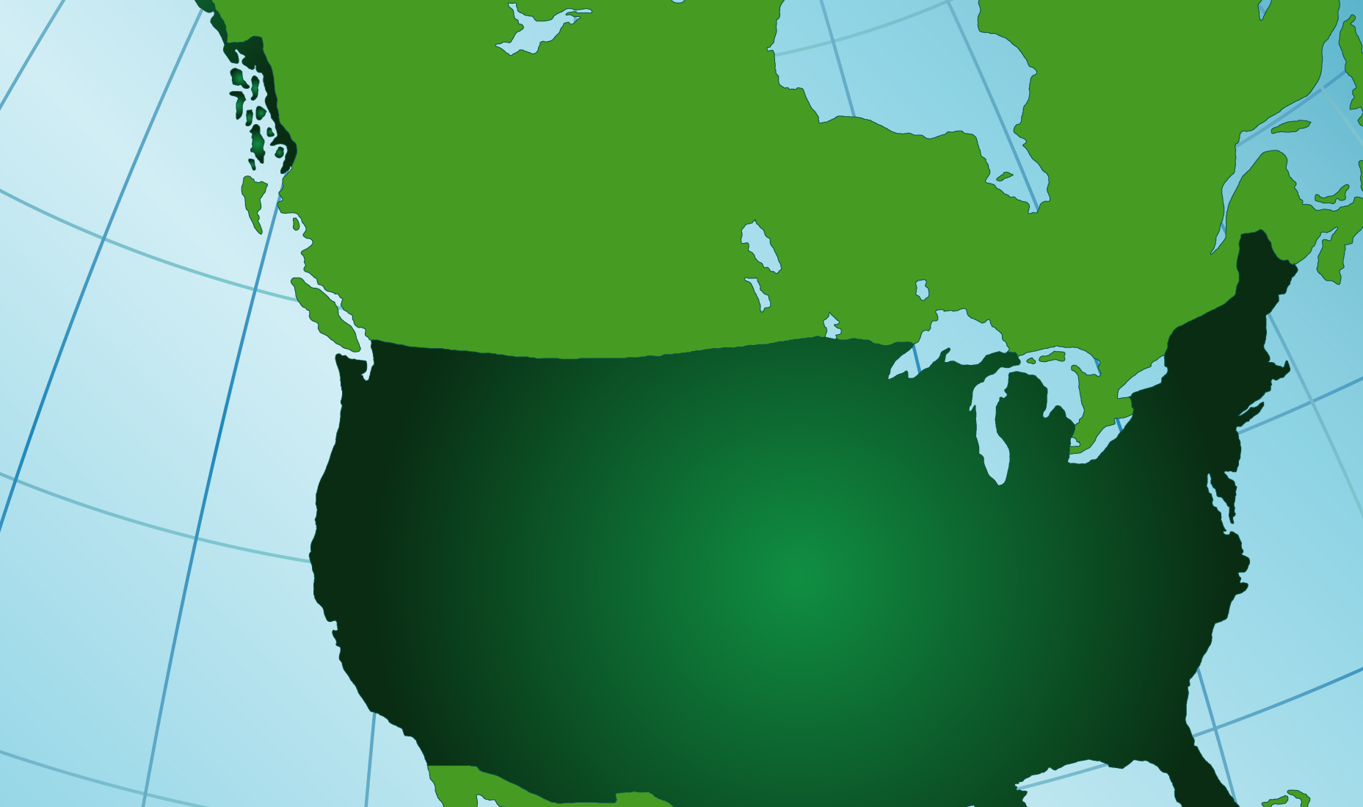




CANADA BUSINESS STRATEGY
Notes:
-going to focus on electrocoagulation for today’s talk, see our website for all our other product/services

Slide 8
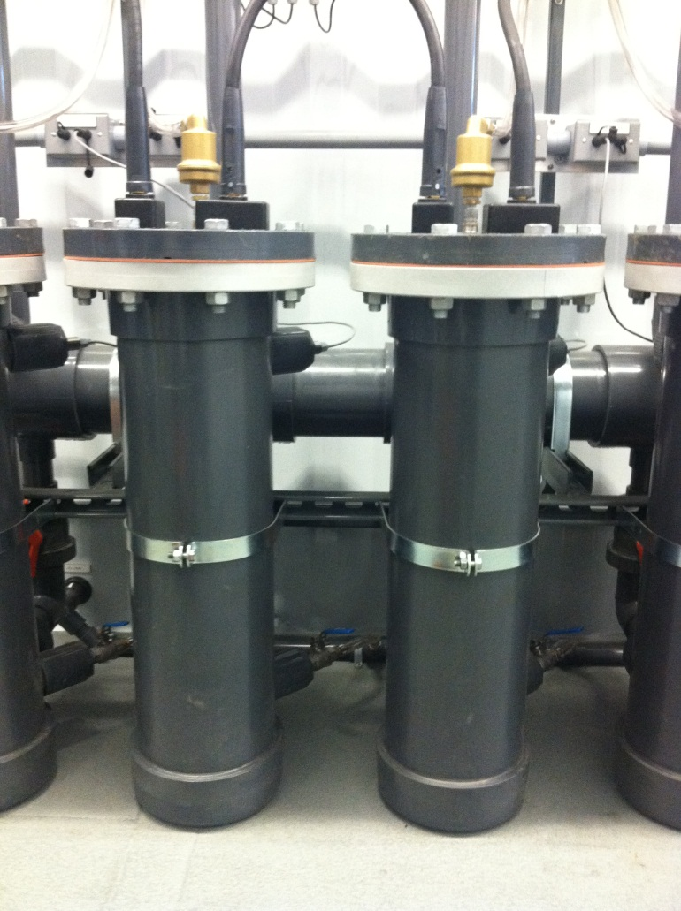
CASE STUDY: CAPITAL SALE
Client: Pure Metal Galvanizing
Industry: Zinc Galvanizing Operation
Location: Brantford, Ontario
Engagement: US technical industry conference
Transaction: Capital equipment purchase
Timeline: 3 years from engagement to completion
Oversight: Ontario Ministry of Environment, Canadian Standards Association
Notes:
-going to focus on electrocoagulation for today’s talk, see our website for all our other product/services

Slide 9
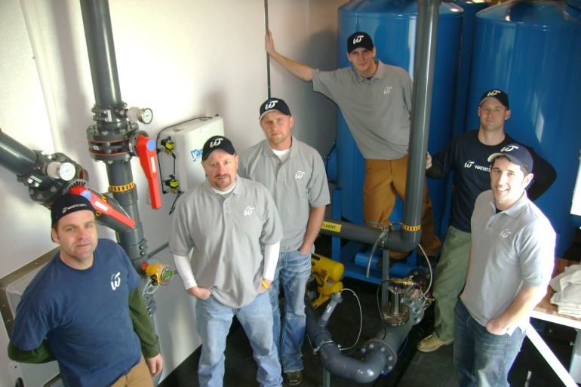
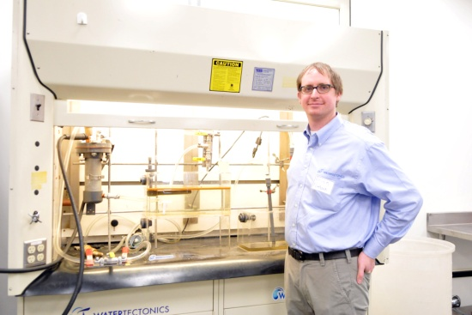
CASE STUDY: CAPITAL SALE
Pre-project:
  In-bound Shipping Documentation
  Power Requirements
  Work Permits
During installation:
  Analytical Testing Equipment
  CSA Inspection
Post-project:
  Product Consumables
  Work Tools

Slide 10
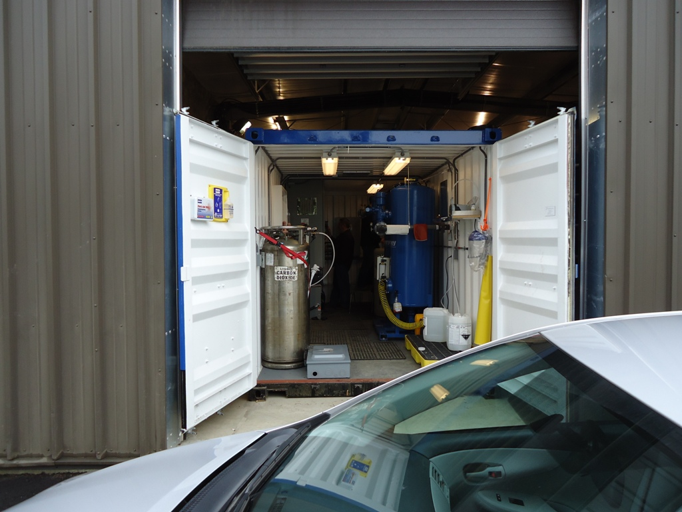
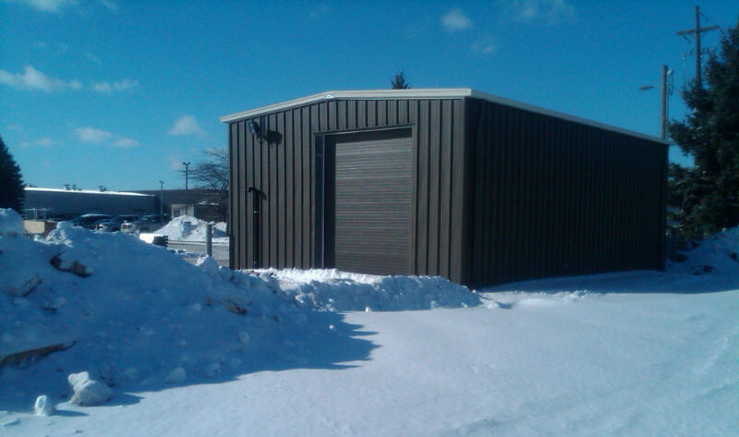
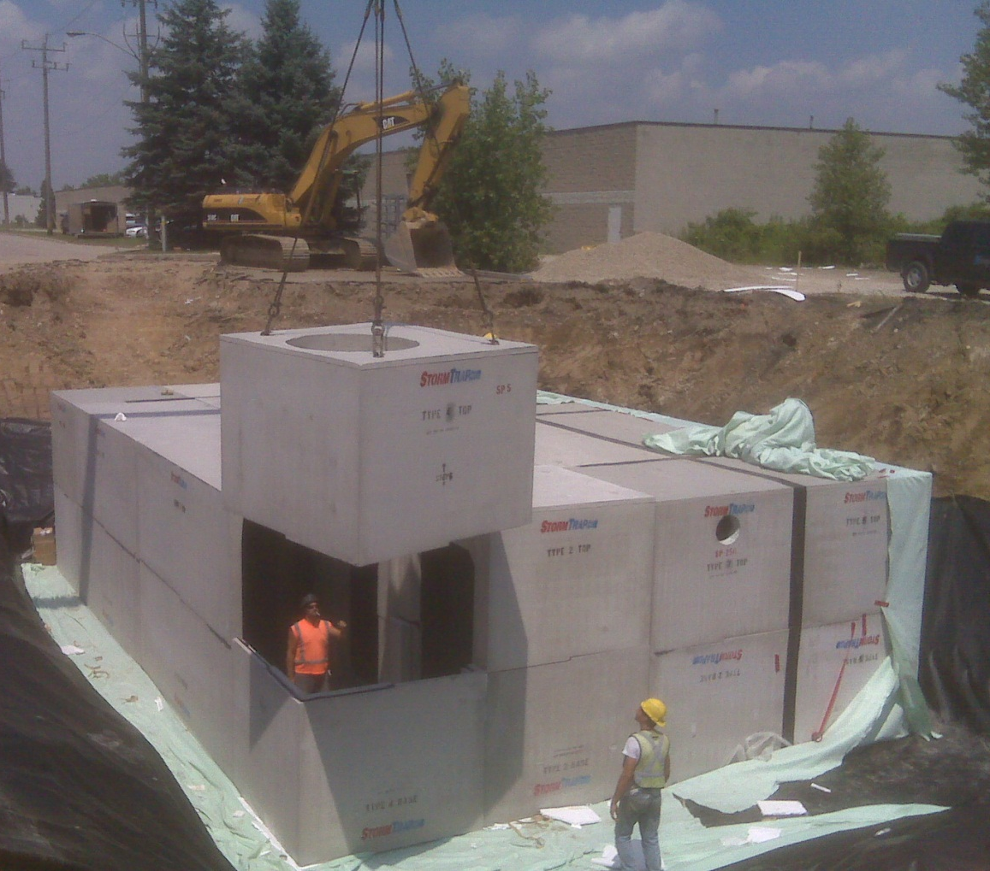
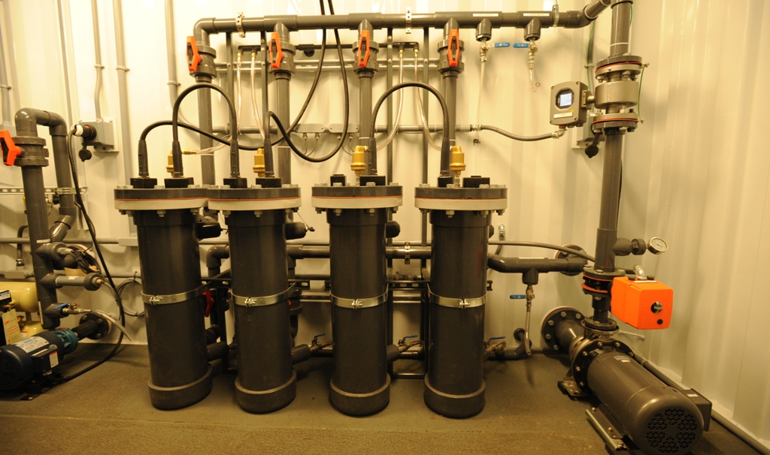
CASE STUDY: CAPITAL SALE
Notes:
-going to focus on electrocoagulation for today’s talk, see our website for all our other product/services

Slide 11
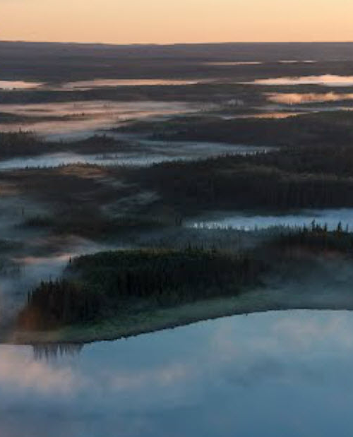
CASE STUDY: CAPITAL LEASE
Client: Confidential
Industry: Oil Extraction
Location: Northern Alberta (North of Wabasca)
Engagement: Canada technical conference, introduced by Canadian strategic partner
Transaction: Capital equipment lease for pilot project
Timeline: 3 Months
Oversight: Alberta Boilers Safety Association, Canadian Standards Association
Confidential & Proprietary
Notes:
-going to focus on electrocoagulation for today’s talk, see our website for all our other product/services

Slide 12
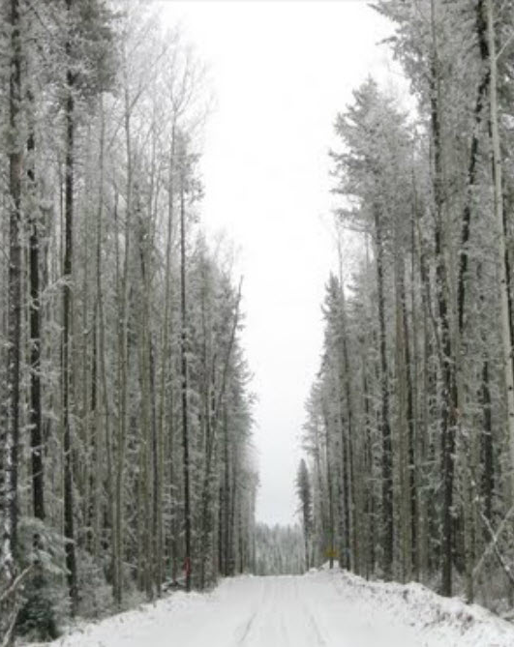
CASE STUDY: CAPITAL LEASE
Pre-Project Issues:
  CSA Inspection
  Prime Contractor Responsibility
  Shipping Tariff
During Project Issues:
  Deliveries
  Weather
  Communication/Reception
  Analytical Testing Methodology

Slide 13
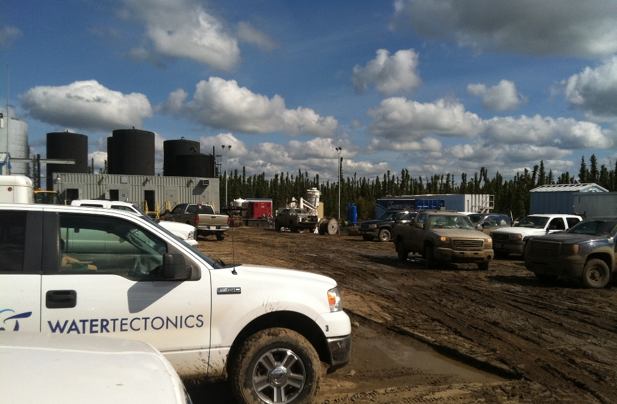
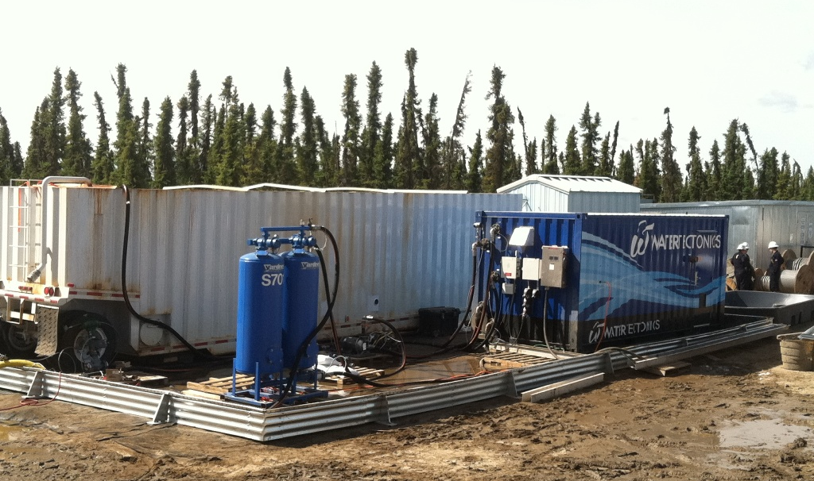
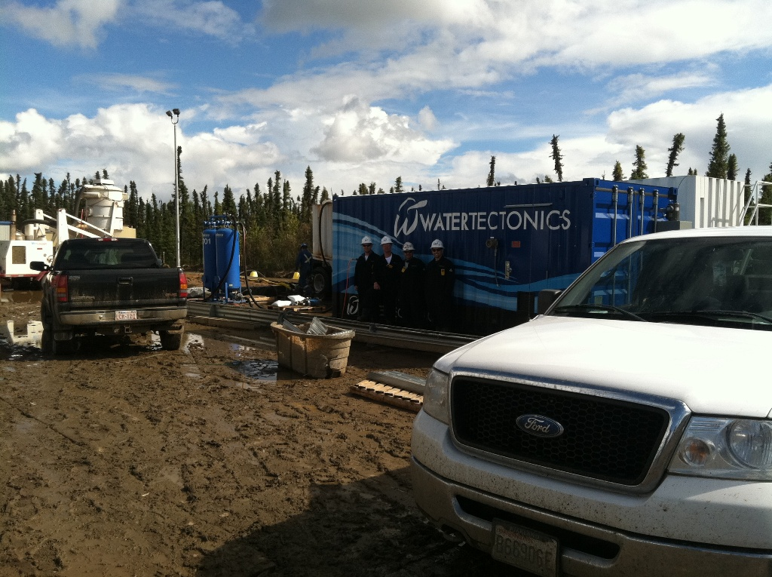
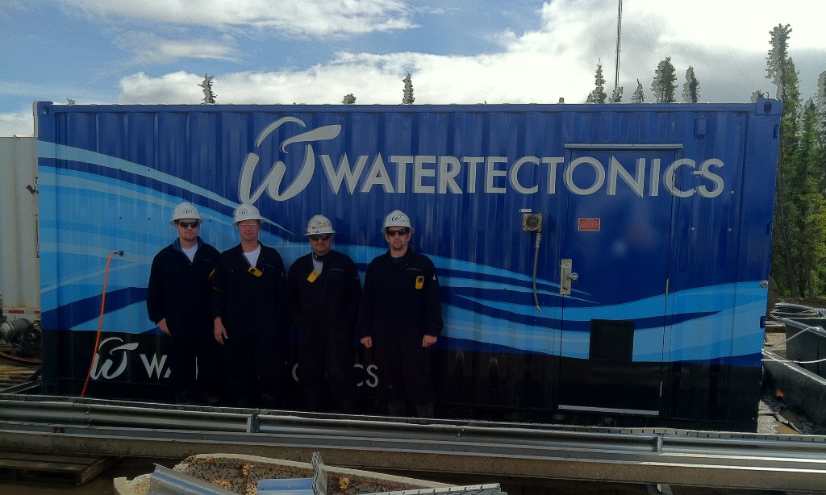
CASE STUDY: CAPITAL LEASE
Notes:
-going to focus on electrocoagulation for today’s talk, see our website for all our other product/services

Slide 14


CASE STUDY: PARTNERING
Partner: Ledcor Group
Employees: 5,000+
Headquarters: Vancouver, British Columbia
Divisions: Construction, Special Projects, Highways, Industrial, Pipeline, Properties
Engagement: US industry water conference
Benefits to Ledcor: Access to proprietary technology, technical advisory, marketing support
Benefits to WT: Access to Ledcor clients in WT target industries, Ledcor is highly respected and can secure meetings with the right contacts
Notes:
-going to focus on electrocoagulation for today’s talk, see our website for all our other product/services

Slide 15
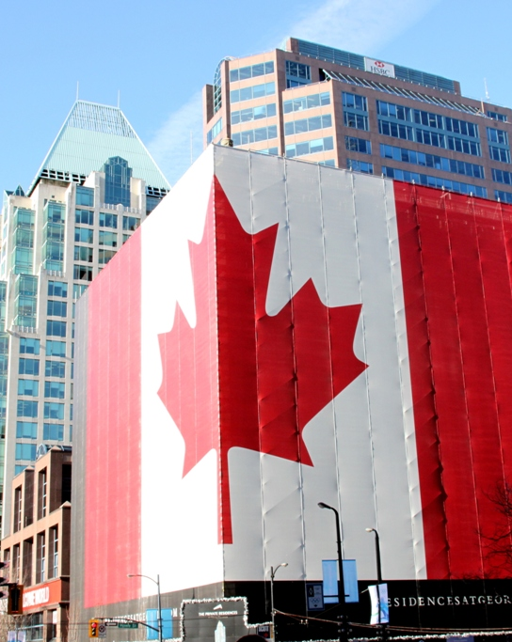
VALUABLE RESOURCES
Washington State Department of Commerce
Consulate General of Canada (special thanks to Vancouver, BC office)
Moss Adams Accounting Advisory
UPS Freight Services
Notes:
-going to focus on electrocoagulation for today’s talk, see our website for all our other product/services

