Slide 1
Becoming Carbon Neutral
How Microsoft is striving to become lean, green, and accountable
TJ DiCaprio

Slide 2
















Demonstrating Responsible Environmental Leadership:
FY13 Environmental Footprint Strategic Pillars
Be
lean
by reducing energy
use and air travel through technology-driven efficiency
Setting targets for reducing energy consumption in our data centers, labs, and offices
Setting targets for reducing air travel using Microsoft collaboration technology
Controlling energy use in our offices with an enterprise-wide energy management program
  Establishing reduction goals for waste and water
Be
green
by making more environmentally responsible choices with our energy, waste, and water
Signing long-term renewable power purchase agreements
Investing capital in new renewable energy
projects
Connecting data centers directly to innovative renewable energy sources
  Purchasing market RECs and carbon offsets
Be
accountable
by quantifying our carbon impact and holding groups responsible
Setting a carbon price to internalize the external impact of our operations
Charging the teams responsible for emissions from data centers, offices, labs, and air travel
  Improving transparency using emission-tracking software and CDP reporting
Optimizing the supply chain
Engaging employees through environmental sustainability programs
Notes:
Here are the new pillars of our corporate commitment around carbon reduction …..

Slide 3




Set in consultation with the Office of the CFO based on the average
price of renewable energy and carbon offset projects globally
Corporate R&D
Product groups
Data center operations
Corporate operations
Sales, marketing, and services
Central fund
Purchase of renewable energy
and carbon offsets

Slide 4
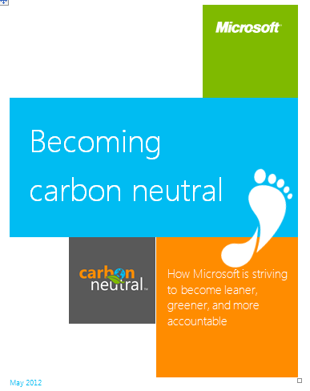
Resources
TJDICAP@microsoft.com

