Slide 1

ENERGY FOR THE WARFIGHTER:
The DoD Operational Energy Strategy
UNCLASSIFIED
Honorable Sharon E. Burke
Assistant Secretary of Defense
Operational Energy

Slide 2
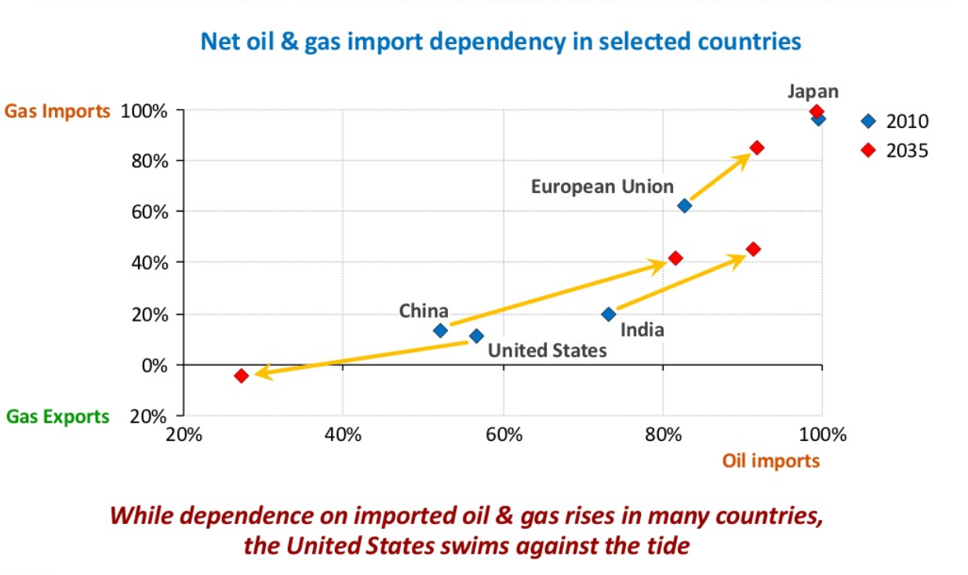
The Context: Global Energy Supply and Demand
¹
¹ IEA World Energy Outlook 2012
Dynamic energy markets have geopolitical, fiscal, and strategic implications

Slide 3


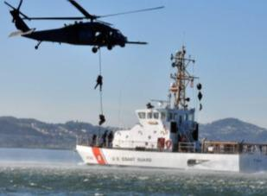




The Context: Strategic Environment
Current Conflicts
Homeland Defense
WMD Proliferation
Cyber Threats
Humanitarian Assistance
Rising Powers

Slide 4
Energy Use and Costs at DoD
DoD Energy
Use, FY11¹
DoD Operational Energy Use and Cost, FY00-11¹
Operational Energy Use by Service, FY12²
Facilities
Operational
Energy
2000 $2.7B
2008 $15.7B
2010 $11.2B
2011 $15.3B
Army 15.5%
Navy / MC 30.4%
Air Force 53.7%
Other DoD 0.4%
Operational Energy 74%
Facilities Energy 26%
¹ FY2011 DoD Annual Energy Management Report, figures by site delivered BTUs
³ DLA-Energy, Total DoD Consumption (Gallons)
Operational Energy – “The energy required for training, moving, and
sustaining military forces and weapons platforms for military operations”

Slide 5

Energy for a Globally Active Force
Defense Fuel Supply Sales By Country
(FY2012)
United Kingdom
82.2M Gallons
$277.8M
Germany
112.2M Gallons
$393.8M
Spain
59.9M Gallons
$209.5M
Italy
24.4M Gallons
$85.0M
Kyrgyzstan
119.5M Gallons
$412.9M
Japan
131.9M Gallons
$458.3M
Afghanistan
529.1M Gallons
$2.93B
Vessels Afloat
495.8M Gallons
$1.707B
Iraq
44.6M Gallons
$180.1M
Qatar
278.2M Gallons
$960.6M
UAE
399.9M Gallons
$1.397B
Guam
69.4M Gallons
$238.5M
4,367,667,058 Gallons of Fuel in FY12

Slide 6
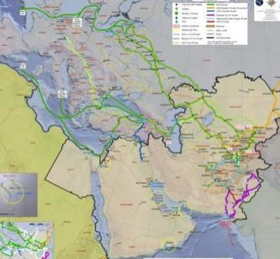
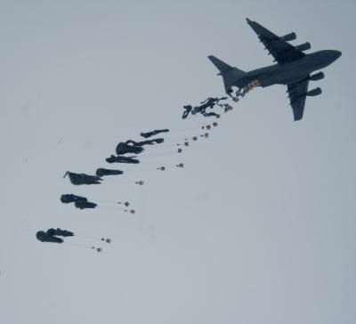
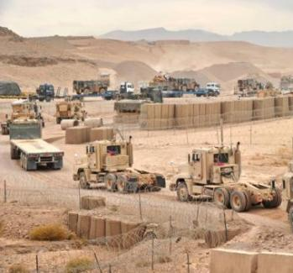
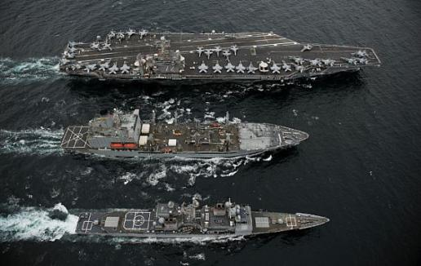
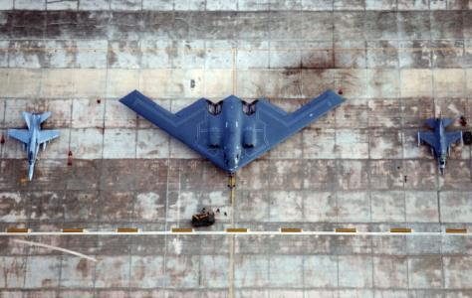
Defense Energy Challenges
Distribution Networks
Distributed Operations
Logistics Convoys
Replenishment at Sea
Power Projection
Logistics and sustainment likely to face challenges of
distance, geography, and direct attack

Slide 7
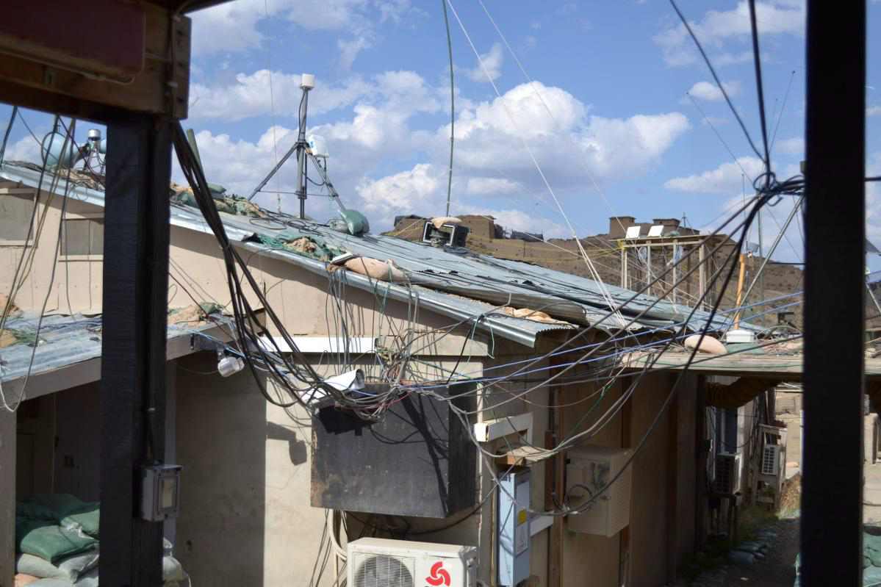

Slide 8
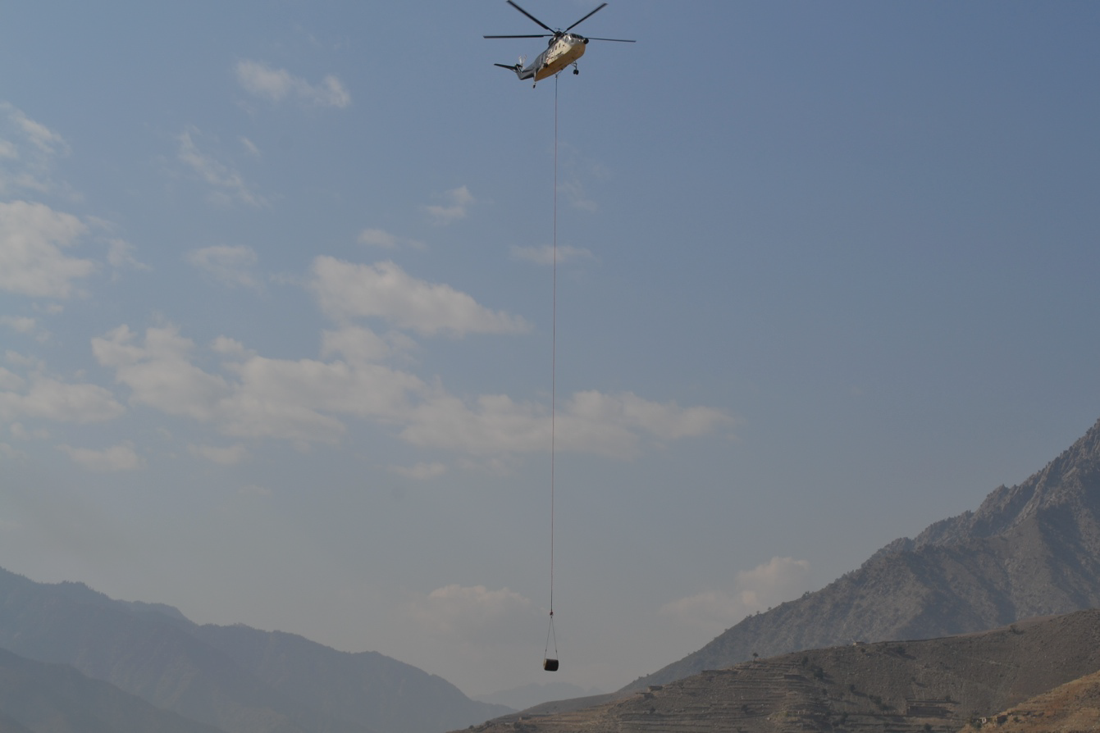

Slide 9
The DoD Operational Energy Strategy
GOAL: to assure that U.S. armed forces will have the energy they require for 21st century military missions
Capability
Risk
Cost
More Fight, Less Fuel
Reduce Demand for Energy in Military Operations
More Options, Less Risk
Expand and Secure the Supply of Energy to Military Operations
More Capability, Less Cost
Build Energy Security into the Future Force

Slide 10
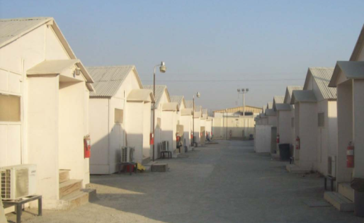
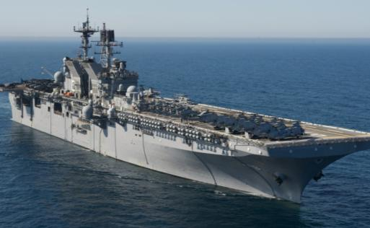
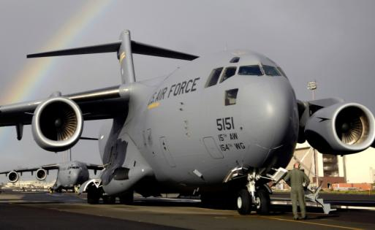
Defense Energy Opportunities - Demand
Centralized power generation
Energy-efficient shelters, lighting, and heating/air conditioning
Fielding of advanced power distribution
Hybrid electric drives in LHDs, LHAs, and DDGs
Better hull and propeller coatings and stern flaps
Improved routing and
flight profiles
Optimized cargo loading and center of gravity
Engine wash / less drag

Slide 11
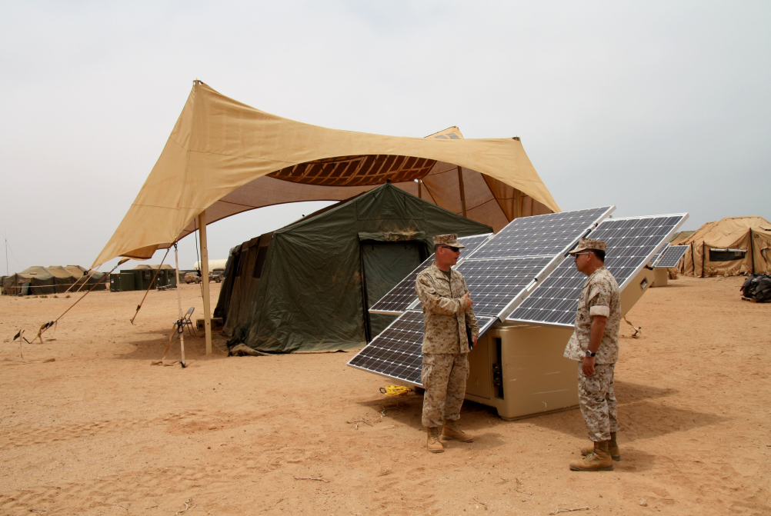
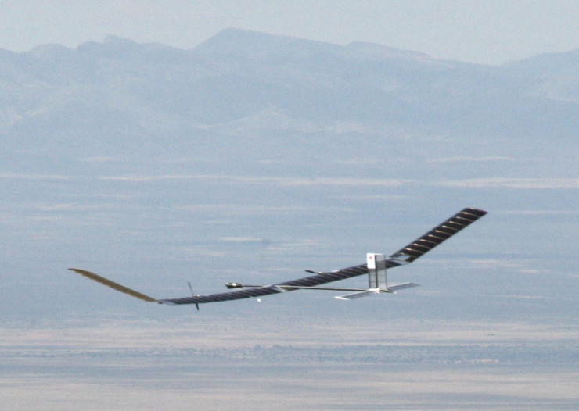
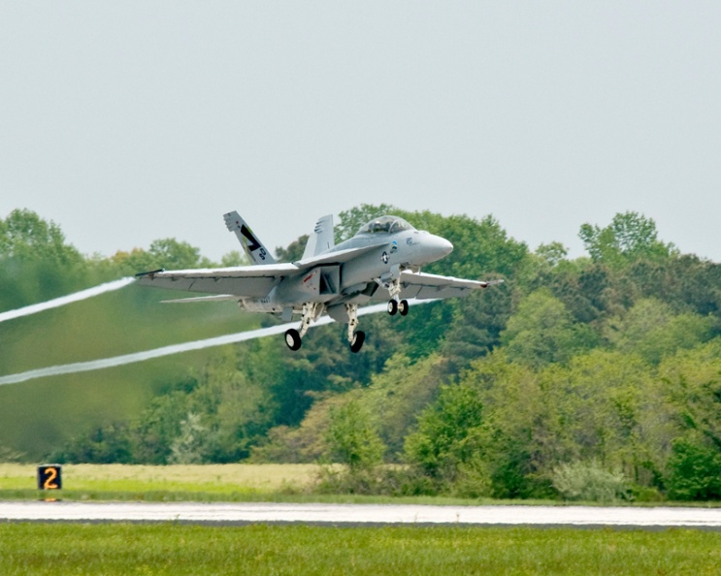
Defense Energy Opportunities - Supply
Hybrid solar power generation
Solar battery chargers
Wearable solar technologies for mobile power generation
Lightweight, efficient, universal batteries
Unmanned Vehicles
Advanced Fuels
Fuel Cells

Slide 12
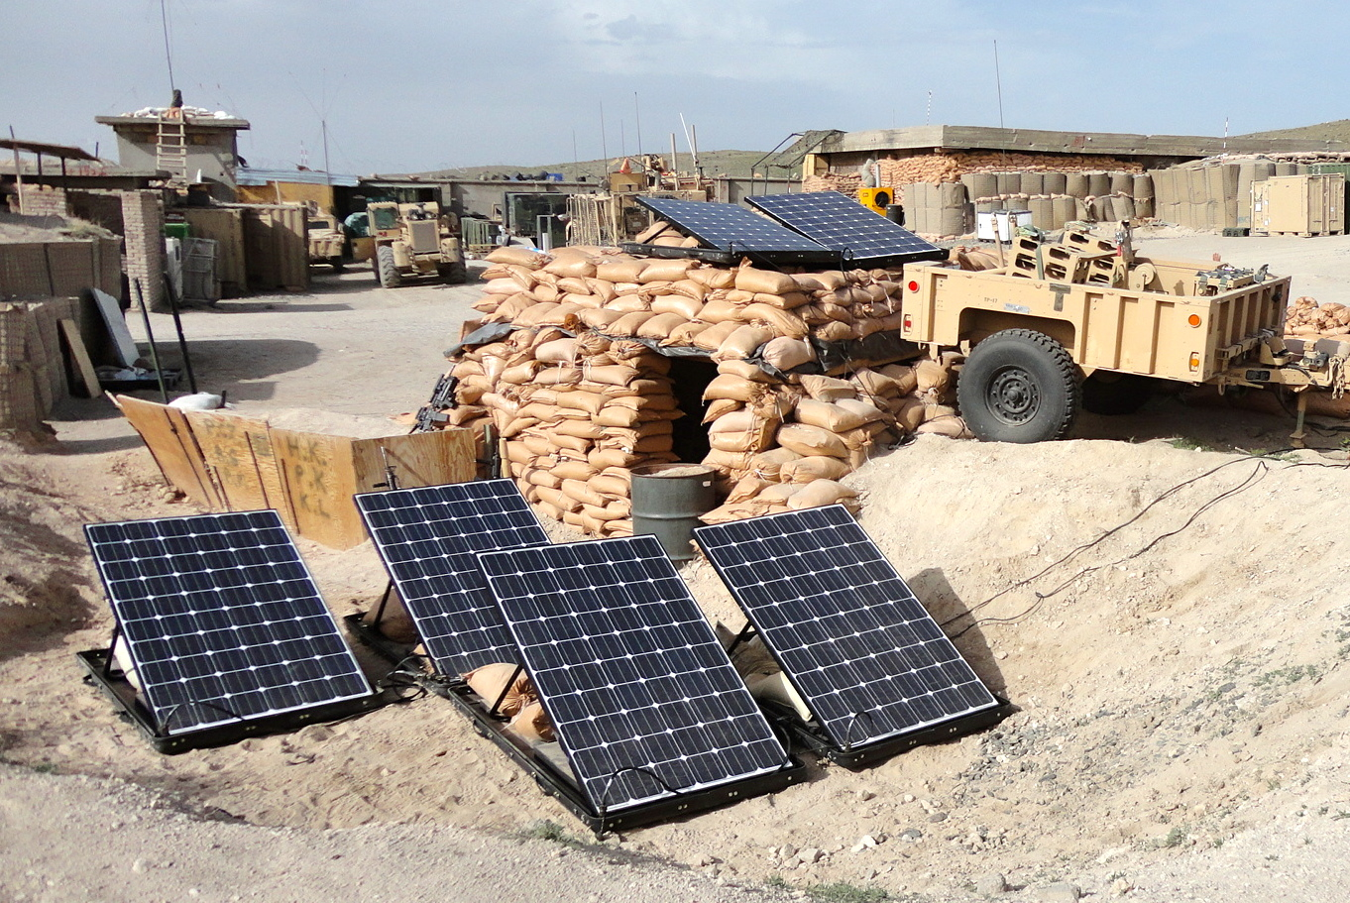

Slide 13
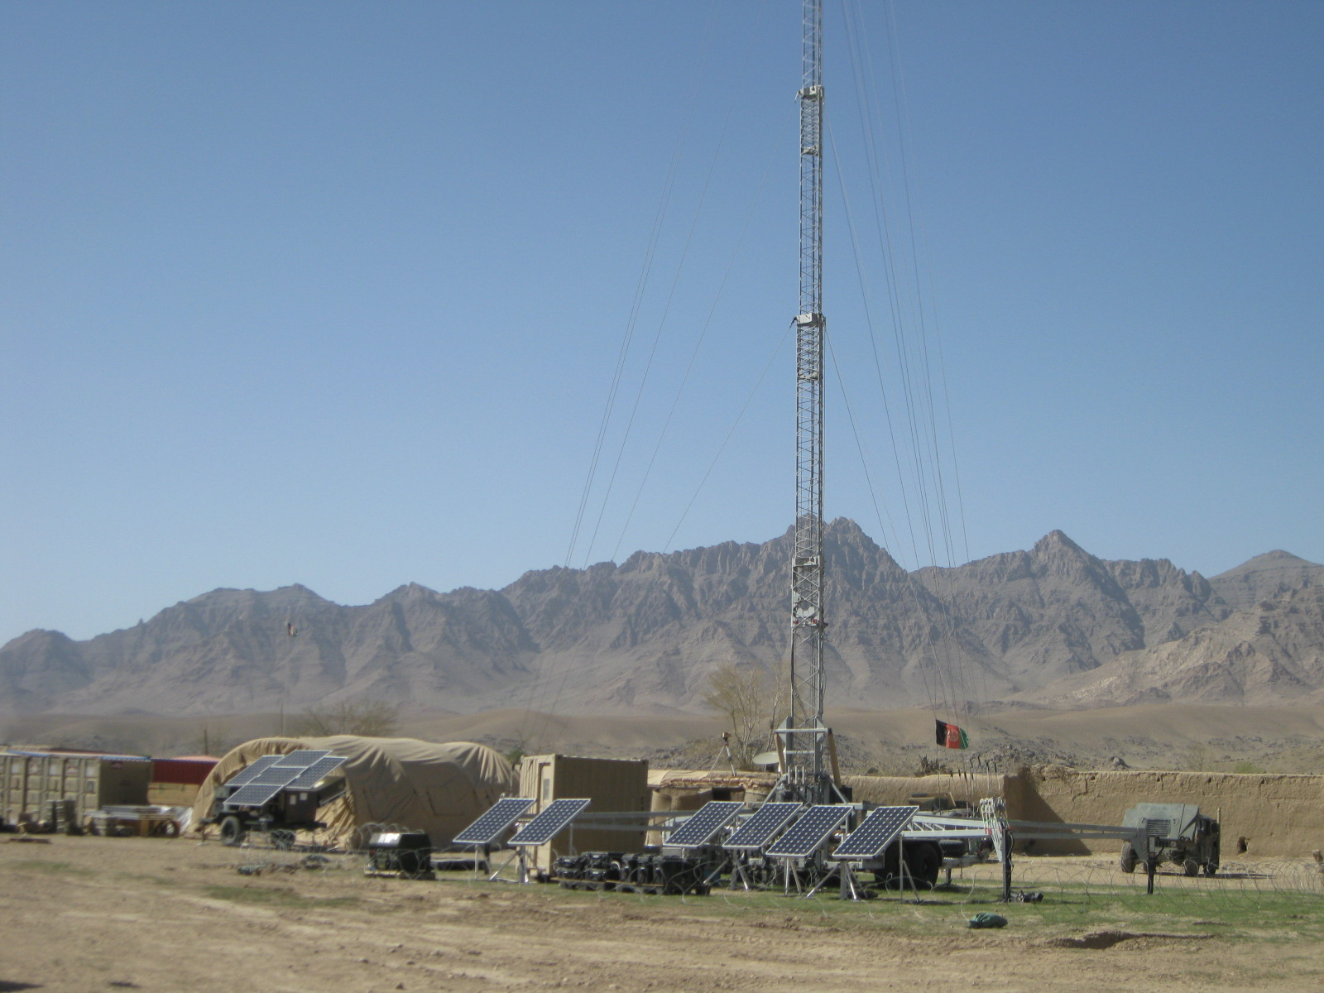

Slide 14
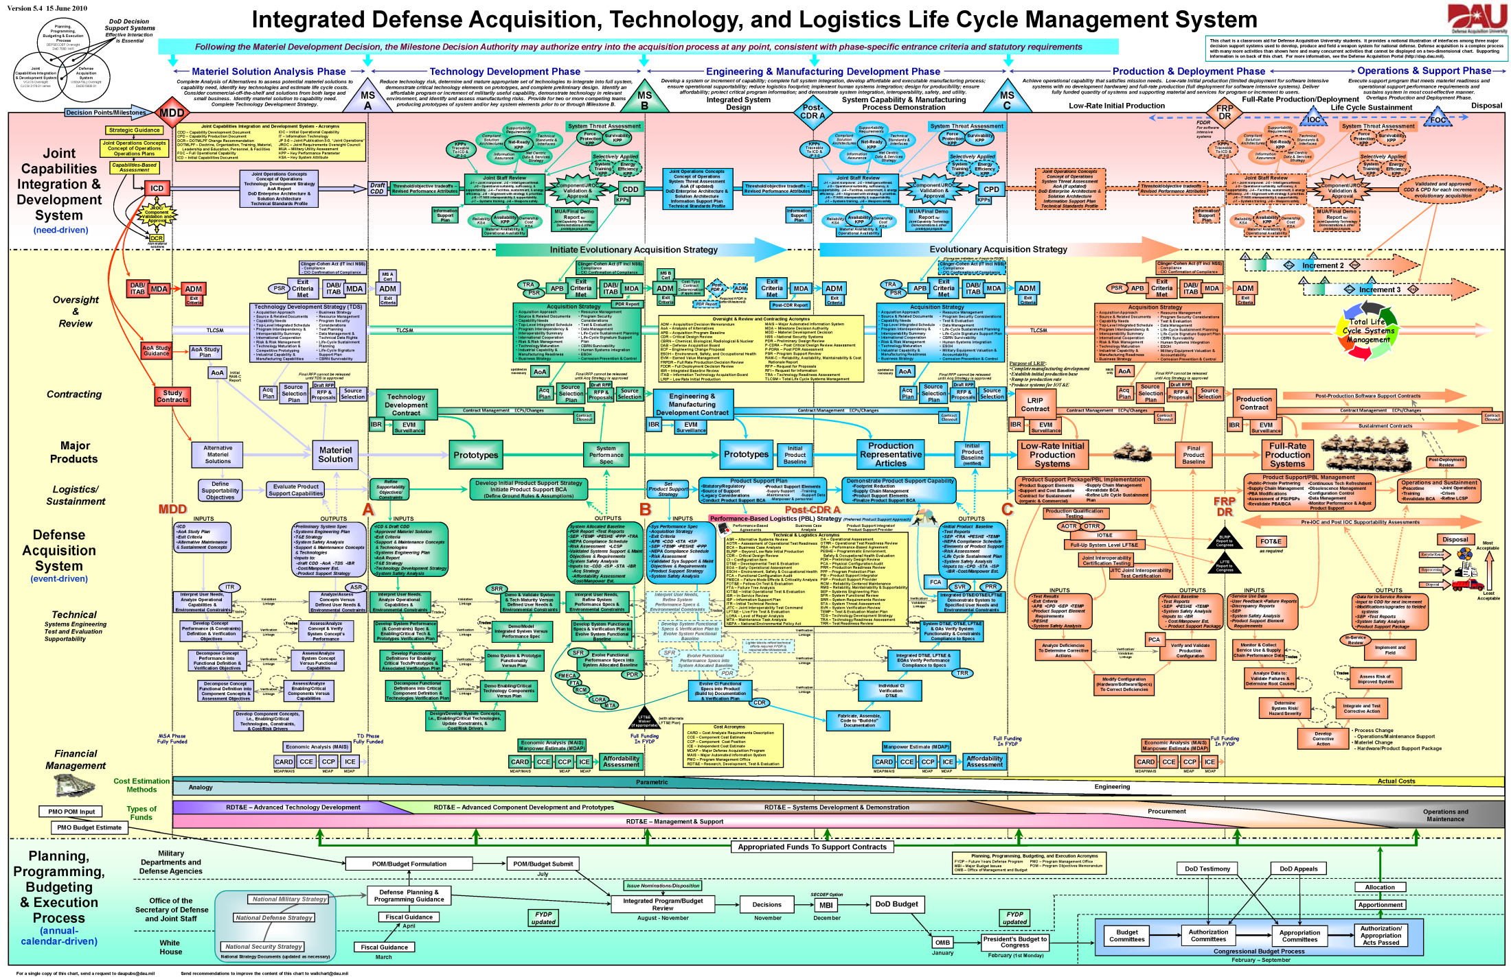
Easy as...

Slide 15
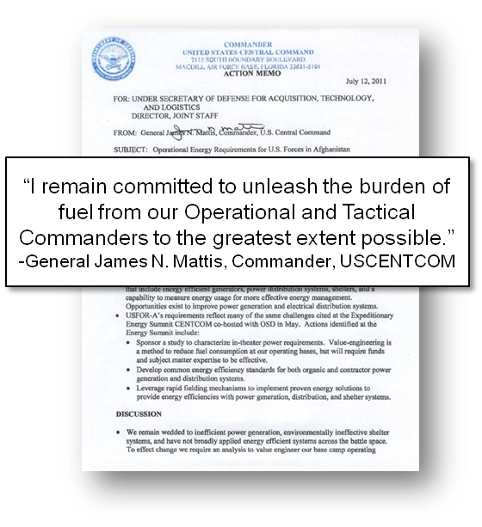
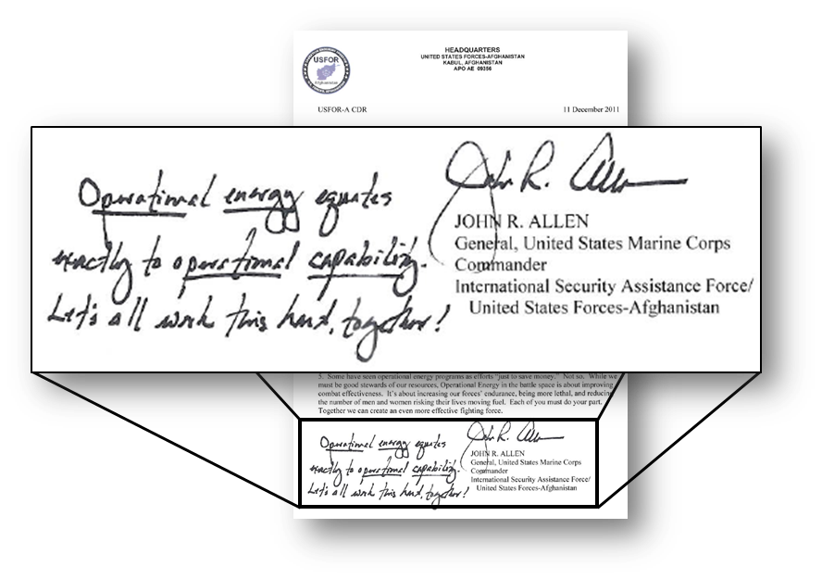
“Operational Energy” = “Operational Capability”
Gen James Mattis
12 July 2011
Gen John R. Allen
11 December 2011
Leadership stands behind capability
improvements through operational energy

Slide 16
Working with DoD
Battlefield Energy Innovation:
  Operational Energy Capabilities Fund: http://energy.defense.gov
  Marine ExFOB: http://www.marines.mil/community/Pages/ExpeditionaryEnergy.aspx
  Army: Rapid Equipping Force: https://www.ref.army.mil;
  Army: Network Integration Evaluation: http://www.bctmod.army.mil/nie_focus/
  Demos at Ft. Devens;; Energy Initiatives Task Force
Facilities Energy Innovation:
  SERDP/ESTCP: http://www.serdp.org/
Renewable Energy Siting on DoD Lands:
  Clearinghouse: http://www.acq.osd.mil/dodsc/
Small Businesses
  DoD SBIR program: http://www.acq.osd.mil/osbp/sbir/
  Defense Venture Capital Initiative: http://devenci.dtic.mil/
Studies
  Minerva Program: http://minerva.dtic.mil/overview.html

Slide 17
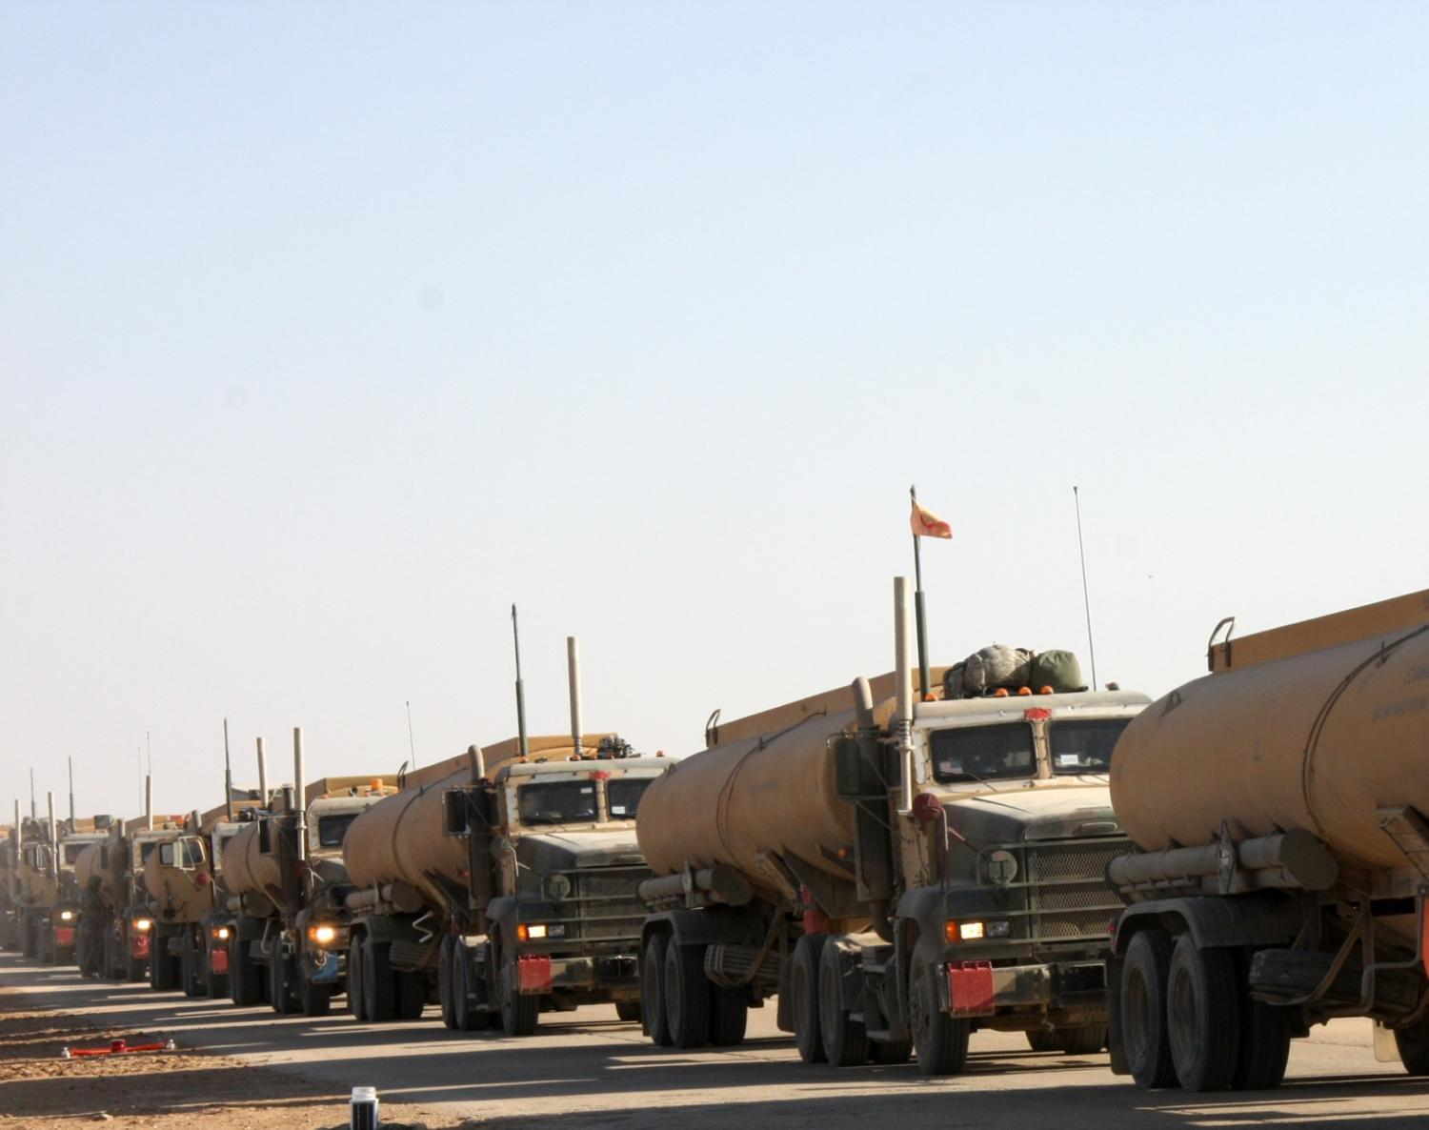


http://energy.defense.gov
facebook.com/sharon.e.burke
asd_sharonburke

