Slide 1
Nutraceuticals as Co-products of Biofuel Development
July 31, 2013
Shulin Chen (chens@wsu.edu), Leader
Bioprocessing and Bioproduct Engineering Laboratory (BBEL)
Department of Biological Systems Engineering
Washington State University

Slide 2
Outline
BBEL’s biofuel R&D program
Nutraceutical industry opportunity
Synergy with biofuel development and the existing food industry
Technology R&D development at BBEL
Current status and next steps

Slide 3
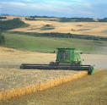
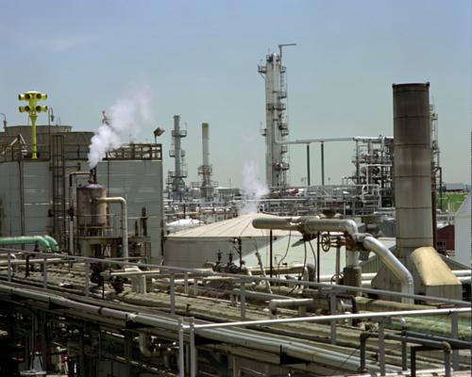
BBEL’s R&D Goal: Biorefining Biomass to Biofuels and Co-products
Bio-
Products
Jet fuel
Nutraceuticals
Fine chemicals
Biogas for power and transportation fuel
Biodiesel
Fertilizers
Feedstocks
Conversion
Processes
Crop residues
Algae
Food Processing by-
products
Animal Wastes
Municipal Solid Waste
Forest residues
Pretreatment and enzymatic hydrolysis
Fermentation
Hydrothermal extraction and conversion
Anaerobic Digestion
Notes:
The Agriculture Industry of the Future is focusing on using crops, trees, and agricultural wastes as feedstocks for making a wide range of chemicals and consumer products like plastics, paints and adhesives.
We have collaborated with the agriculture, chemical, forestry, and life sciences communities on a vision and technology roadmap for biobased products, and have begun implementing them together.

Slide 4
Main R&D Initiatives at BBEL
Converting crop residues to fermentable sugars;
Fermenting cellulosic sugars to lipids for producing biofuels and biochemicals;
Growing algae for producing biofuel and biochemicals;
Discovering and separating bioactive compounds from biomass
Fractionating algal biomass and converting lipids to biofuels;
Recovering bioenergy and nutrients through anaerobic digestion.

Slide 5


Renewable Aviation Fuel
High energy density
No other alternatives
High application priority
Regional industrial strength

Slide 6
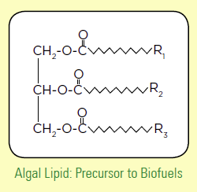
Lipid as a “drop-in” jet fuel intermediate
High energy density
Flexible molecule compositions
Multiple routes of production
Close to petroleum in terms of properties

Slide 7
Our Approach:
Integrated lipid platform for renewable “drop-in” jet fuel

Slide 8
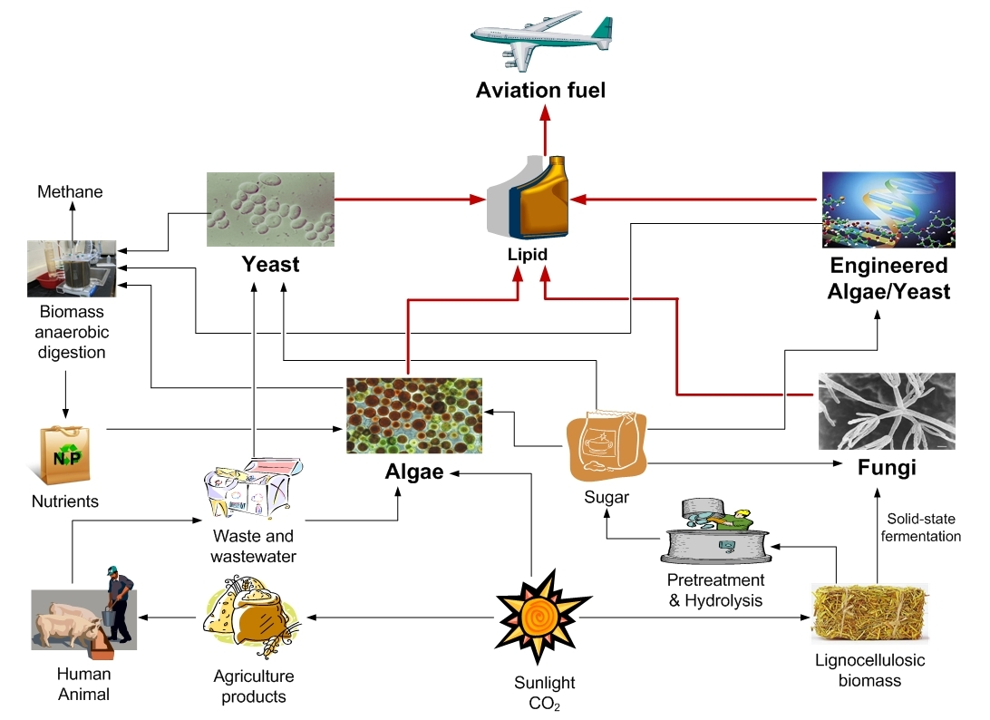

Slide 9
Microorganism species with high oil contents
 |  | Major fatty acid profile
 | Lipid (% w/w) | 14:0 | 16:0 | 16:1 | 18:0 | 18:1 | 18:2 | 18:3
Yeasts
Cryptococcus curvatus | 58 |  | 32 |  | 15 | 44 | 8
Lipomyces starkeyi | 63 |  | 34 | 6 | 5 | 51 | 3
Rhodosporidium toruloidies | 66 |  | 18 | 3 | 3 | 66
Rhodotorula glutinis | 72 |  | 37 | 1 | 3 | 47 | 8
Rhodotorula graminis | 36 |  | 30 | 2 | 12 | 36 | 15 | 4
Yarrowia lipolytica | 36 |  | 11 | 6 | 1 | 28 | 51 | 1
Molds
Entomophthora coronata | 43 | 31 | 9 |  | 2 | 14 | 2 | 4
Cunninghamella japonica | 60 |  | 16 |  | 14 | 48 | 14 | 8
Mortirella alpina | 50 |  | 19 |  | 8 | 28 | 9 | 8
Mucor circinelloides | 25 |  | 22 | 1 | 5 | 38 | 10 | 15
Pythium ultimum | 48 | 7 | 15 |  | 2 | 20 | 16 | 1
Algae
Crpthecodinium cohnii | 40 | 16 | 16 | 1 |  | 21 | 1
Schizochytrium limacinum | 50 | 4 | 56 |  | 1
Thraustochytrium aureum | 15 | 3 | 8 |  |  | 16

Slide 10
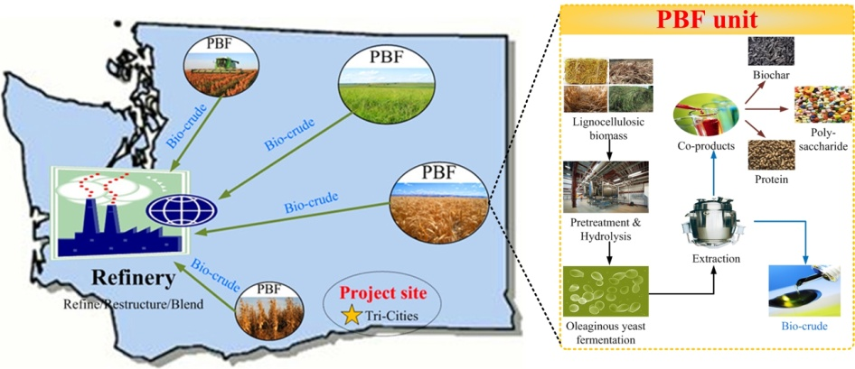
Our vision for implementing lipid based biofuel platform in Washington State

Slide 11
Biofuel reality supported by multiple factors
Biofuel will ultimately become cost effective as a result of cost reduction driven by R&D in strain improvement, culture systems, engineering, and co-products, along with anticipated increase in oil price and incentive in using carbon neutral fuels.
Cost reduction via R&D
Cost
Oil price
Cost reduction via
Co-products and incentive
Time

Slide 12
Nutraceuticals
Nutraceutical = “nutritional” + “pharmaceutical”
Refers to foods thought to have a beneficial effect on human health in addition to traditional nutrition value
Forms of nutraceuticals
  Dietary supplements
  Functional foods
A great variety- a wide range of molecules that are bioactive thus creates variety of potential health benefits
Much higher price than fuels, as high as $100/lb biomass

Slide 13
Major Types of Nutraceuticals
Phenolics, flavonoids,
Alkaloids,
Carotenoids,
Pre- and pro-biotics,
Phytosterols, tannins,
Fatty acids, terpenoids, saponins, a
Soluble and insoluble dietary fibers

Slide 14
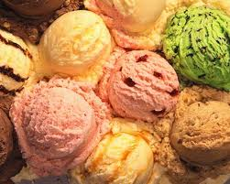

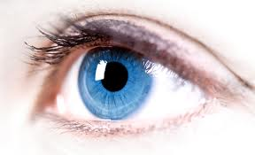
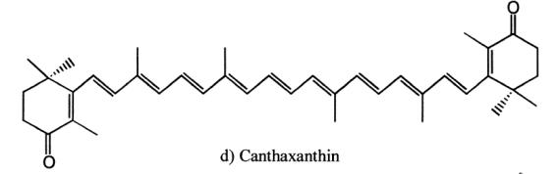
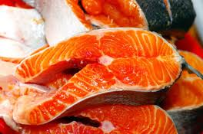
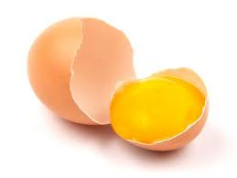
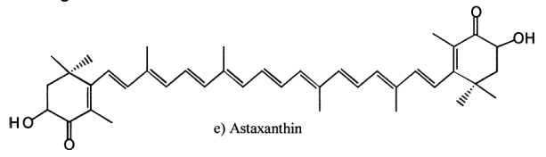
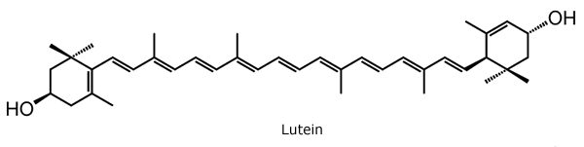
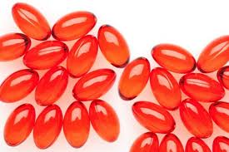
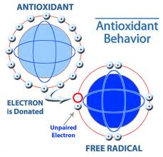
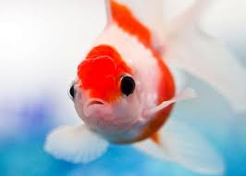
Pigments - Antioxidant

Slide 15
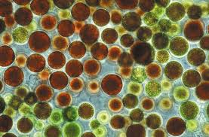
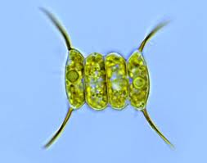
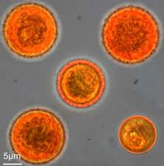
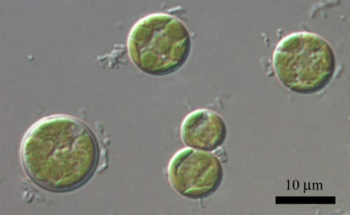
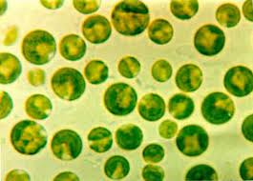
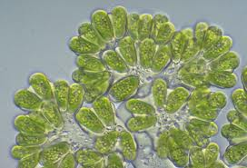
Representative pigments producers
Astaxanthin Lutein β-carotene
Haematococcus pluvialis
Scenedesmus almeriensis
Dunaliella salina
Chlorella zofingiensis
Chlorella protothecoides
Botryococcus braunii

Slide 16


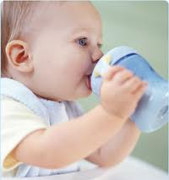
Poly-unsaturated fatty acids (PUFA)
PUFA | Potential application | Microorganism producer
γ-Linolenic acid (GLA) | Infant formulas for full-term infants Nutritional supplements | Arthrospira
Arachidonic acid (AA) | Infant formulas Nutritional supplements | Porphyridium
Eicosapentaenoic acid (EPA) | Nutritional supplements Aquaculture | Nannochloropsis oculata; Porphyridium purpureum, Porphyridium cruentum, Phaeodactylum tricornutum, Phaeodactylum cornutum, Isochrysis galbana, Nitzschia laevis
Docosahexaenoic acid (DHA) | Infant formulas Nutritional supplements Aquaculture | Crypthecodinium cohnii, Shizochytrium, Pavlova luther

Slide 17
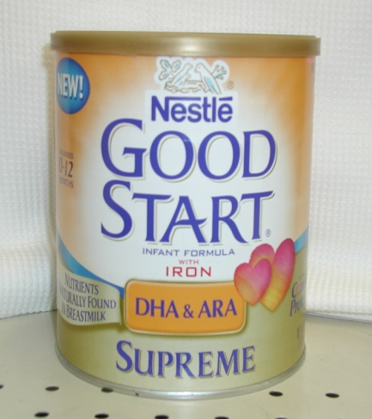
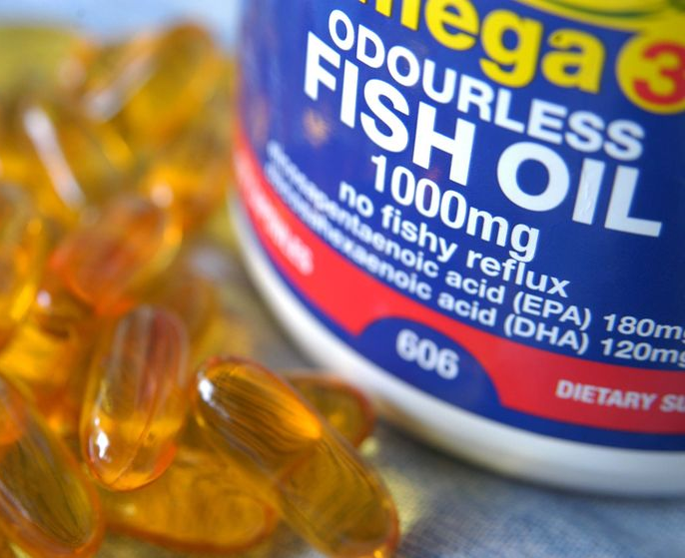
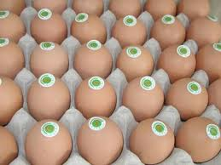
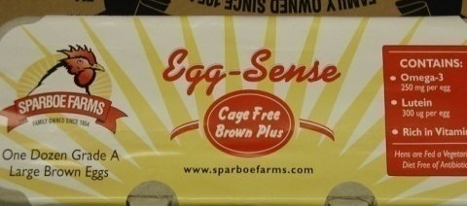
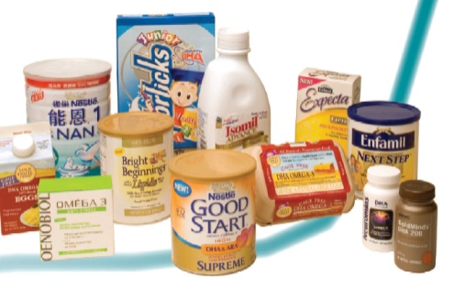
Various products with PUFA supplementation
Infant formula
Dairy drinks
Cheese
Beverage (ex dairy)
Snacks/candy/cookies/crackers
Bread
Cereal/breakfast food
Yogurt

Slide 18
Polyphenolds and main functions
Polyphenols
Anthraquinones
Flavonoids
Lignins
Stilbenes,
Naphto
quinones
Hydroxycinnamic acids
Coumarins
Simple phenols
Phenolic acids
Xanthones
Diseases
Cancer
Coronary heart diseases
Inflammatory disorders
Neurological degeneration
Aging
antioxidant capacity
Prevent

Slide 19
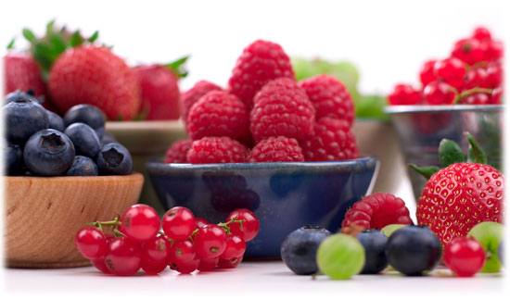
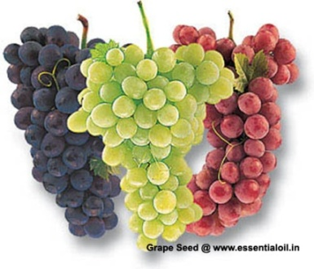
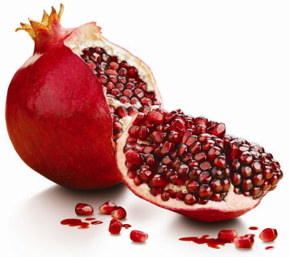
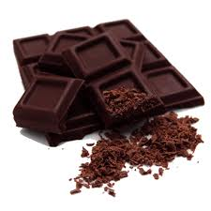
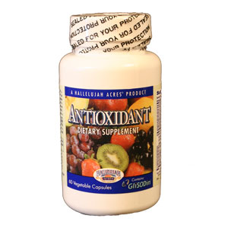
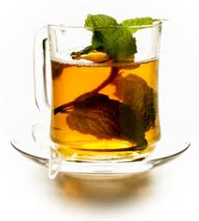
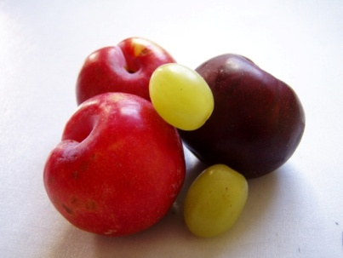
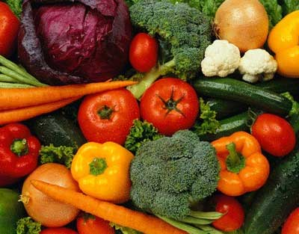
Natural Antioxidant extraction from fruits and vegetables

Slide 20
Nutraceuticals opportunity
A new market report from Transparency Market Research, Albany, NY, has found that the global nutraceutical product market reached $142.1 billion in 2011;
It is expected to reach $204.8 billion by 2017, growing at a CAGR of 6.3% from 2012 to 2017;
Asia Pacific (including Japan) is expected to have the second largest market share after North America by 2017.
(http://www.nutraceuticalsworld.com/contents/view_breaking-news/2013-06-26/nutraceuticals-product-market-forecast-to-reach-2048-billion-by-2017/#sthash.zlj2vNpY.dpuf)

Slide 21
Drivers for growing nutraceutical demands
Increasing health consciousness
Realization of importance of prevention
Cost of prevention versus treatment
Scientific evidences demonstrating real health benefits
Development of science and technology for identification and separation of various bioactive compounds
Competition for new products/markets

Slide 22
Synergy with biofuel development
Biomass as biofuel feedstocks such as microbes contains other cell components such as PUFA, polysaccharides and proteins that have higher values;
Producing a series of co-products will contribute to reducing biofuel production cost;
Separation of these compounds will make biofuel refining more efficient.

Slide 23
Synergy with existing food industry
Washington State’s fruits and vegetable processing industry produce various by-products from which nutraceutical ingredients can be extracted;
Biofuel development provides great potential for new nutraceutical ingredient supplies;
Combinations of these sources would provide significant amount of supply of ingredients for nutraceutical production;
Developing a nutraceutical industry will enhance the competitiveness of the food industry.

Slide 24
Technology R&D development at BBEL
New bioactive compounds discovery and characterization
Nutraceutical production via microbial culture
  DHA
  Astaxanthin
  Lutein
  Extraction of nutraceuticals from agricultural by-products
Extraction and conversion of algal biomass

Slide 25
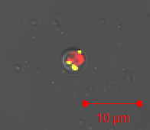
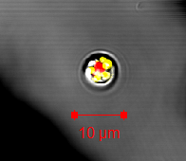
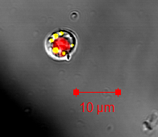
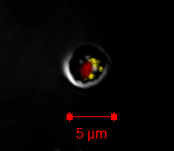
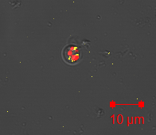
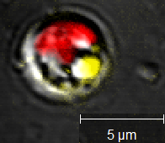
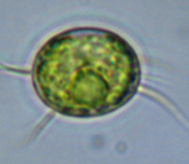
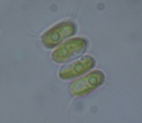
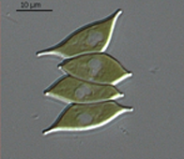
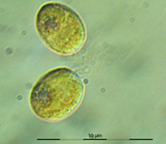
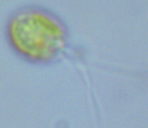
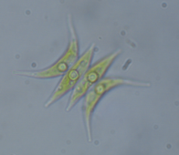
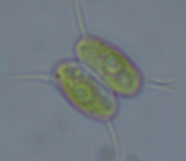
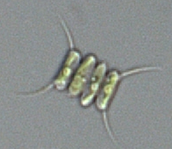
Samples of
regional
algal strain resources
collected by WSU
16% lipid
nitrogen stress
1.16 g/L day
24.74% lipid
1.2 g/L day
18% lipid
nitrogen stress
16.97% lipid
UC-2
PF-1
EV-or-1
EV-OR-5
14.39% lipid
1.24 g
Max=14% lipid
Nitrogen stress
18% lipid
nitrogen stress
MCI
Chlorella s.
PF-1
RS-1
PF-3
EV-B-2
16% fat
N starved
12.7% fat
Non stressed
3.5% EPA
Volvocales
Scenedesmus
EG
MP-2
PF2
PF-4
PF-7

Slide 26
Screening high value compounds from different algae biomasses
Algae
Biomass
Cyanophyceae
Chlorophyceae
Pigments, lipids and semi-polar. Polar small molecules
Target Compounds
Develop robust LC-MS-MS method combining extraction, HPLC separation and MS-MS parameter optimization
R&D Initiatives
Develop a metabolomic library for the target compounds

Slide 27
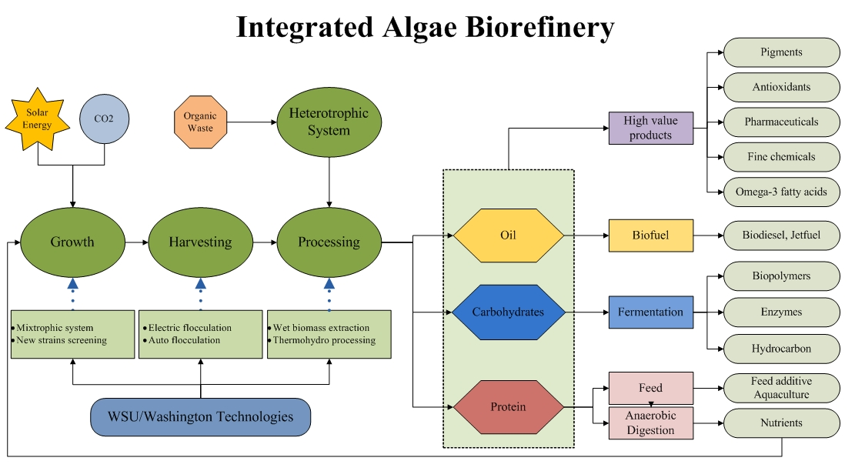
WSU Technology R&D for Algae Biorefinery

Slide 28










Producing FUFA-enriched algae
using cult potatoes

Slide 29





Astaxanthin production using algae Haematococcus pluvialis
Haematococcus pluvialis has been reported to be the richest source of natural astaxanthin and can produce as high as 5% of the dry cell weight under lab conditions.
Develop two-stage culture process and optimize culture conditions for algae growth and astaxanthin accumulation.

Slide 30


Lutein production from green algae
Lutein is used for the pigmentation of animal tissues and products, and effective in the prevention of age-related macular degeneration and cataract.
Lutein is currently produced from the petals of marigold, requiring a lot of labors and arable lands due to the complex processing and low content.
Microalgae are
considered as a
promising alternative

Slide 31

Lutein produced from green algae
Chlorella Sorokiniana
Develop optimal cultural processes for lutein production
  Temperature
  Feeding strategy
  Maximize lutein content without scarifying

Slide 32

Sequential hydrothermal extraction of carbohydrates and lipids from algal biomass

Slide 33


Extracting polyphenols from grape pomace using magnetic beads coated with polyethylene glycol (PEG)
Advantages
Fast adsorption & desorption process
Affinity could be modified by changing the functional ligands on the surface
Magnetic beads
Magnetic separation process
Gregory et al., 2002; Jia & Kang, 2004, Pan et al., 2008;
Xu et al., 2008;Laura Worl & Dennis Padilla, 1996

Slide 34

Developing new functional “smart-food” products from
bioactive ingredients

Slide 35
Status of and Next Steps of Technology Development
Majority of the technologies has passed the “proof-of -concept” stage;
Additional research is being conducted for further refinements;
Industrial interests are critical for saling-up to the next-level;
Commercialization partners are welcome.

Slide 36
Acknowledgements
Bill and Melinda Gates Foundation
Agricultural Research Center, WSU

Slide 37
Thank you for your attention!

Slide 38
About Our Lab - BBEL
Program Goal
  Advances sciences and technologies for producing biofuels and biochemicals
Credential
  Five US patents issued, 10 more applications filed
  Three technologies currently being commercialized
  Over 200 refereed journal publications
  Over $18M research grants and contracts
  Twenty research staff and graduate students
  A large number of industrial partners
  A broad range of research collaborations

