Slide 1

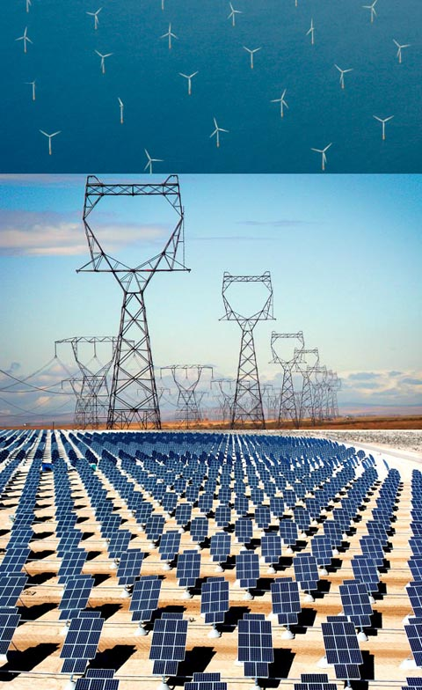
Funds for Clean Energy: 2013-14
Overview of Programs & Schedules
August 8, 2013

Slide 2
Agenda
Welcome, Introduction and Objectives:
  Brian Bonlender, Director Department of Commerce
Agenda and Today’s Program: Richard Locke, Executive Director,
Office of Economic Development and Competitiveness
Overview of Programs: Tony Usibelli, Dept of Commerce
  Revolving Loan Fund Grants
  Smart Grid Grants to Utilities
  Federal Grant Matching Funds
  Returning Recovery Act Funds
  Energy Efficiency and Solar Grants for Public Buildings
Questions, Answers, and Feedback

Slide 3
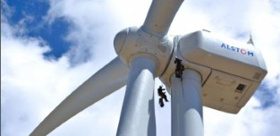
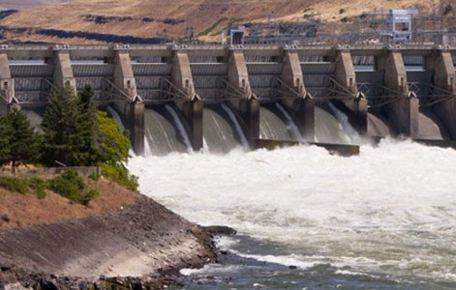

Clean Energy Objectives
Governor Inslee:
economic growth through clean energy
Job growth
Meet greenhouse gas reduction goals
Develop clean energy solutions in Washington for eventual export
Performance-based grant agreements
  Measureable Performance
  Capacity to Deliver

Slide 4

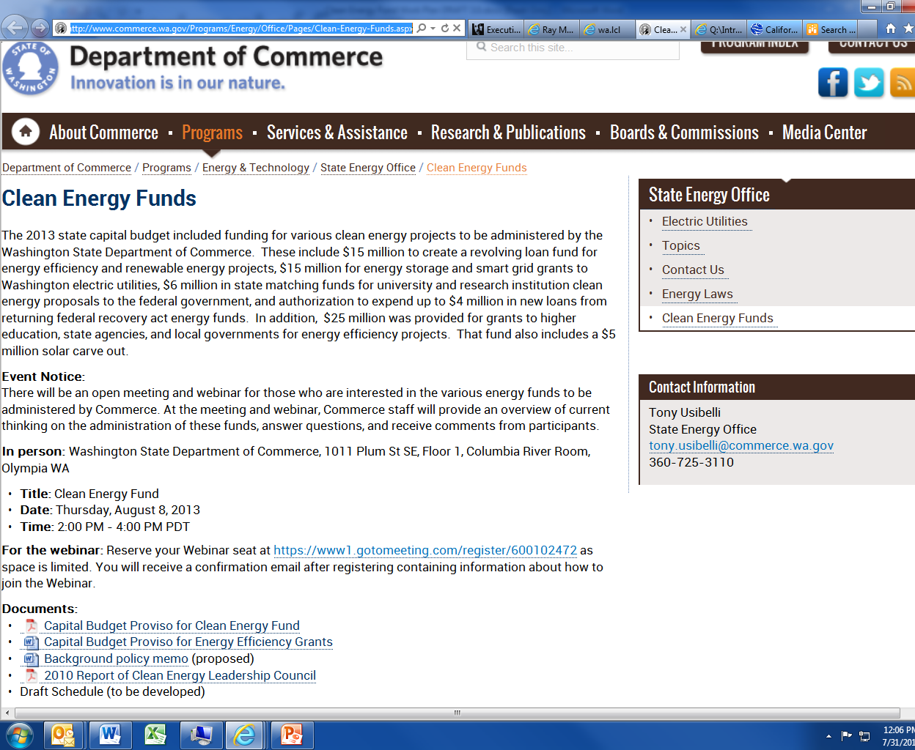
Program Background
www.commerce.wa.gov
navigate to Programs/
Energy & Technology/
State Energy Office
box on upper right
Clean Energy Funds
Sub Heading
This is a place to start plugging in info for presentation.

Slide 5

1. Revolving Loan Fund Grants
Section 1074 (3)(a): “$15,000,000 of the state taxable building construction account—state appropriation in this section is provided solely to create a revolving fund to support widespread use of proven building energy efficiency and renewable energy technologies now inhibited by lack of access to capital”
Grants to competitively selected nonprofit lender
  Grants to one or more lenders
Nonprofit lender duties (not limited to)
  Match Commerce grant 1 to 1 with lender capital
  Demonstrate path to at least 5 to 1 leverage in 4 years
  Market loans to prospective borrowers
  Underwrite loans
  Meet all state reporting and compliance requirements
Commerce duties
  Compliance oversight
  Reporting assistance to lender
  Program policies, procedures, performance standards
  Final approval of all enrolled loans for compliance with state requirements
Form Advisory Panel

Slide 6
Criteria for Nonprofit Lenders
Qualifying entities
  Community Development Financial Institutions
  Credit Unions
  State conduit financing entities (e.g., Housing Finance Commission)
Selection criteria
  1:1 dollar match with lender capital as funds flow and
  credible path to at least 5:1 leverage in 4 years.
  Experience originating loans for
  energy efficiency and/or renewable energy
  Experience with innovative financing approaches
  Organizational capacity to
    generate deal flow
    underwrite loans and manage a loan portfolio
    meet requirements for reporting and compliance

Slide 7
Potential loan types
Whole-house retrofits by homebuilders who purchase existing homes and then resell them
Commercial energy retrofits
Residential and community-scale solar
Residential and community-scale wind
Anaerobic digesters
Combined heat and power projects
Financing for export of clean energy goods or services from in-state companies
Other

Slide 8
Proposed Schedule: Revolving Loan Fund Grants
Milestone | Date
Open meeting for interested parties | August 8
Review/Advisory Panel Selected | August 16
Draft Request for Qualifications (RFQ) posted on-line | August 26
Public comment back on Draft RFQ | September 6
Final RFQ posted on-line | September 11
Statement of Qualifications submitted to Commerce | September 20
Announce grant awards | October 2
Complete contracting with grantees | December 15

Slide 9

2. Smart Grid Grants to Utilities
Section 1074 (4): “$15,000,000 … is provided solely for grants to advance renewable energy technologies by public and private electrical utilities…The department shall work with utilities to offer matching grants for projects that demonstrate new smart grid technologies.”
Grants to competitively selected consortium of utilities, utility vendors and researchers
Consortium must match $15 million state investment
Consortium projects will:
  Integrate intermittent renewables through energy storage and information technology
  Dispatch energy storage resources from utility control rooms
  Use thermal properties of buildings and/or district energy systems to store energy
  Improve the reliability and reduce the costs of intermittent or distributed energy
Form Advisory Panel

Slide 10
Proposed Selection Criteria
At least one-to-one match
Washington companies as significant vendors to support
in-state economic development
Proposed projects:
  Hit spot between unproven, high-risk new technologies and well understood approaches that utilities would do anyway
  Have potential to scale and drive market in and outside Washington
  Can deliver results by first half of 2015.
Meets legislative requirements to:
  Help integrate intermittent renewables through energy storage and information technology
  Dispatch energy storage from utility control rooms
  Use thermal properties of buildings and district energy systems for energy storage
  Improve the reliability and reduce the costs of intermittent energy

Slide 11
Proposed Schedule: Smart Grid Grants to Utilities
Milestone | Date
Open meeting for interested parties | August 8
Review/Advisory Panel Selected | August 23
Draft Request for Proposals (RFP) posted on-line | September 12
Public comment back on Draft RFP | September 19
Final RFP posted on-line | September 26
Consortium Proposals submitted to Commerce | October 10
Announce grant awards or request for supplemental materials from selected applicants | October 30
Complete contracting with grantees | December/January

Slide 12
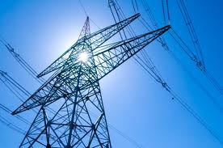
3. Federal Grant Matching Funds
Section 1074 (5): “$6,000,000 of the state taxable building construction ...is provided solely for grants to match federal funds used to develop and demonstrate clean energy technologies.”
“to develop and demonstrate” rather than “research”
State share 50% or less
Commerce shall work with
  University of Washington
  Washington State University
  Pacific Northwest National Laboratory
Projects including but not limited to:
  Energy storage
  Solar technologies
  Manufacturing Innovation Centers using carbon fiber

Slide 13
Proposed Schedule: Federal Grant Matching Funds
Milestone | Date
Commerce letter to UW, WSU & PNNL requesting representatives | August
Open meeting for interested parties | August 8
Convene meeting with research institutions’ representatives | August
Develop draft criteria for qualifying applications | September
Post final criteria and application process | October

Slide 14
4. Returning Recovery Act Funds: $4 million
  State Energy Program funds that were loaned and are in process of repayment
  Funds not on hand
  Decisions regarding use of funds on hold

Slide 15

5. Energy Efficiency and Solar
Grants for Public Buildings
At least 10% of each competitive grant round for small cities or towns with a population of 5,000 or fewer residents
Projects ranked on:
  Ratio of non-state funding sources to state grant
  Amount energy savings
Commerce will develop rating criteria and a scoring system for $5M in grants to purchase and install Washington-manufactured solar energy systems, including solar modules and inverters
Sec. 1075. “$18,000,000 for fiscal year 2014 and
$7,000,000 for fiscal year 2015 is provided solely for grants to be awarded in competitive rounds to local agencies, public higher education institutions, and state agencies for operational cost savings improvements to facilities and related projects that result in energy and operational cost savings.

Slide 16
Proposed Schedule*: Grants for Public Buildings
Milestone | Date
FY 14 Round 1: Applications Available | October 2013
Applications Due | January 2014
Awards Announced | March 2014
FY 14 Round 2: Applications Available (If funds remain) | March 2014
Applications Due | May 2014
Awards Announced | July 2014
FY 15 Round 1: Applications Available | July 2014
Applications Due | September 2014
Awards Announced | November 2014
* Subject to Change Possible FY15 Round 2 if funds remain

Slide 17
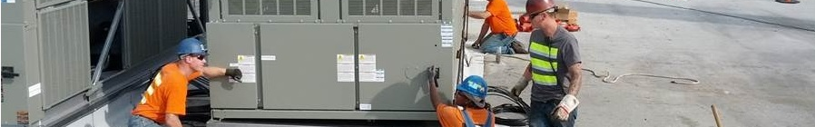
Questions, Answers, and Feedback

Slide 18
For more information
Tony Usibelli
Assistant Director
State Energy Office
tony.usibelli@commerce.wa.gov
360-725-3110
Submit written comments or inquiries to:
Energy_policy@commerce.wa.gov
August 2013

