Slide 1



Washington Clean Technology Alliance
Investing in the
Blue Revolution
September 11, 2013
San Francisco
Presented by Laura Shenkar, Principal

Slide 2

Agenda
Introduction to Artemis, Artemis Top 50
The Water Challenge from an Investor’s Eye
Water Tech Today
Smart Water Investment in the Second Wave
Notes:
Draft Outline-- September 11 Breakfast Meeting for the WCTA:
TItle: Driving water investment-- local business leadership
INTRO
Slide 1: Intro to Artemis, Artemis Top 50
Slide 2: Need for water innovation-- growing water scarcity
-Challenges will require more than new policy and incremental improvements in existing processes
--Start-ups--In other industries introduce game-changing solutions and drive industry change
Slide 3: Deal velocity
-- Artemis Top 50 is a diverse group, provides an "index" for the water tech industry. Critical challenge to growth is a lack of "deal velocity": time for start-ups to raise money, time for start ups to provide returns to investors.
--Cleantech Group estimate on venture capital funding for water start-ups-- 2005-2013
Slide 4:
--Seed investment is critical: not just the money, but long-term oriented investors are critical
--the best have:
------"deep pockets" for follow-on investment, experience and success from start-ups (often in adjacent industries)
------connections with leaders a) corporate water users b) executives in the water industry
--Most successful start-ups bring in more than one investor, best situation is a community of active investors that provide a consistent approach over a period of years
Case studies:
-International: Israel-- local business people invested in the first VCs, local business people and foreigner with ties to Israel are still responsible for 80% of investment in early-stage tech start-ups, including water.-- E.g., Aqwise, Emefcy, Takadu
-National:
--Albuquerque, New Mexico
--Portland, OR
--Boston, MA
--Milwaukee, WI
--Denver, CO
--Fresno, CA
Emerging: North Carolina, Cincinnati
While investors are generally aware of the growing importance of water in business operations, it will not be a factor until business operations suffer more serious problems.
Perpetual life funds, such as the the sovereign wealth funds and endowments, that manage large investment funds for the long term, are leading the drive for investment in water. While water is already emerging as a promising technology investment theme, the world’s largest funds can raise the profile of water tech as an important investment vehicle.

Slide 3

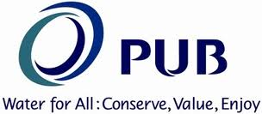
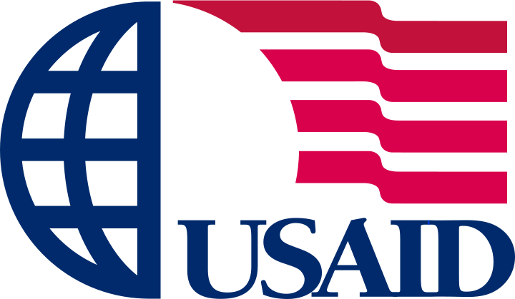
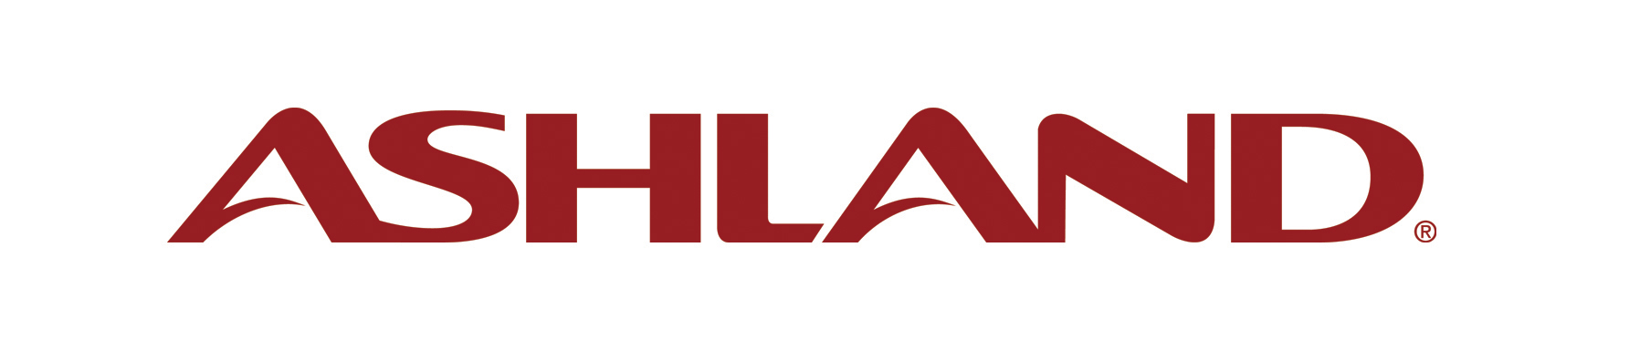

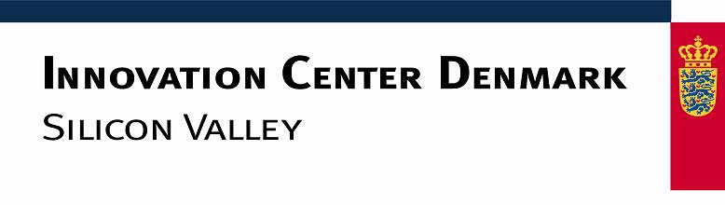

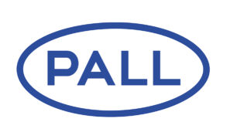
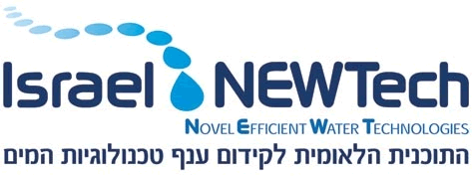

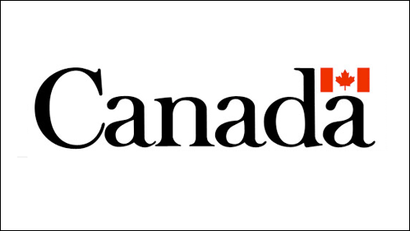

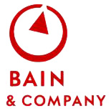

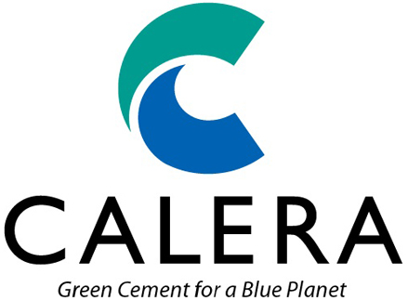




Artemis: Driving Revenue in Water Through Innovation
Multi-Stakeholder Client Base
Notes:
Artemis Water Strategy is a boutique strategy consulting firm focused around IP-intensive water technology that recasts water management. Since 2005, it has worked with the corporations, the water equipment companies and the start-ups that are applying advanced water technology at wide scale. Artemis develops private/public sector forums to drive the development of water tech clusters.

Slide 4
Introduction: Artemis’ Resources
International network of leaders in innovation: executives, investors, academics
Database of 4,000 contacts, including 1200 promising water tech start ups
Over 20 years of global experience in successful start-ups and venture capital
Deep understanding of best practices in innovation from adjacent industries
Projects with a diverse group of stakeholders enable Artemis to see emerging trends early and develop action plans.

Slide 5
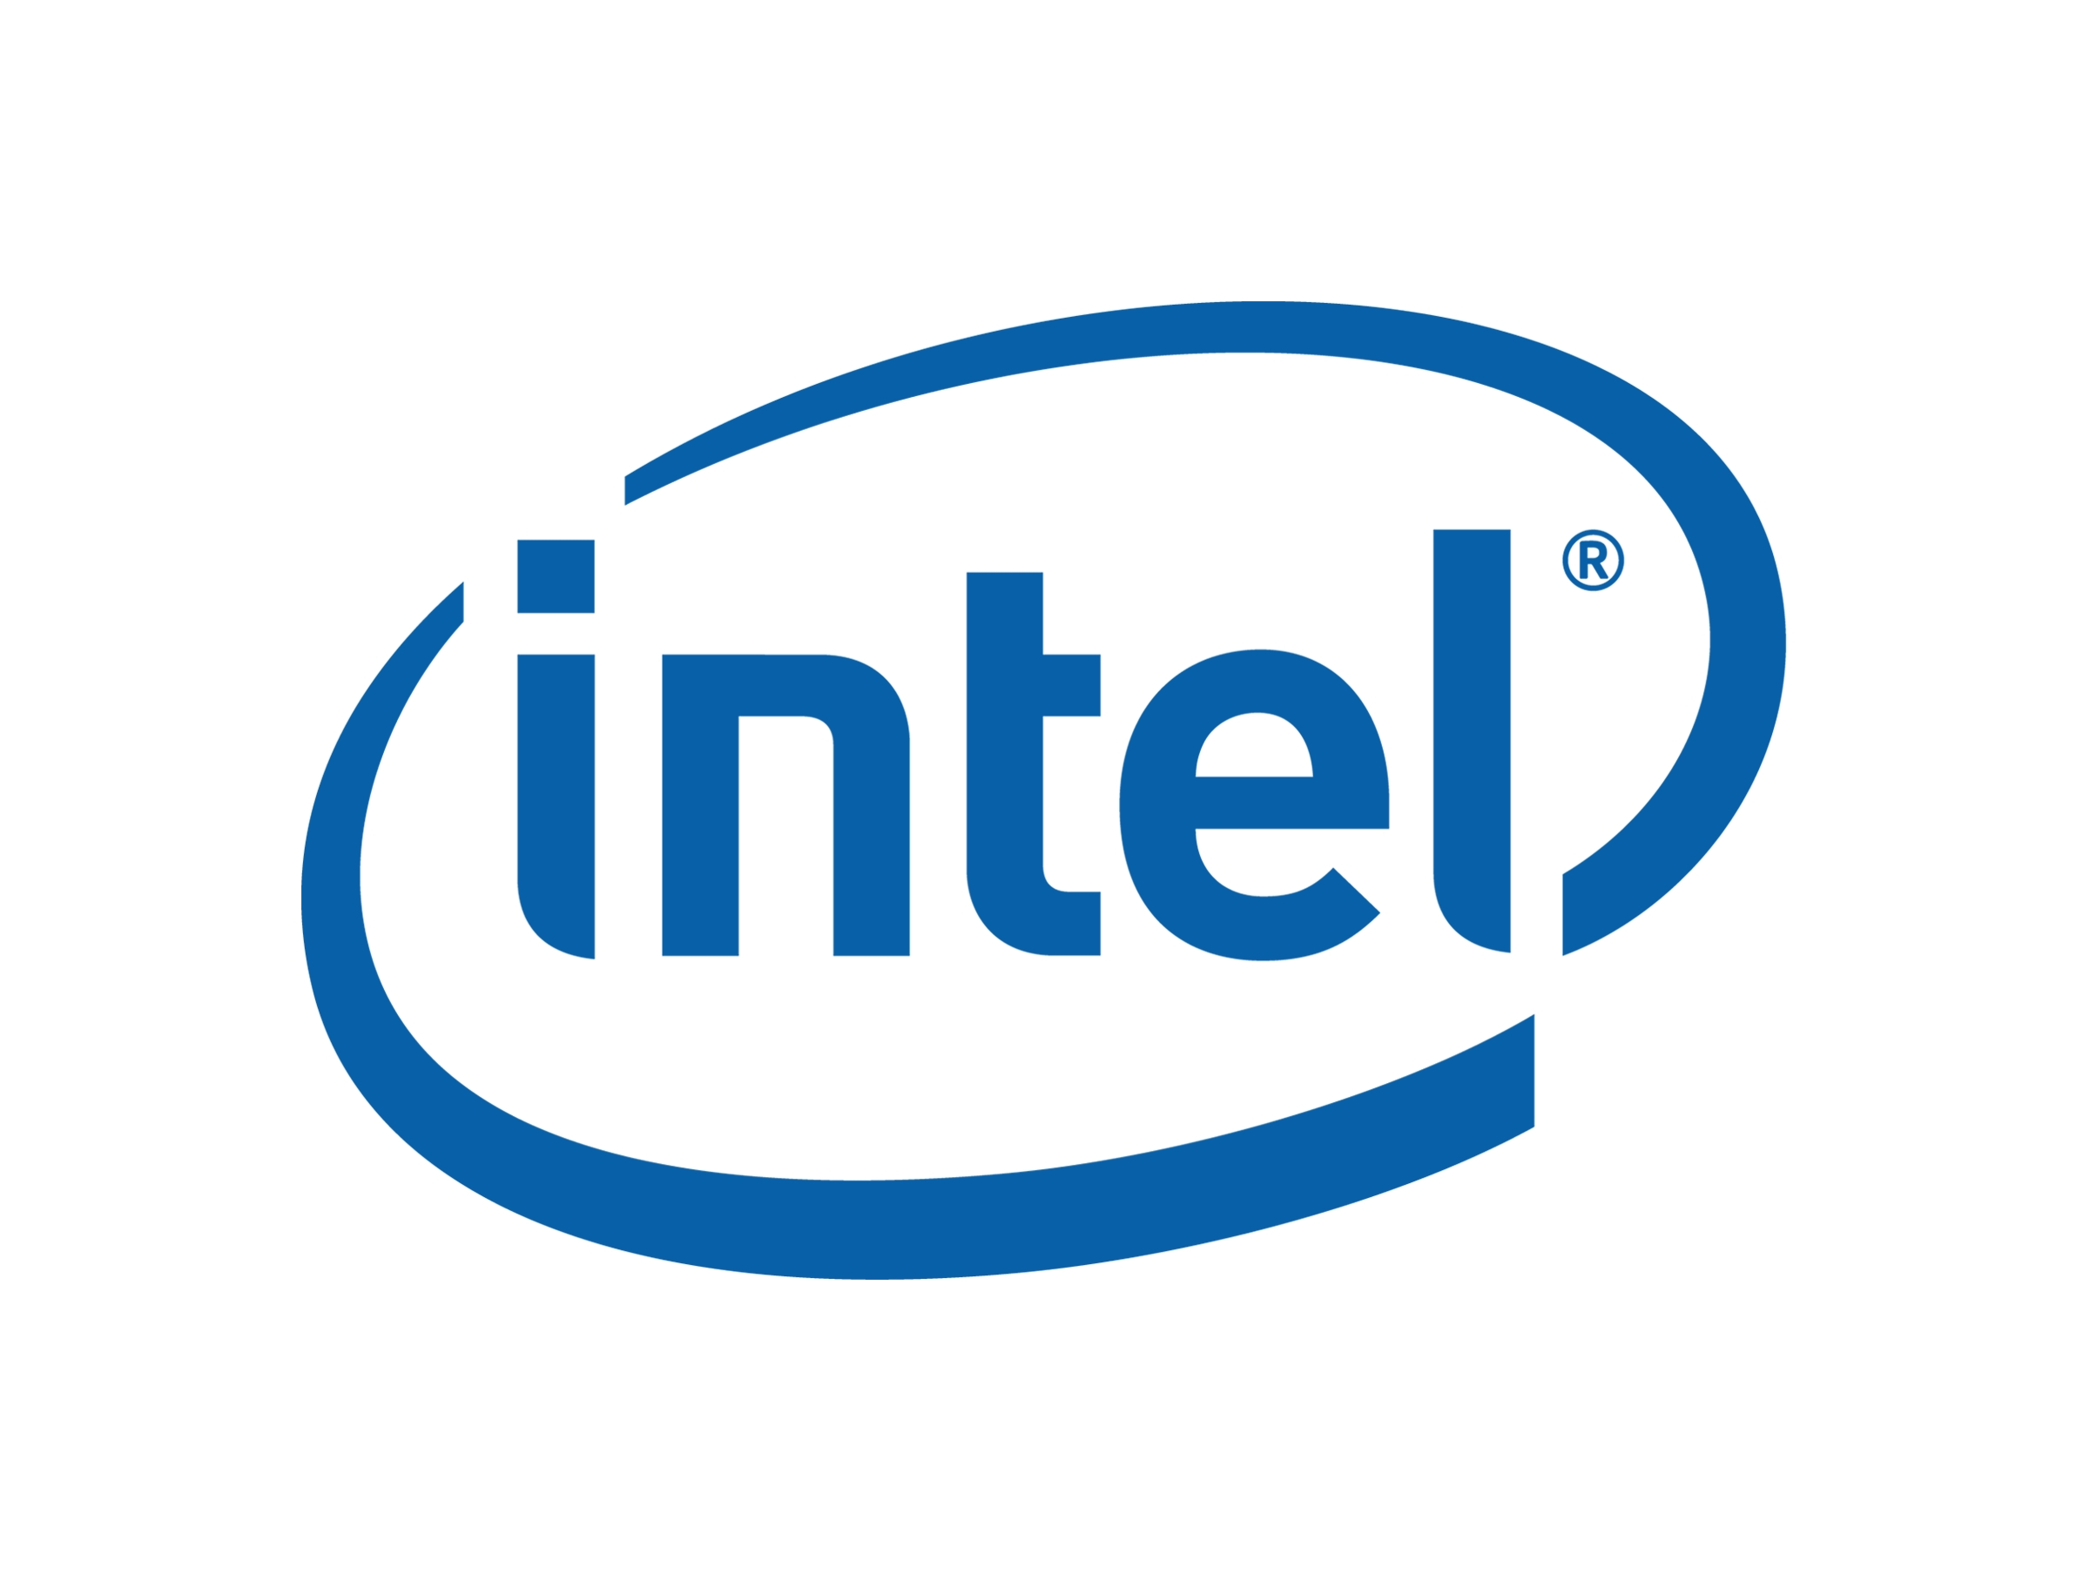
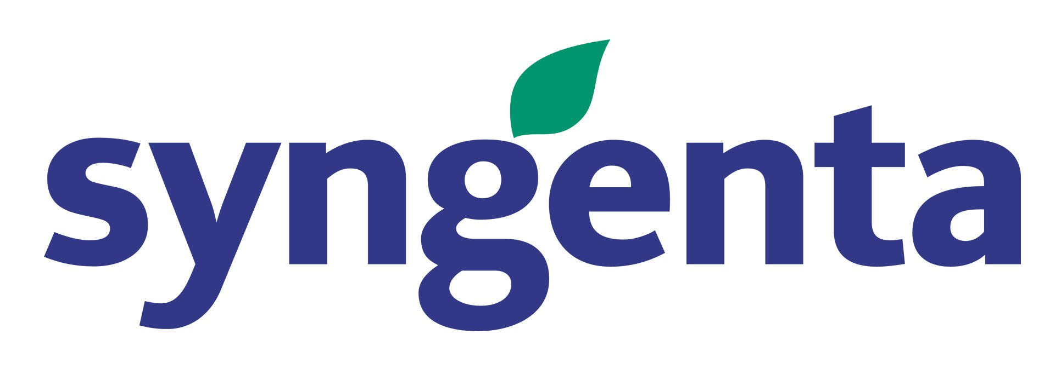
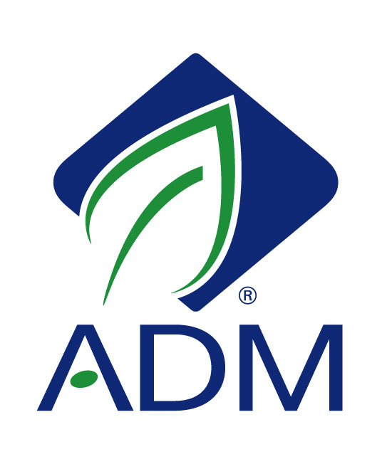
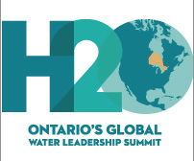

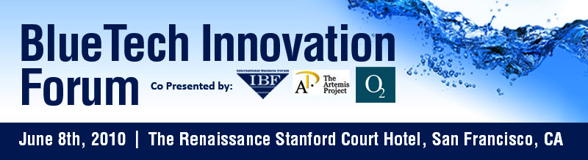
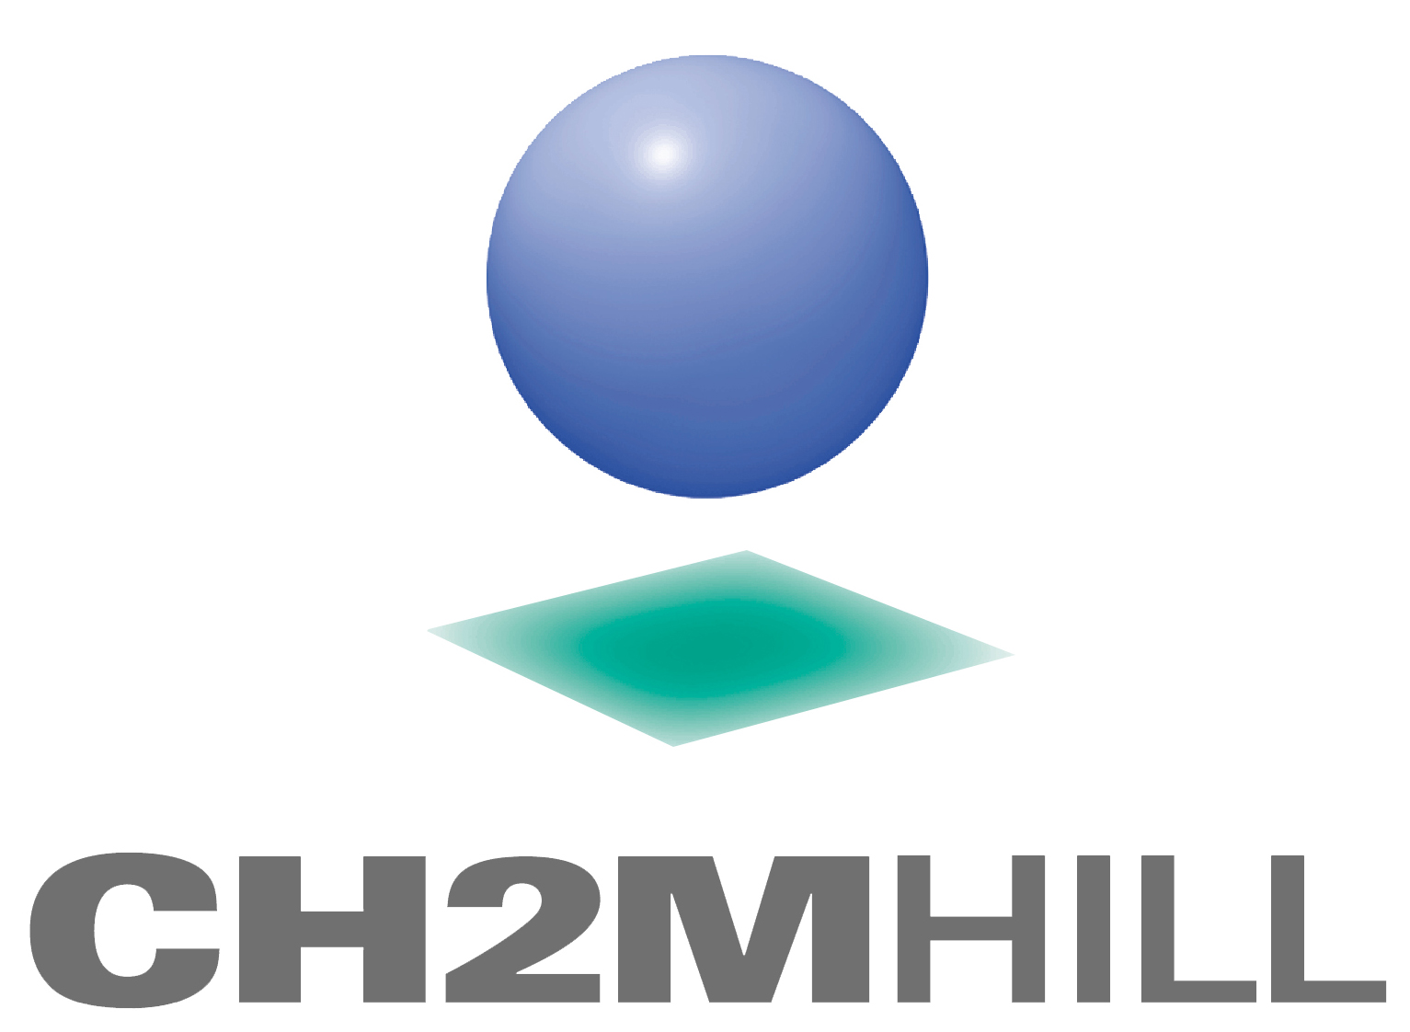
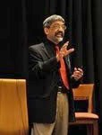

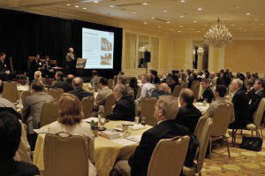
Closed-Door Forums
Artemis Top 50: 2012 jury included Intel, Archer Daniels Midland, Syngenta, IBM, CH2M Hill, Singapore PUB and Ecolab
Founded the BlueTech Forum, Chaired the Ontario Water Leadership Summit
Closed-door client forums

Slide 6
Agenda
Introduction to Artemis, Artemis Top 50
The Water Challenge from an Investor’s Eye
Water Tech Today
Water Investment in the Second Wave
Notes:
Draft Outline-- September 11 Breakfast Meeting for the WCTA:
TItle: Driving water investment-- local business leadership
INTRO
Slide 1: Intro to Artemis, Artemis Top 50
Slide 2: Need for water innovation-- growing water scarcity
-Challenges will require more than new policy and incremental improvements in existing processes
--Start-ups--In other industries introduce game-changing solutions and drive industry change
Slide 3: Deal velocity
-- Artemis Top 50 is a diverse group, provides an "index" for the water tech industry. Critical challenge to growth is a lack of "deal velocity": time for start-ups to raise money, time for start ups to provide returns to investors.
--Cleantech Group estimate on venture capital funding for water start-ups-- 2005-2013
Slide 4:
--Seed investment is critical: not just the money, but long-term oriented investors are critical
--the best have:
------"deep pockets" for follow-on investment, experience and success from start-ups (often in adjacent industries)
------connections with leaders a) corporate water users b) executives in the water industry
--Most successful start-ups bring in more than one investor, best situation is a community of active investors that provide a consistent approach over a period of years
Case studies:
-International: Israel-- local business people invested in the first VCs, local business people and foreigner with ties to Israel are still responsible for 80% of investment in early-stage tech start-ups, including water.-- E.g., Aqwise, Emefcy, Takadu
-National:
--Albuquerque, New Mexico
--Portland, OR
--Boston, MA
--Milwaukee, WI
--Denver, CO
--Fresno, CA
Emerging: North Carolina, Cincinnati
While investors are generally aware of the growing importance of water in business operations, it will not be a factor until business operations suffer more serious problems.
Perpetual life funds, such as the the sovereign wealth funds and endowments, that manage large investment funds for the long term, are leading the drive for investment in water. While water is already emerging as a promising technology investment theme, the world’s largest funds can raise the profile of water tech as an important investment vehicle.

Slide 7
Largest Funds Drive Water Investment
World investment is driven by a small number of large investment funds at the “Top of the Pyramid” (TOP)
TOP funds invest in smaller funds that dominate the public investment markets, as well as large private investment funds, or vehicles.
Perpetual Life Funds represent the tip of that investment pyramid.
In 2012, the world’s top 36 SWFs totaled nearly $5 trillion.
Notes:
World investment is driven by a small number of large investment funds, which in turn invest in smaller funds which dominate the public investment markets, as well as large private investment funds, or vehicles. A small percentage of the largest funds funnels down to early-stage private equity investment vehicles.
Perpetual life funds take a different perspective than other large funds because they are investing for returns over the next decades, rather than the next years or months. In addition, they tend to prefer growth in the investments rather than cash withdrawals from those investments, or returns over liquidity. Therefore they can take on higher risk than traditional foreign exchange reserves that also invest the wealth of a country.
In 2012, the world’s top 36 Sovereign Wealth Funds (SWFs) totaled nearly $5 trillion. Oil and gas-related SWFs comprised the majority of the overall dollar amount, at 57.3%. With 40.5% of the total pie, Asia was the region with the largest share, followed by the Middle East with 35.6%.
SWFs usually invest globally, although some also invest indirectly in domestic state-owned enterprises.
The first ever SWF was the Kuwait Investment Authority, created in 1953 from oil revenues before Kuwait even gained independence from the United Kingdom; that fund is now worth nearly $300 billion. Since 2000, the number of sovereign wealth funds has increased dramatically.

Slide 8
A View from the Top of the Investment Pyramid
New investment approaches have generated dramatic returns and high profile leadership– maintaining high returns require aggressive development of new investment opportunities
  Investment allocation based on risk of different economic forces
  Diversifying investments into new financial instruments
  Balancing risk, rather than choosing stocks and bonds becomes the primary focus
  International investment focus
Water investments will define the success of TOP funds during the next decade. TOP funds will drive a dramatic increase in water investment.
Notes:
While investors are generally aware of the growing importance of water in business operations, it will not be a factor until business operations suffer more serious problems.
Perpetual life funds, such as the the sovereign wealth funds and endowments, that manage large investment funds for the long term, are leading the drive for investment in water. While water is already emerging as a promising technology investment theme, the world’s largest funds can raise the profile of water tech as an important investment vehicle.
A View from the Top of the Pyramid: Perpetual Life Funds
Historically, few of the perpetual life funds risked making investments outside of their own country. Investors, from the largest to the smallest, looked at two investment options– equity and debt, with an emphasis upon investing in the largest public companies, and a small group of promising private concerns. US funds held 60% of their investments in US equities and 40% in US bonds. Over the past twenty years, the best “top of the pyramid” (TOP) funds have achieved higher investment yields through investment new investment structures and new geographic regions.
Focus upon Risk: Because they have no end point to their investment horizon, TOP funds’ perpetual life can build a portfolio of investments with substantially more risk (to market volatility, drawdown, market and other risks) and substantially less liquidity than other funds. By focusing upon balancing risk with optimal return, leading TOP funds have earned dramatic returns. For example, from July 2000 through June 2003, the US S&P 500 index fell 33 percent, but Yale’s endowment gained 20 percent. Yale’s annual net investment returns have averaged 14.2 percent over the past 20 years.
New geographies: Because they have larger scale, the world’s largest funds can afford to spend more to access investments outside of established markets.
By investing in evaluating opportunities in markets not efficiently covered by the larger population of investors, these large funds have found better investment terms. However, as the the first successful investments by a large fund prove out a new investment area, small funds flock to it and that investment becomes more efficiently priced. In order to achieve premium returns, the largest funds need to continuously seek out new investment opportunities.
**Overseeing the activity of an investment in a distant country, and understanding legal requirements and mechanisms for withdrawing funds from those countries, are critical successful investment in the most promising geographic markets. This is an area where partnership with USAID may be an important asset to investors.
2) During the 1980s, the best perpetual funds started to change their investment allocation beyond stocks and bonds. Yale University pioneered a new investment strategy focused upon balancing the risk of different investments with a complex diversity of new investment instruments, such as derivatives, real estate funds and specialized equity funds. Yale’s innovation was recognizing that an endowment’s perpetual life allowed it to handle substantially more risk (volatility, drawdown, market and other risks) and substantially less liquidity than endowments typically employed. In 1991, 53 percent of Yale’s endowment was committed to U.S. stocks, bonds, and cash; today, barely 10 percent is devoted to domestic marketable securities with only 4 percent in fixed income.
These strategies generated breakthrough results. From July 2000 through June 2003, as the S&P 500 fell 33 percent Yale’s endowment gained 20 percent, Yale’s annual net investment returns have averaged 14.2 percent over the past 20 years. This
Yale currently identifies seven major asset classes for investment plus cash (with target allocations in parenthesis): private equity (34 percent), real estate (20 percent), absolute return (17 percent), foreign equity (9 percent), natural resources (9 percent), domestic equity (7 percent), and fixed income (4 percent). Water gains a high profile as part of the natural resources asset class.

Slide 9
Agenda
Introduction to Artemis, Artemis Top 50
The Water Challenge from an Investor’s Eye
Water Tech Today
Smart Water Investment in the Second Wave
Notes:
Draft Outline-- September 11 Breakfast Meeting for the WCTA:
TItle: Driving water investment-- local business leadership
INTRO
Slide 1: Intro to Artemis, Artemis Top 50
Slide 2: Need for water innovation-- growing water scarcity
-Challenges will require more than new policy and incremental improvements in existing processes
--Start-ups--In other industries introduce game-changing solutions and drive industry change
Slide 3: Deal velocity
-- Artemis Top 50 is a diverse group, provides an "index" for the water tech industry. Critical challenge to growth is a lack of "deal velocity": time for start-ups to raise money, time for start ups to provide returns to investors.
--Cleantech Group estimate on venture capital funding for water start-ups-- 2005-2013
Slide 4:
--Seed investment is critical: not just the money, but long-term oriented investors are critical
--the best have:
------"deep pockets" for follow-on investment, experience and success from start-ups (often in adjacent industries)
------connections with leaders a) corporate water users b) executives in the water industry
--Most successful start-ups bring in more than one investor, best situation is a community of active investors that provide a consistent approach over a period of years
Case studies:
-International: Israel-- local business people invested in the first VCs, local business people and foreigner with ties to Israel are still responsible for 80% of investment in early-stage tech start-ups, including water.-- E.g., Aqwise, Emefcy, Takadu
-National:
--Albuquerque, New Mexico
--Portland, OR
--Boston, MA
--Milwaukee, WI
--Denver, CO
--Fresno, CA
Emerging: North Carolina, Cincinnati
While investors are generally aware of the growing importance of water in business operations, it will not be a factor until business operations suffer more serious problems.
Perpetual life funds, such as the the sovereign wealth funds and endowments, that manage large investment funds for the long term, are leading the drive for investment in water. While water is already emerging as a promising technology investment theme, the world’s largest funds can raise the profile of water tech as an important investment vehicle.

Slide 10
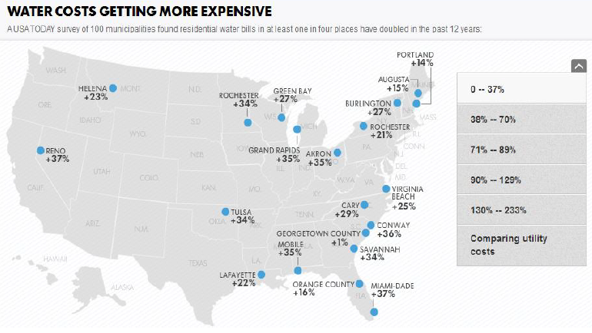
Early Signs of the New Age of Water
Water prices are rising– Even in the US
Source: Circle of Blue Pricing Analysis
Notes:
Water scarcity is driving up water prices, even in the most protected markets such as the US.

Slide 11
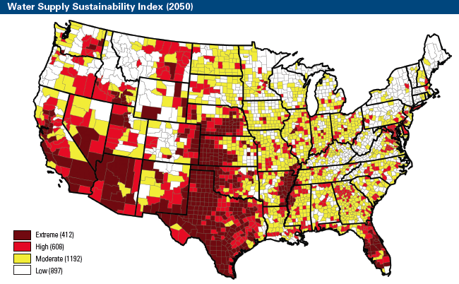
Water Scarcity Drives Dramatic Changes
Water scarcity has outpaced projections, driving the Great Plains and the Southwest to implement aggressive water strategies.
Notes:
Source: NRDC
“The report finds that 14 states face an extreme or high risk to water sustainability, or are likely to see limitations on water availability as demand exceeds supply by 2050. These areas include parts of Arizona, Arkansas, California, Colorado, Florida, Idaho, Kansas, Mississippi, Montana, Nebraska, Nevada, New Mexico, Oklahoma, and Texas. In particular, in the Great Plains and Southwest United States, water sustainability is at extreme risk.
“The more than 400 counties identified as being at greatest risk in the report reflects a 14-times increase from previous estimates,” NRDC said.

Slide 12
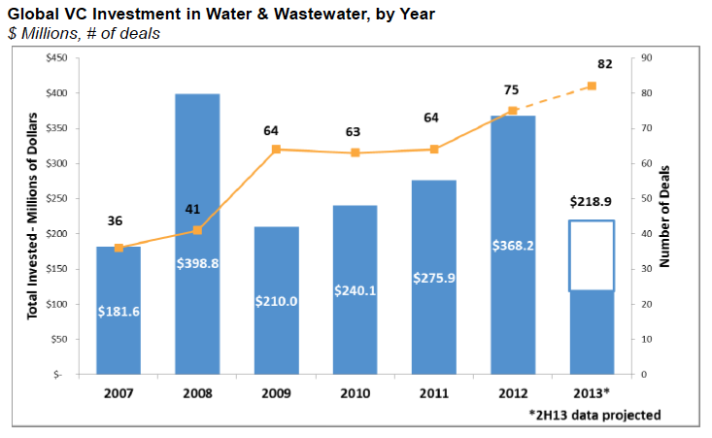
The Velocity Challenge—
Money in? Money out?
Source: The Cleantech Group
Notes:
Its been a tumultuous year and a half for clean technology investors. A series of reports
and studies found that venture investment in cleantech startups dropped significantly in 2012
as traditional investors including insurance companies, pensions, and university endowments
pulled out. That caused big failures at Hudson Clean Energy Partners and VantagePoint Partners,
which admitted defeat on $2.75 billion in combined fundraising as investor interest flagged.
Venture firms responded by raising smaller funds and refocusing on capital-light startups. Deal
volume dropped 25 percent in the first quarter of 2013 from the same period in 2012, and average
deal size plummeted 66 percent to $2 million, according to PwC MoneyTree.
Just how bad were clean-tech investments?
May 1 2013 Cambridge Associates today published its first-ever set of performance statistics statistics on investment into private cleantech companies, based on a data set of over 1,200 deals for 644 companies since 2000. The deals represented over $21 billion in capital from 302 venture capital funds and 106 private equity funds, with nearly three-quarters of the dollars disbursed to U.S. companies.
CA found that these deals produced a gross internal rate of return (IRR) of 6.6% through the end of Q3 2012, and a gross total value to paid in capital multiple of 1.2x. That's several miles below spectacular -- particularly since the net IRR to limited partners is closer to 2.2% -- but it's not the black hole that many have made clean-tech out to be.
Moreover, U.S. clean-tech companies outperformed foreign clean-tech companies, generating a gross company-level IRR of 7%.
CA also broke down clean-tech into four sectors, finding the strongest gross IRR performance in renewable power development (11.4%) and the weakest in resource resolutions (1.4%):
Acccording to the Cleantech Group, Water & Wastewater, at 1,600 companies, is one of the largest taxonomy sectors. Water technologies have a huge impact on Oil & Gas and Agriculture as well as all types of energy generation: this widespread impact is one reason why we're hosting our Water Innovation Summit this September.
Cleantech Overall:
% Change on 2011
Dollars Invested in 2012 $6.8 billion -29.3%
Deal Count in 2012 806 -6.2%
Water & Wastewater:
% Change on 2011
Dollars Invested in 2012 $355 million +34.2%
Deal Count in 2012 65 +14%

Slide 13
Agenda
Introduction to Artemis, Artemis Top 50
The Water Challenge from an Investor’s Eye
Water Tech Today
Smart Water Investment in the Second Wave
Notes:
Draft Outline-- September 11 Breakfast Meeting for the WCTA:
TItle: Driving water investment-- local business leadership
INTRO
Slide 1: Intro to Artemis, Artemis Top 50
Slide 2: Need for water innovation-- growing water scarcity
-Challenges will require more than new policy and incremental improvements in existing processes
--Start-ups--In other industries introduce game-changing solutions and drive industry change
Slide 3: Deal velocity
-- Artemis Top 50 is a diverse group, provides an "index" for the water tech industry. Critical challenge to growth is a lack of "deal velocity": time for start-ups to raise money, time for start ups to provide returns to investors.
--Cleantech Group estimate on venture capital funding for water start-ups-- 2005-2013
Slide 4:
--Seed investment is critical: not just the money, but long-term oriented investors are critical
--the best have:
------"deep pockets" for follow-on investment, experience and success from start-ups (often in adjacent industries)
------connections with leaders a) corporate water users b) executives in the water industry
--Most successful start-ups bring in more than one investor, best situation is a community of active investors that provide a consistent approach over a period of years
Case studies:
-International: Israel-- local business people invested in the first VCs, local business people and foreigner with ties to Israel are still responsible for 80% of investment in early-stage tech start-ups, including water.-- E.g., Aqwise, Emefcy, Takadu
-National:
--Albuquerque, New Mexico
--Portland, OR
--Boston, MA
--Milwaukee, WI
--Denver, CO
--Fresno, CA
Emerging: North Carolina, Cincinnati
While investors are generally aware of the growing importance of water in business operations, it will not be a factor until business operations suffer more serious problems.
Perpetual life funds, such as the the sovereign wealth funds and endowments, that manage large investment funds for the long term, are leading the drive for investment in water. While water is already emerging as a promising technology investment theme, the world’s largest funds can raise the profile of water tech as an important investment vehicle.

Slide 14
The Future of Water Investment
As the first water tech leaders emerging and gain market scale, new investment structures are opening up
2015
2013
2000-2010
Large pension funds, endowments and other PE funds are looking to water tech as a real asset investment, and as a hedge against water scarcity.
14 Artemis Water Strategy Proprietary Sep-9-13
Notes:
Water is destined to be decisive for all business in the future. Increasingly, water tech is not considered based on its technology, but on the solution that it applies in the field and the bottom line benefits that it generates. The best solutions that we see today are competing successfully with established approaches.
Going forward, water infrastructure is a great focus for investment in real assets. A water smart grid project is optimizing infrastructure that is mission critical and supported by local government. Project financing can support the capital requirements of a project without diluting the equity of early-stage investors, such as venture capital funds.
Natural resources-- timber, agricultural lands, energy and water is a high-profile growth area for private equity investment. We are beginning to see a few leading-edge investment managers structuring PE funds to reduce risk and capture the upside of water management. How do the early leaders in water tech fit this model? The answer is critical to the success of water tech start-ups, as well as investors looking at investments in emerging growth water tech companies.
The challenge today is to identify intersection between solutions that are emerging into wide scale application and those that create a low-risk, wide-scale investment opportunity for project management. Looking for an investment model comparable to leasing rail cars.
Best targets for a fund:
Almost half (47 percent) of U.S. shale gas and oil wells are being developed in regions with high to extremely high water stress. This means that more than 80 percent of the annual available water is being withdrawn by municipal, industrial and agricultural users in these regions. Overall, 75 percent of wells are located in regions with medium or higher baseline water stress levels.

Slide 15
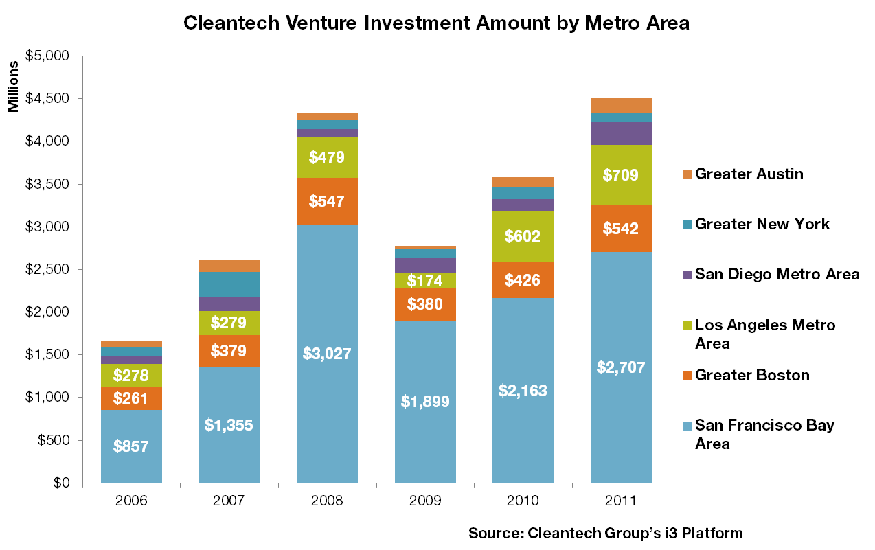
What is the role of local communities in launching start-ups?
Notes:
In contrast to investments in public stocks, early stage investors have the ability to drive the success of promising tech companies. Local investors provide critical support:
-local due diligence
-recruit new executives
-introduction to potential pilot sites and early customers
-bringing in local suppliers-- banks, lawyers, recruiters
-business strategy advice
**Bridge to larger investors. Formally organized funds value the presence of a board and investors that bring strong business experience and can be present on a regular basis.
Israel provides a compelling example: In the 1990s, the Israeli government sponsored 7 small venture funds established by local business people. Those funds have brought in the world’s leading investors--- from Kleiner Perkins to Sequoia to Syngenta.

Slide 16
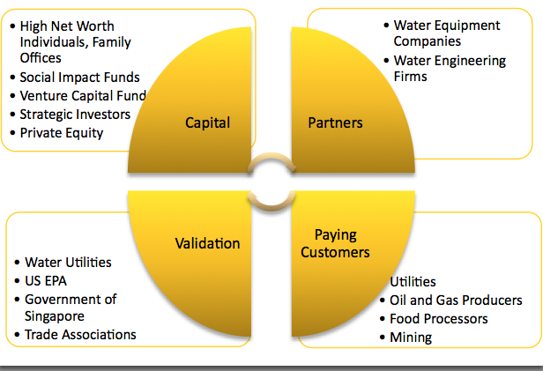
The Artemis Quadrinity:
Barriers to Entry for Water Tech Start-ups
Regardless of their plans, every water tech start-up that has succeeded in the past decade has addressed these four targets concurrently.
Notes:
If you’re looking at an early stage water tech company, you need to gauge its ability to address these four barriers to entry.

Slide 17
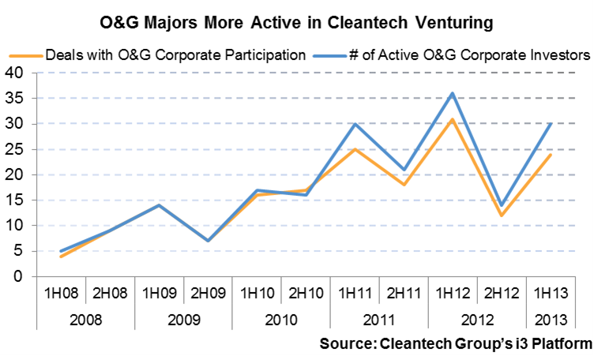
Defining Moment for a Start-Up: The First Blue Chip Customer
“it’s often about “identifying [a start-up's] sweet spots” in niche markets..that’s a challenge that someone with industry experience is particularly well-suited to help navigate.”
Notes:
Early-stage investors have been decisive in bringing in corporate customers, some of which have also invested in start-ups.
Mr. Gires’ move from a position of leadership at one of the largest traditional O&G companies to cleantech venture capital could well be a bellwether for the sector. VCs have already made a significant pivot in recent years toward conventional energy (see chart). Concurrently, as demonstrated in the first half of this post, O&G corporates are partnering with and investing in growth-stage cleantech startups more than ever before. Now, the transition of O&G industry veterans like Gires into partner roles at cleantech venture firms is bringing deeper expertise to early-stage technology support, and can only serve to bolster start-ups’ chances of being successful. As Gires put it, it’s often about “identifying [a start-up's] sweet spots” in niche markets. And that’s a challenge that someone with Gires’ experience is particularly well-suited to help navigate.
Domain experts in cleantech venture firms bring deeper expertise to early-stage technology support, and can only serve to bolster start-ups’ chances of being successful. As Gires put it, it’s often about “identifying [a start-up's] sweet spots” in niche markets. And that’s a challenge that someone with industry experience is particularly well-suited to help navigate.

