Slide 1
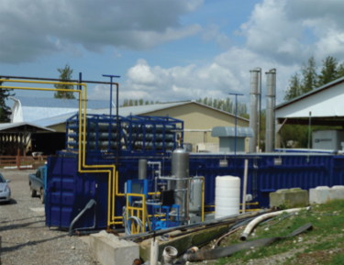
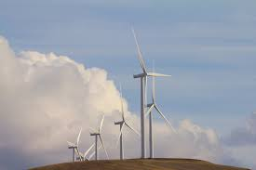

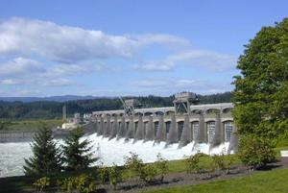
Task 1 Results
Evaluation of Approaches to Reduce Greenhouse Gas Emissions in Washington State
September 11, 2013

Slide 2
Task 1 Scope of Work
Analyze WA State’s total consumption and expenditures for energy by fuel category and sources of the fuels, including imports of foreign oil and other fossil fuels; and analyze the trends in price and consumption since 1990
Evaluate the existing state level GHG emissions reduction policies that will contribute to meeting the targets
Analyze the state’s non-energy sources of GHG emissions, such as cement production and agricultural sources
Evaluate significant GHG emissions reduction initiatives undertaken by local governments in WA.
Analyze the overall effect on global GHG levels if WA achieves its targets

Slide 3
Task 1 in Context
How does Task 1 fit into the overall project?
Task 1 sets the stage for all further analyses, which include:
  Task 2 – evaluate GHG emissions reduction programs outside of Washington
  Task 3 – quantify contribution to State’s emissions reduction from federal policies
  Task 4 – Final Report – consider results from Tasks 1-3, including policy interactions
  Task 5 – provide technical support to CLEW for meetings and public hearings, make adjustments to analysis provided in Tasks 1-3, or offer new analyses as directed
Next Steps?
Tasks 2 and 3 are in progress and will be presented at CLEW’s 9/27 meeting
Task 4 Report draft follows quickly thereafter, draft at the end of September

Slide 4
How Task 1 Will Feed Into Recommendations
Sets the stage
Where are we now?
What are the GHG drivers?
What are the trends?
Provides context for evaluation of new policies
How much can we expect to achieve through existing policies?
Provides lessons that may inform future policies

Slide 5
Task 1a –Washington State’s Total Consumption and Expenditures for Energy

Slide 6
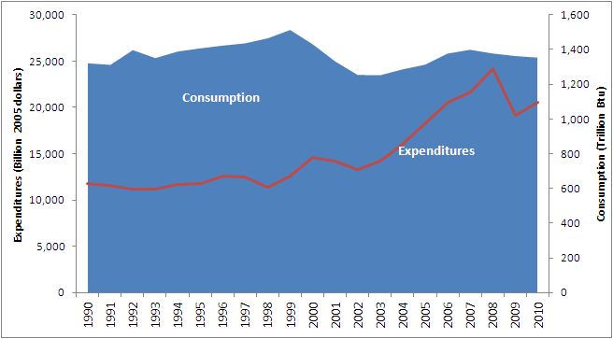
Task 1a –Washington State’s Total Consumption and Expenditures for Energy
Source: WA Dept. of Commerce 2013 Biennial Energy Report
Source: EIA SEDS

Slide 7
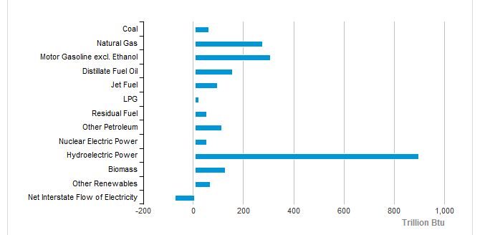
Task 1a –Washington State’s Total Energy Consumption, 2011
Source: EIA SEDS

Slide 8
Task 1a –Washington State’s Total Consumption and Expenditures for Energy – Analysis of GHG Emissions
WA State GHG Emissions by Source, 2010. Source: WA 2010 GHG Inventory

Slide 9
Task 1b – Evaluation of Existing Policies That Will Contribute to GHG Targets

Slide 10
Task 1b – Evaluation of Existing Policies That Will Contribute to GHG Targets
 | GHG Emission Reductions in Target Years (Million Metric Tons CO₂e)
Existing Policy | 2020 | 2035 | 2050
Renewable Fuel Standard | 0.3 | 0.4 | 0.5
Washington State Energy Code | 1.2 | 4.5 | 4.1
GHG Emissions Performance Standards | 0 | 2.9 | N/A
Appliance Standards | 0.7 | 0.9 | N/A
Energy Independence Act (I-937) | 11.2 | N/A | N/A
Energy Efficiency and Energy Consumption Programs for Public Buildings | 0.03 | 0.04 | 0.04
Conversion of Public Fleet to Clean Fuels | 0.03 | 0.04 | 0.05
Purchasing of Clean Cars | 5.0 | 10.0 | 11.7
Growth Management Act | 1.6 | 2.4 | 2.6
Note: Reductions for each policy are not additive because interactions are not accounted for in these values.

Slide 11
Task 1 b - Renewable Fuels Standard
 | GHG Emission Reductions in Target Years (MMTCO₂e)
Existing Policy | 2020 | 2035 | 2050
Renewable Fuel Standard | 0.3 | 0.4 | 0.5
Policy defined - starting in 2008, at least:
  2% of total gasoline sold in WA must be ethanol
  2% of total diesel fuel sold in WA must be biodiesel or renewable diesel
  Results presented are associated with an RFS of 5%, biodiesel only.
Key data sources
  Office of Financial Management Transportation Revenue Forecast Council
  Carbon intensities for fuels - A Low Carbon Fuel Standard in Washington: Informing the Decision and California ARB - LCFS
Assumptions
  Feedstocks
  Policy modification allows for successful implementation

Slide 12
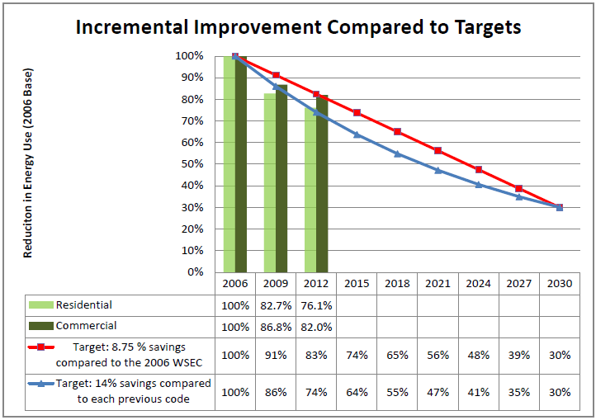
Task 1 b – Washington State Energy Code
 | GHG Emission Reductions in Target Years (MMTCO₂e)
Existing Policy | 2020 | 2035 | 2050
Washington State Energy Code (WSEC) | 1.2 | 4.5 | 4.1
Policy defined
  Building energy codes must achieve a 70% reduction in annual net energy for new bldgs
Key data sources
  Baseline energy use data from NEEA reports
  Residential new construction forecast based on U.S. Dept. of Commerce data
  Commercial new construction forecast based on Sixth Power Plan (adjusted for recession)
Assumptions
  Policy only impacts buildings constructed through 2033 but reductions persist at flat rate 2034-2050
  Only savings for new construction considered
  New construction rates recover from recession by about 2018
  Electricity EFs continually improve over time

Slide 13
Task 1 b – GHG Emissions Performance Standards
 | GHG Emission Reductions in Target Years (MMTCO₂e)
Existing Policy | 2020 | 2035 | 2050
GHG Emissions Performance Standards | 0 | 2.9 | N/A
Policy defined
  Baseload electricity generation – the lower of 1,100 lb/MWh or average output of a Combined Cycle Combustion Turbine (CCCT)
  Quantification reflects reductions associated with Centralia’s compliance with EPS
  Developed in consultation with WA State Energy Office
Key data sources
  Power purchase agreement through 2025 between TransAlta and PSE
  Fuel Mix Disclosure data, PSE purchases, total coal power market purchases
Assumptions
  Electricity generated at Centralia that is ultimately consumed in Washington includes:
    power purchases from PSE and
    50% of additional market purchases
  Replaced with electricity from 90% natural gas CCCT and 10% renewable resources.

Slide 14
Task 1 b – Appliance Standards
 | GHG Emission Reductions in Target Years (MMTCO₂e)
Existing Policy | 2020 | 2035 | 2050
Appliance Standards | 0.7 | 0.9 | N/A
Policy defined as efficiency standards for products not yet superseded by Federal standards
  Wine chillers designed and sold for use by an individual
  Hot water dispensers and mini-tank electric water heaters
  Bottle-type water dispensers
  Pool heaters, residential pool pumps, and portable electric spas
  Commercial hot food holding cabinets
Key data sources
  American Council for an Energy Efficient Economy (ACEEE)
  Appliance Standards Awareness Project (ASAP)
  Personal communication with Washington State Department of Commerce staff
Assumptions
  A national study (with adjustments) applies to WA

Slide 15
Task 1 b – Energy Independence Act (I-937)
 | GHG Emission Reductions in Target Years (MMTCO₂e)
Existing Policy | 2020 | 2035 | 2050
Energy Independence Act (I-937) | 11.2 | N/A | N/A
Policy defined
  Large utilities to obtain 15% of their electricity from new renewables by 2020 and to undertake cost-effective energy conservation
Key data sources
  Fuel Mix Disclosure data
  NPCC Sixth Power Plan for historic and forecast load growth
  Washington CAT 2007 policy analysis for non-fossil mix of resources for new electricity demand
  U.S. EIA Annual Energy Outlook for Electric Power Projection for additions to future fossil fuel mix
  NWPCC Conservation Target Calculator
Assumptions
  2007 represents BAU baseline consumption and fuel mix
  Regional load growth data between 2007 and 2010 (total 3 year growth of 0.8%)
  After 2010, forecast energy load through 2030 based on annual load growth of 1.4%, as forecasted in Power Plan
  Utilities will meet RPS in 2012, 2016; however we assume that not all will in 2020, only getting to 12% by 2020 before hitting cost caps

Slide 16
Task 1 b – Energy Efficiency and Energy Consumption Programs for Public Buildings
 | GHG Emission Reductions in Target Years (MMTCO₂e)
Existing Policy | 2020 | 2035 | 2050
Energy Efficiency and Energy Consumption Programs for Public Buildings | 0.03 | 0.04 | 0.04
Policy defined
  Certain state-funded “major facility projects” must meet high performance building requirements – LEED Silver
  State agencies, higher ed, and public schools
  Qualifying “major facility projects” of new construction and renovation
Key data sources
  Baseline Energy Use Index Of The 2002-2004 Nonresidential Sector: Idaho, Montana, Oregon, And Washington
  2012 Facilities Inventory System (FIS) and System Report - data for State-owned buildings.
  NPCC Sixth Power Plan – K-12 floor space forecast including floor space retirement rate
Assumptions
  Newly constructed high-performance State-owned buildings are 10% more efficient, on average, than facilities built according to the minimum effective energy code requirements.

Slide 17
Task 1 b – Conversion of Public Fleet to Clean Fuels
 | GHG Emission Reductions in Target Years (MMTCO₂e)
Existing Policy | 2020 | 2035 | 2050
Conversion of Public Fleet to Clean Fuels | 0.03 | 0.04 | 0.05
Policy defined
  State & local governments must satisfy vehicle & vessel fuel usage with electricity or biofuel
  40% by June 1, 2013
  100% by June 1, 2015
Key data sources
  State agency biannual diesel and biodiesel consumption data submitted to Dept. of Commerce
Assumptions
  Annual diesel and gasoline consumption will remain flat, equivalent to avg. consumption in recent years’ data, with increases to be offset by efficiency gains
  Diesel vehicles and WSF fleet meet but do not exceed B20 by 2020; maintain through target years
  Future shares of biodiesel feedstocks developed with Department of Commerce staff
  EVs are assumed to replace 60% of agency gas vehicles in 2020, 75% in 2035, and 85% in 2050
  CNG displaces 10% of gasoline consumption after 2020

Slide 18
Task 1 b – Purchasing of Clean Cars
 | GHG Emission Reductions in Target Years (MMTCO₂e)
Existing Policy | 2020 | 2035 | 2050
Purchasing of Clean Cars | 5.0 | 10.0 | 11.7
Policy defined
  California Pavley Standards for vehicle model year 2009-2016 and California LEV III GHG emission standards for vehicle model years 2017-2025
Key data sources
  ARB assessments and reports associated with Pavley Standards and LEV III
Assumptions
  5 MMtCO₂e/year achieved by Pavley is constant for each year and therefore added to the LEV III Reductions

Slide 19
Task 1 b –Growth Management Act
 | GHG Emission Reductions in Target Years (MMTCO₂e)
Existing Policy | 2020 | 2035 | 2050
Growth Management Act | 1.6 | 2.4 | 2.6
Policy defined
  1990 framework for land-use planning
  It enables but does not require local government planning to encourage Compact Transit-Oriented Development
Key data sources
  Washington 2008 CAT, Transportation Implementation Working Group, Appx. 4
Assumptions
  CTOD Strategy and estimate prepared by the CAT for 2020 is assumed most representative of the GMA policy
  Assumed growth rate gradually decreases from 3% to 1% per year 2020- 2050

Slide 20
Task 1c – Non-Energy Sources of GHG Emissions

Slide 21
Task 1c – Non-Energy Sources of GHG Emissions
Industrial Processes
  Category includes
    Manufacturing of cement, petrochemicals, aluminum
    Leakage and fugitive emissions of ODS substitutes HFCs, PFCs, and SF₆
  3.8 MMTCO₂e, or 4% of total in 2010
Waste Management
  Category includes
    Landfills, wastewater treatment, composting
  3.8 MMTCO₂e in 2010, or 4% of total
Agriculture
  Category includes
    Enteric fermentation by livestock, manure management, and agricultural soils
  5.2 MMTCO₂e, or 5.4% of total in 2010

Slide 22
Task 1d – Washington State Counties’ and the City of Seattle’s GHG Reduction Initiatives

Slide 23
Task 1d – Washington State Counties’ and the City of Seattle’s GHG Reduction Initiatives
 | CAP | GHG Inventory | Sustainability Report | Land use strategies | Traffic Mgmt. | Alt. fuel/ EVs | CTR | Weather-ization | Energy Eff. | Green Purchasing | Waste Red. | Ded. Staff | Member-ships | Data Available/ Reporting
Benton/ Franklin |  |  |  |  | ✓ | ✓ | ✓ | ✓
Clallam | ✓ | ✓ |  | ✓ |  | ✓ |  | ✓ | ✓ |  | ✓ | ✓ | ✓
Clark |  | ✓ | ✓ | ✓ | ✓ | ✓ | ✓ | ✓ | ✓ | ✓ | ✓ |  | ✓ | ✓
Cowlitz |  |  |  |  |  |  |  | ✓ | ✓
Island | ✓ | ✓ |  |  | ✓ | ✓ | ✓ | ✓ | ✓ |  |  |  | ✓
King | ✓ | ✓ | ✓ | ✓ | ✓ | ✓ | ✓ | ✓ | ✓ | ✓ | ✓ | ✓ | ✓ | ✓
Kitsap |  |  |  |  |  |  | ✓ | ✓ |  |  |  | ✓
Klickitat |  |  |  | ✓ |  |  |  | ✓ | ✓ |  |  |  |  | ✓
Pacific |  |  |  | ✓ | ✓ | ✓ | ✓ | ✓ | ✓ | ✓ | ✓
Pierce |  | ✓ | ✓ | ✓ | ✓ | ✓ | ✓ | ✓ | ✓ | ✓ | ✓ | ✓ |  | ✓
San Juan |  |  |  | ✓ | ✓ | ✓ | ✓ | ✓ | ✓ | ✓ | ✓ |  |  | ✓
Seattle | ✓ | ✓ |  | ✓ | ✓ | ✓ | ✓ | ✓ | ✓ | ✓ | ✓ | ✓ | ✓ | ✓
Skagit | ✓ | ✓ |  | ✓ | ✓ | ✓ |  | ✓ | ✓ | ✓ | ✓ | ✓ | ✓ | ✓
Snohomish | ✓ | ✓ |  | ✓ | ✓ | ✓ | ✓ | ✓ | ✓ | ✓ | ✓ | ✓ | ✓
Stevens |  |  |  | ✓ |  |  | ✓ | ✓ | ✓ |  | ✓
Thurston | ✓ | ✓ | ✓ | ✓ |  | ✓ | ✓ | ✓ | ✓ | ✓ | ✓ | ✓ | ✓ | ✓
Walla Walla |  |  |  | ✓ | ✓ |  | ✓ | ✓ | ✓ | ✓
Whatcom | ✓ | ✓ |  |  | ✓ | ✓ | ✓ | ✓ | ✓ |  | ✓ |  | ✓ | ✓

Slide 24
Task 1e –Overall Effect on Global GHG Levels if WA Achieves Its Targets

Slide 25
Task 1e –Overall Effect on Global GHG Levels if WA Achieves Its Targets
In perspective
2010 GHG Emissions
  The world, CO2 from energy: 31,502 MMTCO₂
  U.S. CO2 from energy: 5637 MMTCO₂
  WA, total CO2e all sources: 96.1 MMTCO₂e
  WA, CO2e from energy: 82.6 MMTCO₂e
If WA was a country, it would be 43rd
  After China, USA, Russia, India, & Japan…
  WA falls between Kuwait and Chile
Global emissions projected to increase
If WA achieves its goals
Not a large share of world emissions
Leadership matters – WA influences other states, the nation, other nations
WA Baseline, Current, and Target GHG Emissions (MMTCO₂e)
1990 | 2010 | 2020 | 2035 | 2050
88.4 | 96.1 | 88.4 | 66.3 | 44.2

