Slide 1
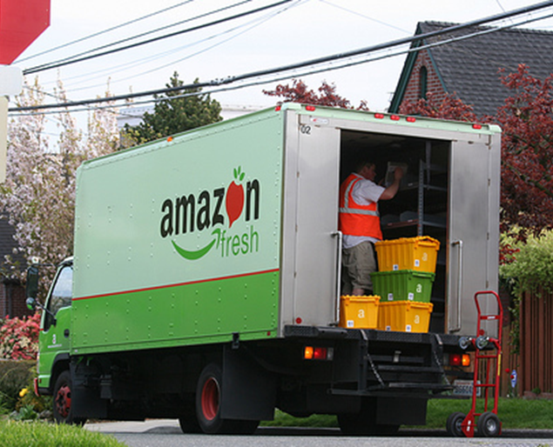
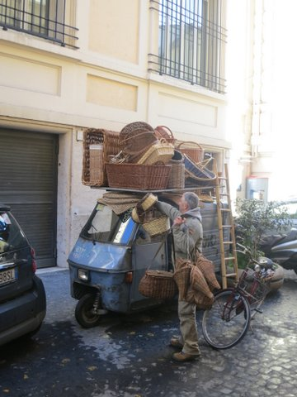
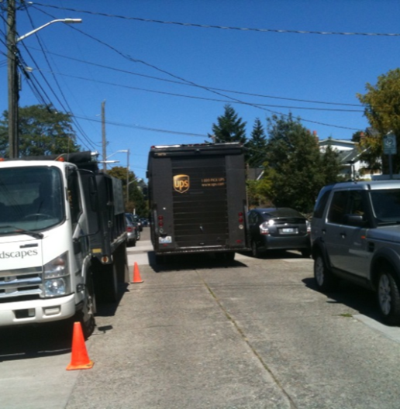
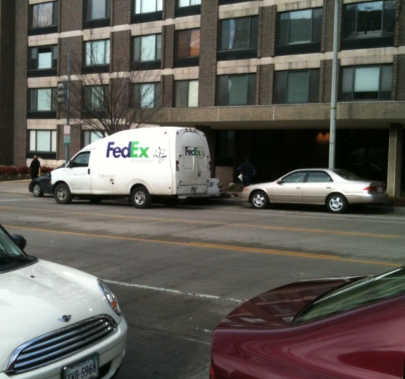
Sustainability Impacts of Changing Retail Behavior
http://www.belltowner.com/2008/05/amazon-fresh-now-available-in.html
Anne Goodchild, PhD
Erica Wygonik
Goods Movement Collaborative
University of Washington
Notes:
As we have heard already this afternoon, freight vehicle volumes are steadily increasing, but have very large impacts in terms of energy use and environmental impacts.

Slide 2
Online Shopping is Growing
What is the impact on the sustainability and the transportation system?
Substitution of freight for passenger travel
Look at the example of grocery delivery in Seattle

Slide 3
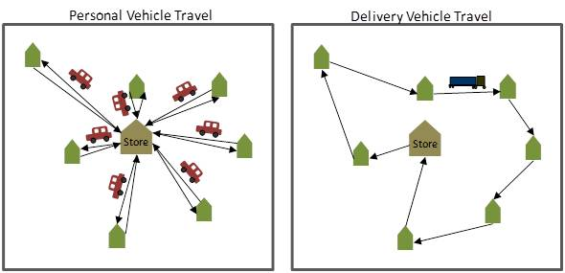
The Bus for Groceries

Slide 4
Routing of the two logistics bounding cases
Random selection Proximity assignment
Notes:
The results for the delivery service routing look like this.
As you can see, the sampling significantly affects the distance travelled by the delivery vehicle.
in each case 35 households are served,
the delivery vehicle drives far further when serving randomly selected households.
These graphics represent one truck of routing serving two different samples –
they are not serving the same households,
though they serve the same number of households.

Slide 5
Impact on VMT

Slide 6
Impact on CO2

Slide 7
Vehicle Substitution Results
Delivery vehicles require far fewer feet of travel when customers are clustered
  Randomly-selected: 70-90% reductions
  Proximity-assignment: 90-95% reductions
Significant CO₂ reductions are possible when delivery vehicles serve clustered customers
  Randomly-selected: 20-75% reductions
  Proximity-assigned: 80-90% reductions

Slide 8
For the individual
By doing shopping online with a reasonably efficient service you can:
  Cut your CO2 impact by half
Assumptions
  Previously drove to the store
  No trip chaining
  Store is also source of new delivery

Slide 9
Tradeoffs
What is the relationship between:
  financial cost
  CO2 emissions
  Service quality
We find ample opportunities to:
  reduce BOTH CO2 and cost
  Service quality increases
    Financial cost
    CO2

Slide 10
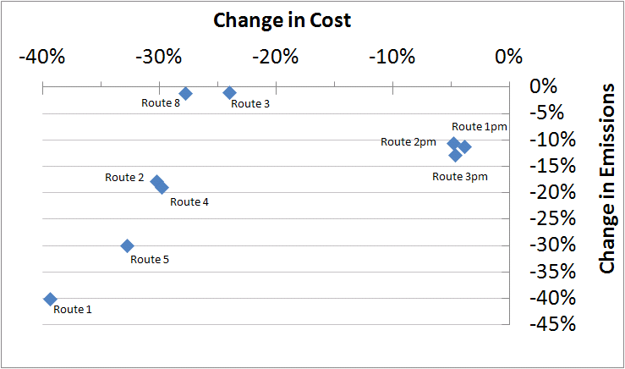
UWMS Results

Slide 11
Questions?
http://www.belltowner.com/2008/05/amazon-fresh-now-available-in.html

Slide 12
Additional References
Wygonik, E. and A. Goodchild. (2012). Evaluating the Efficacy of Shared-use Vehicles for Reducing Greenhouse Gas Emissions: A Case Study of Grocery Delivery in Seattle. Journal of the Transportation Research Forum, Vol 51. No. 2, 111-126.
Pitera, K., Sandoval, F., & Goodchild, A. (2011). Evaluation of Emissions Reduction in Urban Pickup Systems. Transportation Research Record: Journal of the Transportation Research Board, 2224(-1), 8-16.
Wygonik, E. and A. Goodchild. (2011). Evaluating CO₂ emissions, cost, and service quality trade-offs in an urban delivery system case study. IATSS Research, doi:10.1016/j.iatssr.2011.05.001.

Slide 13
Using an ArcGIS Model
Extend roadway information to include cost data
Use the VRP tool to optimize on chosen cost metric
Feed solution through the Traveling Salesman Problem tool to collect all other cost information
Works well for:
  dense networks
  homogeneous fleets
No control over optimization algorithm

Slide 14
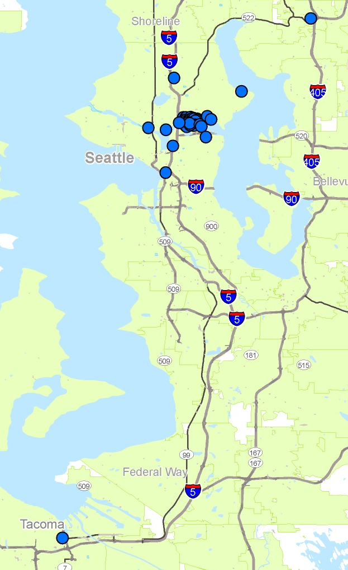
First test case: UWMS
56 customers
Delivery of packages and mail
7 morning routes
5 afternoon routes
Fixed arrival time
Seattle
45 miles

Slide 15
Metaheuristic Design
Creation algorithm features:
  I1 algorithm (Solomon 1987)
  Seed with customer with earliest time window
  With parameter values of 0.5 for α1, α2, μ, and λ
  Establishes an initial feasible solution
Improvement algorithm features:
  2-opt (Braysy & Gendreau 2005)
  Trades two travel links both between and within routes
  Accepts trades that reduce objective function

Slide 16
Meeting Energy & Environmental Goals through Logistics
Future Directions
Policy Implications
Some limitations observed applying this metaheuristic to diverse problems
On-going improvement may address this limitation or unique solutions may be required
Routing improvements and technology solutions reduce urban goods movement system impacts
Regional freight movements rely on technological solutions

