Slide 1
WA Clean Tech: Role of Retail
Derek Eisel
derek@Scope5.com
@derekeisel
206 456-5657

Slide 2

Under
Pressure
Customer RFPs
B2Bs
Investor CDP
Employees…

Slide 3

Company Stories
Champion
Understand
Align with Brand

Slide 4
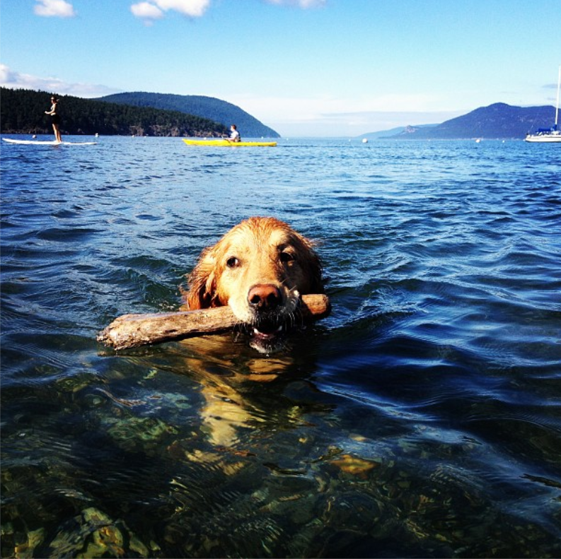
Throw a dog a bone
Consolidate
Modal-moderate
differentiate

Slide 5

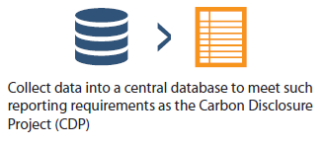
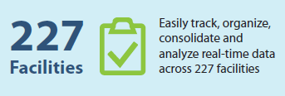
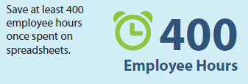
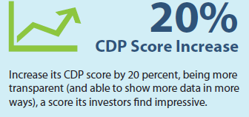
Derek Eisel
derek@Scope5.com
@derekeisel
206 456-5657

