Slide 1
Washington State Biodiesel Use & Lessons Learned
Presented by Atul Deshmane
April 2014

Slide 2
Biodiesel in Washington
Washington State is one of the largest public consumers of biodiesel in the nation
51% of all biodiesel consumed by the state must come from in state sources
Feedstocks for the biodiesel used by Washington State DOT and WSF include canola, camelina, and recycled vegetable oil from the Pacific Northwest and soy beans from the Midwest
While the feedstock has little to no impact on the performance of the fuel, feedstock’s origin and type can greatly affect the lifecycle carbon intensity of the fuel

Slide 3
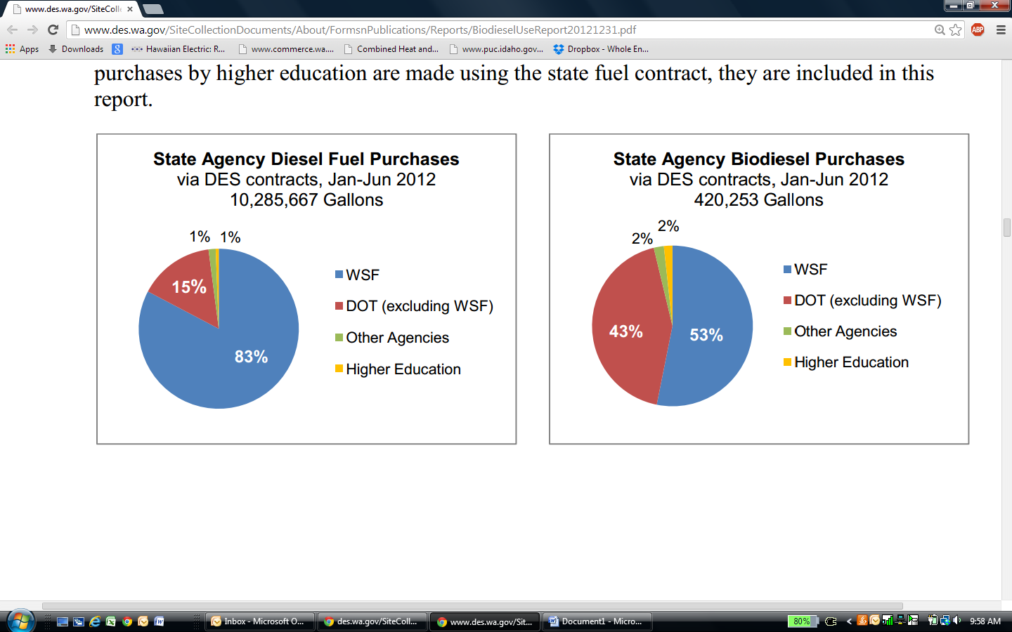
Who’s Using Biodiesel?

Slide 4
Biodiesel Benefits
The EPA’s studies conclude that substituting traditional diesel with B20 results in;
diesel particulate reduced by approximately 10%,
carbon monoxide reduced by 11%
hydrocarbon emissions reduced by 21%.
Supports local jobs and keep US $ in North America
Increased lubricity & higher cetane number
Reduces our dependence on Petroleum and foreign oil

Slide 5
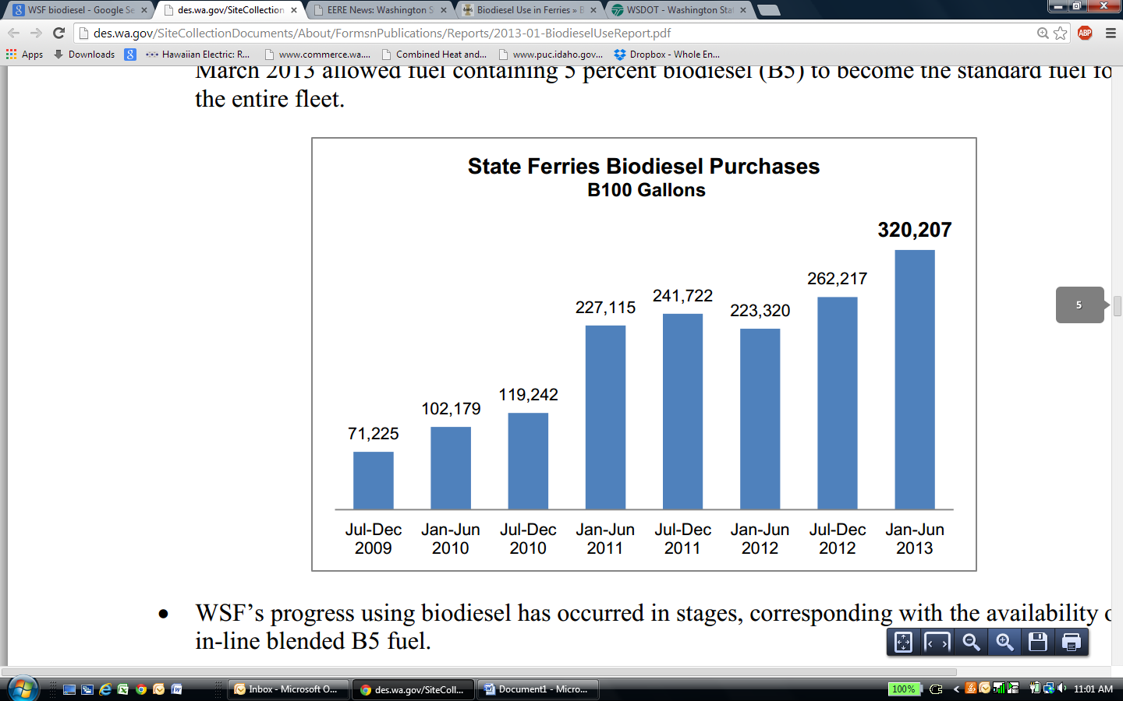
WSF Biodiesel Consumption

Slide 6
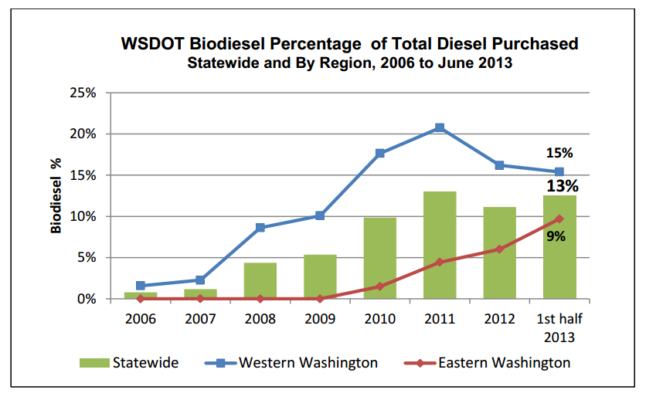
Terrestrial Consumption Statewide
Washington State DOT is the largest consumer of biodiesel in the land use sector, accounting for over 90% of the biodiesel consumed.

Slide 7
Fuel Blends
In Western Washington;
85% of fuel deliveries were B20,
10% were B10
5% were B5
In Eastern Washington B5 is the standard fuel for winter use due to improved performance in cold temperatures.
After April, consumption of B20 and B10 become dominant.
As of May 2012 WSDOT has suspended purchases of blends higher than B20 upon a review of EPA regulations (40 CFR 280.32), and biodiesel materials compatibility and handling guidelines. The review cites the necessity of upgrading the current storage tanks to meet certification requirements for high concentration biodiesel storage.

Slide 8
WA State Biodiesel Mandate
WSF is directed to use a minimum of 5%bbiodiesel in all vessels as long as the price of a B5 biodiesel blend does not exceed the price of diesel by 5% or more.
All other state agencies are directed to use a minimum of 20% biodiesel by total volume to operate diesel vessels, vehicles, and construction equipment.

Slide 9
WSF Infrastructure
WSF has three fueling facilities, all of which have inline blending capability for B-5. The blending infrastructure was installed in stages.
The first WSF facility to use inline blending was the Harbor Island truck facility in August 2009.
The Anacortes facility gained inline blending capability in January 2011.
The last in-line blending system was installed at Seattle Harbor Island dock facility in February 2013 and accounts for 35% of total fuel consumption by WSF.
Since the installation of the Harbor Island Dock facility, B5 has become the standard fuel for WSF.

Slide 10
Biodiesel Handling, Lessons Learned
Fuel contamination
The organic nature of biodiesel opens it up to a range of contamination issues. Many of the early performance issues with biodiesel stemmed from improper fuel handling practices.
Poor handling and storage can lead to the fuel becoming contaminated with water and/or micro organism growth. This can become especially problematic in high humidity and marine environments.
Biocides can be added to the fuel to prevent bacterial growth.
Carful and consistent handling and storage procedures and equipment can help prevent water contamination.
Regular cycling of inventory and cleaning of storage containers is critical to maintain clean, safe, and effective fuel.

Slide 11
Lessons Learned
Cold weather performance
It is not recommended to operate or store B20 or higher fuel blends in freezing temperatures. For this reason Eastern Washington operations use B5 or lower concentrations almost exclusively from November until April, they then switch to higher biodiesel concentrations for the rest of the year to reach their target volume of consumption.
No biodiesel related performance or quality issues were reported for the Jan-June 2013 reporting period.
The average price paid by the state ferries for diesel during Jan-June 2013 was $3.49 per gallon; the average price paid for B5 according to postings was $3.54 per gallon, a difference of less than 1.5 percent

Slide 12
DOT Experience
From the DOT
WSDOT’s experience with biodiesel fuels and testing biodiesel blends up to B90 has demonstrated the importance of:
(1) Managing biodiesel concentration based on climate and conditions;
and (2) limiting biodiesel at sites with low fuel turn-over.
WSDOT continues to employ best practices for using biodiesel. Operational issues include:
Replacing fuel dispenser filters at twice the previous rate.
Using a more porous filter to minimize filter failure.
Monitoring tanks at a higher frequency.

Slide 13
Sources of info.
Biodiesel Use by Washington State Agencies, WSDES, Dec 2013
http://des.wa.gov/SiteCollectionDocuments/About/FormsnPublications/Reports/2013-01-BiodieselUseReport.pdf
Washington State Ferry Biodiesel Research & Demonstration Project, Washington State University, University of Idaho, The Glosten Associates, Inc., Imperium Renewables, Inc.; 2008
http://web.cals.uidaho.edu/biodiesel/files/2013/08/Wa-State-Ferries-Final_Report_April09.pdf

