Slide 1
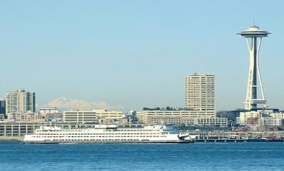
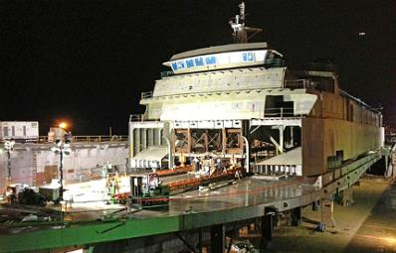
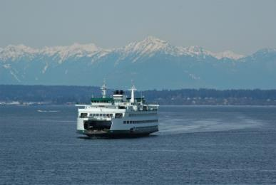
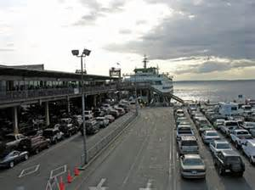
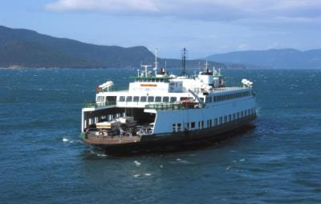
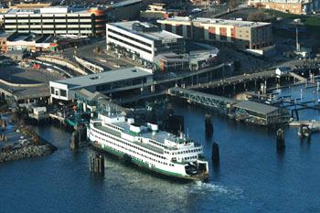
Washington State Ferries
Fuel Efficiencies
Capt. George A. Capacci
Deputy Chief, Operations and Construction
WSDOT Ferries Division
Washington Clean Technology Alliance
April 9, 2014

Slide 2
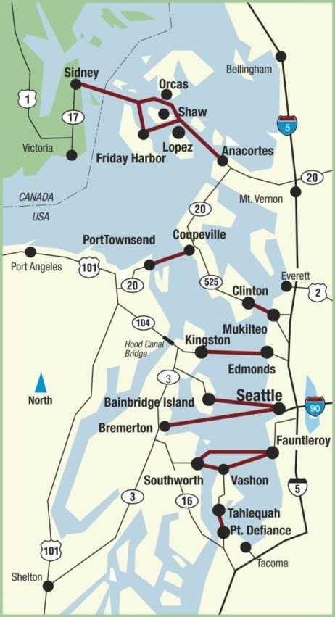
System overview
More than 22 million riders per year
10 million vehicles carried per year
Fleet of 22 auto-passenger ferries, 34 cars to 202 cars
20 terminals on 10 routes
450 departures per day
1800 employees
Nine unions and 11 collective bargaining agreements
2

Slide 3







Existing Washington State ferry fleet
Jumbo Mark II
Super Class
Issaquah Class
Jumbo Class
Hiyu
Kwa-di Tabil Class
Evergreen State
3

Slide 4
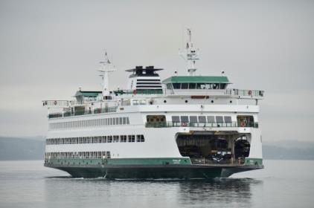
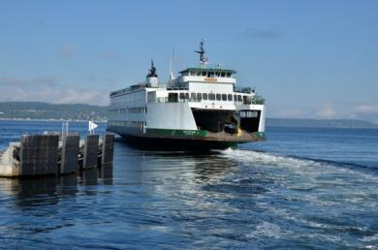
Importance of fuel efficiency
WSF burns more than 17 million gallons of fuel annually
Fuel represents 23 percent of FY13-15 operating budget (compared to 11 percent in FY00-01)

Slide 5
WSF current fuel efficiencies
Propeller redesign/replacement – Jumbo Mark II
Hull coatings
New cylinder and piston assemblies for EMD engines
Operational changes:
  Schedule adjustments during off hours
  Pushing the berth SRPM adjustments
  Kwa-di Tabil class to operate in full feather mode
  Vessel trim – variable vehicle loading
  Increase departure time from 90 to 150 seconds

Slide 6
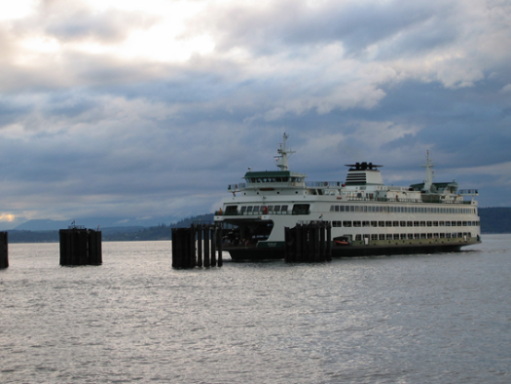
Fuel consumption
Fuel conservation
2012 - the American Association of State Highway and Transportation Officials recognized WSF with the President’s Transportation Award for WSF’s innovative work to save 180,000 gallons of fuel and more than $700,000 per year on the Edmonds/Kingston route.
We are applying this same initiative to other routes in the system.
Shore-based power
Many of our vessels now plug into shore- based power to run the lights/heat during overnight tie-up.

Slide 7
Ultra-low sulfur and biodiesel
Ultra-low sulfur diesel (ULSD)
WSF began using ULSD in 2007 and helped prove that high sulfur fuels were not needed for engine lubrication.
Biodiesel
WSF conducted a pilot biodiesel fuel test in 2004 using B20. The pilot project experienced challenges due to excessive clogging in fuel purifiers and plugging of fuel filters during testing.
WSF conducted additional testing of B20 in 2008.
As of February 2013, all of WSF’s 22 vessels use B5 biodiesel – a blend of 5 percent biodiesel and 95 percent ultra-low sulfur diesel.

Slide 8
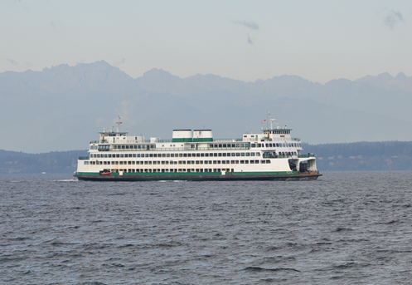
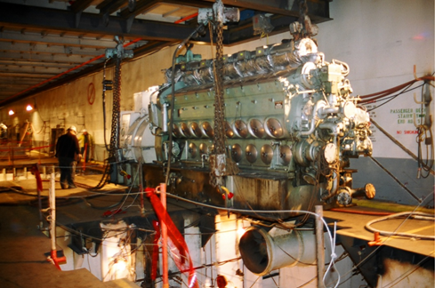
Hyak Hybrid Project
WSF is proposing a combined power management and hybrid concept on the 144-car/2,000-passenger Hyak.
The Hyak burns an average of 1.34 million gallons of fuel per year.
Fuel savings will total about $21.5 million over the remaining life of the vessel.
Estimated completion in 2016.

Slide 9
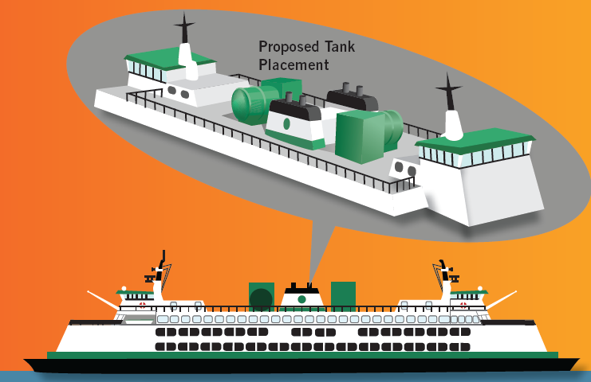
Liquid natural gas conversion
WSF proposes retrofitting 6 Issaquah Class vessels to burn LNG fuel

Slide 10
Opportunities with LNG
Economy:
  Moving from diesel to LNG could save 40-50% at today’s pricing.
Pollutant Reduction:
  WSF is the largest single source of carbon emissions in Washington state government and significant emissions reductions could be achieved with conversion.

Slide 11
Status of LNG project
WSF has conducted nearly 4 years of analysis, evaluation and detailed studies on conversion of existing fleet to LNG.
On Nov. 18, 2013, WSF submitted a formal Letter of Intent (LOI) to the U.S. Coast Guard forwarding Waterway Suitability Assessment (WSA).
WSF is awaiting USCG approval of WSA followed by RFP for detailed design of LNG conversion.
WSF is committed to LNG as a transitional fuel to save money and reduce emissions.

Slide 12
Contact
  Capt. George A. Capacci
  WSDOT Ferries, Deputy Chief, Operations and Construction
  206-515-3414
  CapaccG@wsdot.wa.gov
  For more information, please visit us on the Web:
  www.wsdot.wa.gov/ferries
  LNG: www.wsdot.wa.gov/ferries/environment/LNG
  Hyak: www.wsdot.wa.gov/projects/ferries/hyakpreservation

