Slide 1



Economic Impact of the Maritime Industry
^{in Washington State}

Slide 2
Washington State’s Maritime industry is rooted in the State’s rich history of timber production, its location as a trade hub, and its proximity to some of the world’s most productive fisheries.
The cluster includes the following core sectors:
Passenger Water Transportation
Ship and Boat Building, Maintenance and Repair
Maritime Logistics and Shipping
Fishing and Seafood Processing
Maritime Support Services
Companies in the cluster range from local owner-operated firms, to global Fortune 500 companies.

Slide 3
Annual Economic Impact in Washington
^{Direct Revenue}
$15.2B
^{Additional Revenue*}
$14.8B
Combined Annual Impact to WA Economy
$30B
* Additional revenue refers to indirect impacts associated with first round purchases through suppliers as well as induced impacts through labor income and additional jobs, income, and output resulting from the spending of this income in WA.

Slide 4
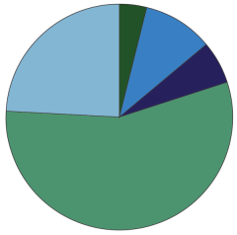
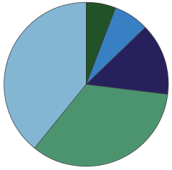

Annual Revenues
($millions)
Number of
Establishments
^{$544.5}
^{$1,489.7}
¹¹⁷
¹³⁴
^{$864.2}
^{$3,722.4}
²⁶⁹
⁷⁵⁰
^{$8,592.6}
⁶⁵⁷
Maritime Logistics and Shipping
Fishing and Seafood Processing
Maritime Support Services
Boat and Ship Building, Repair and Maintenance
Passenger Water Transportation

Slide 5
Fishing and Seafood Processing accounted for nearly 60% of total revenues
Maritime Logistics and Shipping was the second largest contributor, at nearly 25% of total revenues
Revenues cluster-wide have grown an average of 6.4% per year, while Maritime Logistics and Shipping saw the highest growth rate of 10.2%

Slide 6
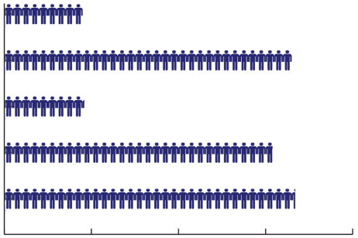
^{Jobs by Industry Subsector}
Passenger Water Transportation
Boat and Ship Building, Repair and Maintenance
Maritime Support Services
Fishing and Seafood Processing
Maritime Logistics and Shipping
⁰
^{5,000}
^{10,000}
^{15,000}
^{20,000}
In 2012, the maritime cluster directly employed 57,700. Indirect and induced maritime jobs accounted for another 90,000, for a total impact of nearly 148,000 jobs in Washington.

Slide 7
Innovation drives growth in each sector of Washington’s Maritime.
Research and resource management has transformed Washington and Alaska’s fisheries from endangered to some of the best managed in the world.
Technological advances have allowed commercial seafood processors to more efficiently use and capitalize total catch of fish.
Lighter building materials (first aluminum, now composites) have enabled boat and ship builders to construct stronger, cheaper, and safer vessels for their customers.
New fuel sources, such as LNG and biofuels, are helping fleets become more fuel efficient and reduce greenhouse gas emissions.

Slide 8
^{New Opportunities for Growth}
Gradual replacement of commercial fishing fleet (vessels no longer tied to quota rights)
Oil, natural gas, rare earth mineral exploration in the Arctic
WSF fleet replacement and conversion

Slide 9
Download the Maritime Cluster
Economic Impact Study at: www.EDC-SeaKing.org/maritime-study
Contact us:
Economic Development Council of Seattle and King County
On the web: www.EDC-SeaKing.org
Facebook: facebook.com/EDCSeattleKingCounty
Twitter: @EDCseattleking

