Slide 1
Port of Seattle Clean Air Strategy
Paul Meyer
Manager, Seaport Environmental

Slide 2
Port Air Quality Plan
Organized around meeting Century Agenda goals through implementation of Northwest Ports Clean Air Strategy objectives.
Reduce air pollutants and carbon emissions, with specific emphasis on:
air pollutant emission reduction by 50 percent from 2005 levels
carbon emission reduction from all seaport operations by 50 percent from 2005 levels
Meet all increased energy needs through conservation and renewable resources

Slide 3
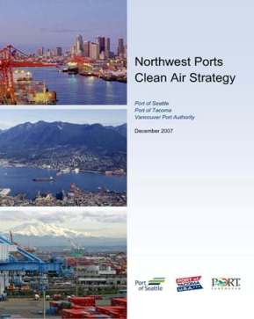
Northwest Ports Clean Air Strategy
Strategy Objectives:
Reduce maritime & port-related air quality impacts
Reduce contribution to climate change by reducing air quality impacts; and
Help the Georgia Basin-Puget Sound Airshed continue to meet/exceed air quality standards

Slide 4
Northwest Ports Clean Air Strategy
Focused on diesel particulate matter and greenhouse gases
Clear, measurable performance measures
Ocean-going vessels (OGV)
Cargo handling equipment (CHE)
Trucks
Rail
Harbor vessels
Encourages ongoing innovation and efficiencies
Short Term and Long Term targets

Slide 5
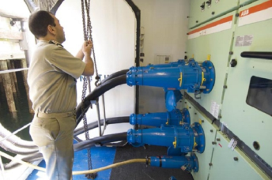
Emission Reduction - Ocean-Going Vessels
The At-Berth Clean Fuels program incentivizes shipping and cruise lines to burn reduced sulfur distillate fuel while at berth
Since 2009, the program has eliminated nearly 900 metric tons of sulfur emissions
Most cruise vessels calling at Terminal 91 use shore power

Slide 6
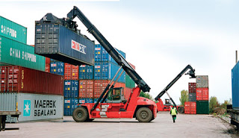
Emission Reduction - Cargo Handling Equipment
Idle-reduction devices installed on yard trucks
Engine block heaters installed on CHE
Retrofitted diesel-powered equipment with diesel particulate filters
Encouraged voluntary use of cleaner and alternative fuels
Notes:
79% of CHE have Tier 2 equivalent or better engines
39% of CHE have Tier 4 equivalent engines.

Slide 7

Emission Reduction - Clean Truck Program
Starting 2011 limited terminal entry to 1994 or newer drayage trucks
In 2013, implemented RFID at all terminal in-gates
Conducted $1.5M program to scrap pre-1994 trucks
Scrapped 280 trucks
Loans for replacements
Initiated planning for a program to scrap pre-2007 trucks

Slide 8
Emission Reduction Progress
Much of the clean air progress is due to significant, voluntary investments of the maritime industry and government agencies in cleaner technology, cleaner fuels and more efficient systems of operation
Notes:
There have been important regulatory changes, such as requirements for cleaner fuel in both on road and off road engines, that have contributed to emission reductions.
Some of the decrease also can be attributed to fewer ship calls and less cargo resulting from a sluggish economy, however, data in the Emissions Inventory report shows both overall and normalized numbers (e.g., per 10,000 tonnes of cargo) have gone down.

Slide 9
Port of Seattle 2005 - 2011 Emission Reductions - SO2

Slide 10
Port of Seattle Emissions Reduction GHG

Slide 11
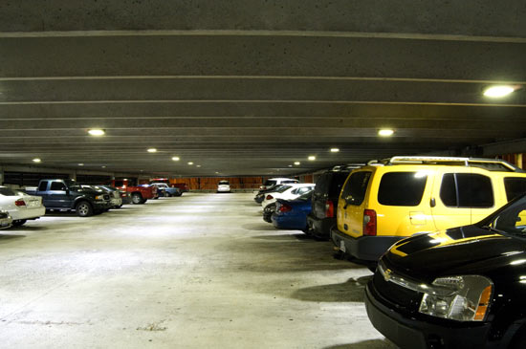
Energy Conservation
LED light demonstration project Bell Street Parking

Slide 12
Terminal 46 Lighting Upgrade
Terminal 46 Lighting Upgrade installed March 2011
Reduced the number of lights on the site from 630 1000 watt bulbs down to 300.
Energy Savings
Energy savings = over 1 million kWh a year
Cost savings of ~$100,000 per year.
GHG’s deferred ~600 ton/year
Business Metrics
NPV after 10yrs $169,140
ROI at 10yrs 61.07%
Simple Payback Yrs 4.88

Slide 13
P69 Energy Conservation Measures
Initiated program in late 2000 in response to energy crisis and Governor’s request to reduce electrical consumption by 10%
Reduced HVAC & lighting schedules
Optimized HVAC equipment operation
Upgraded, repaired, fine-tuned, and closely monitored building control system (DDC system)
Turned off unnecessary lighting
Implemented building wide comfort levels of 70° - 74°
Installed occupancy sensors in all service rooms
Reduced water heater settings to 120°

Slide 14
Energy Conservation Measures
Installed VendingMI$ER™ on vending machines
Increased communications with employees to encourage conservation
Replaced all exit signage with light emitting diode (LED) technology
Replaced 400w metal halide up-lighting in east atrium with new T5 high-output fluorescent fixtures
Replaced 258 PAR 38 floods with LED fixtures
Enrolled the building in ENERGY STAR® “Portfolio Manager” to enable benchmarking of energy usage

Slide 15

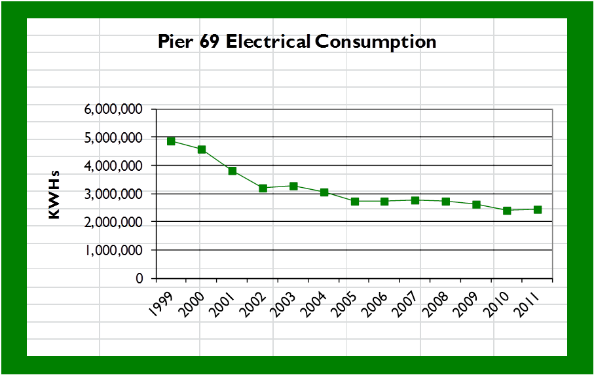
Results
Electrical usage reduced by 50%
Earned ENERGY STAR for Buildings in 2010
4.77 million kWH to 2.39 million KWH, a reduction of 2.38 million KWH,
$160K reduction in annual operating expense
1428tons/yr GHG reduction
equipment optimization and reduction of operating hours reduced equipment wear and tear
Annual indoor air quality (IAQ) complaints reduced by 80%

Slide 16
Terminal 91 Exterior lighting
Replace 381 exterior lighting fixtures at Piers 90, 91 and cruise parking with more efficient fixtures and install lighting controls

Slide 17
Justification
Reduce electrical consumption by over 721,000 kw/hrs per year.
Reduce electricity costs by over $42,000/yr
Defer 497 tons/yr GHG emissions
Reduce maintenance cost by almost $500,000 over 10 years
Reduce light and glare to neighborhoods.

Slide 18
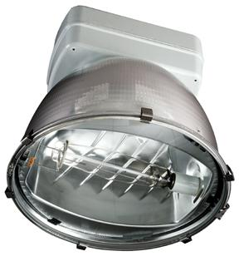
Old Technology
391 1000 watt High pressure sodium Fixtures

Slide 19
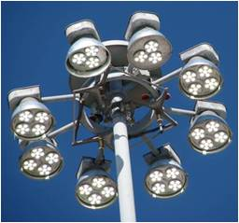
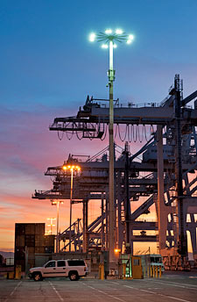
New Technology
LED Luminaires
LEP Luminaires

Slide 20
HPS vs LEP
Existing HPS fixtures:
Consume a lot of energy
Have poor durability
Create a lot of light pollution
Generate light of poor color for night vision
New LEP fixtures
Consume 64% less energy
Have more than 10x durability
Create negligible light pollution
Generate light with the right color for night vision

Slide 21
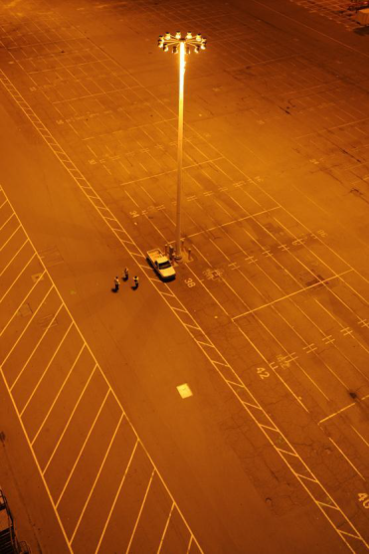
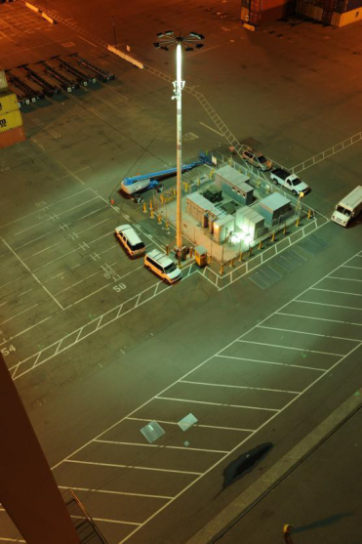
HPS vs. LEP Color (LEP Prototype with “Doughnut”)

Slide 22
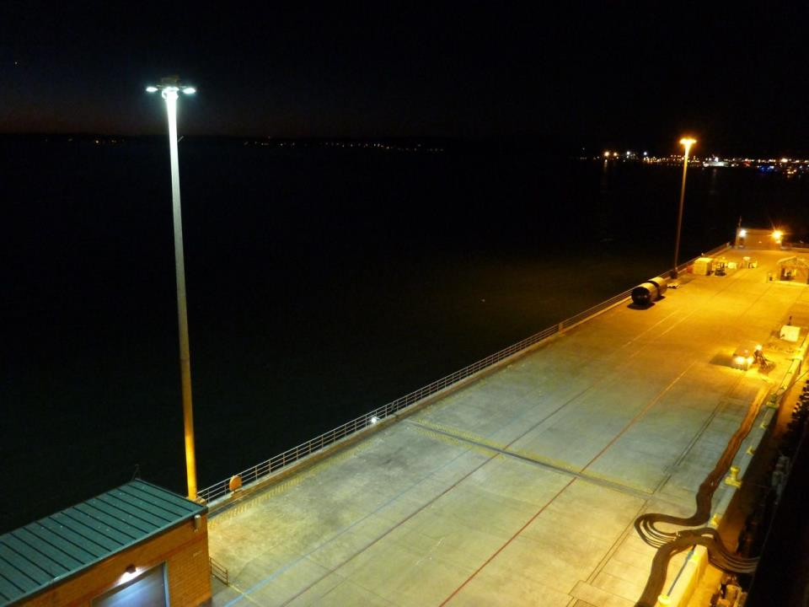

Slide 23
T5 Flyover Access Road
Scope: Provide adaptive street lighting controls to reduce energy and motion sensing to provide full light output when activated during non or low use hours
The Port of Seattle Terminal 5 Flyover access road had HPS cobra heads operating of standard photo control. Installed 42 LED cobra heads with adaptive controls and motion sensors at entry points to activate lights when a vehicle enters during dim or sleep mode periods.

Slide 24
Justification
Reduce electrical consumption by over 45,613 kw/hrs per year.
Reduce electricity costs by over $2,730/yr
Defer 31 tons/yr GHG emissions

Slide 25
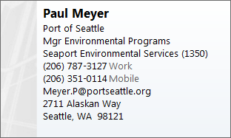
Thank You

