Slide 1

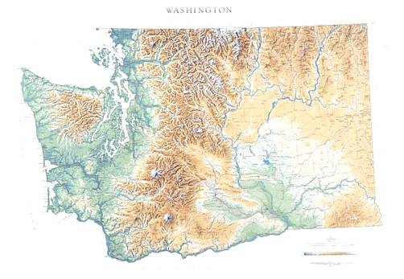
Electric Vehicles - State Policy and Activities
CleanTech Alliance – Government Affairs Committee
August 7, 2018

Slide 2

Washington’s Energy System

Slide 3
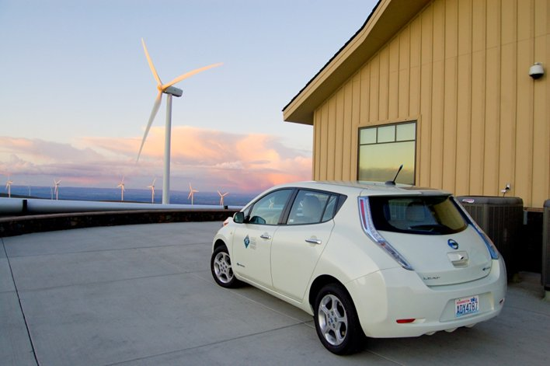
Overview
State Electric Vehicle Goals
Possible 2019 Legislation
VW Settlement
Other State EV Funding
Electric Drive Washington
www.electricdrive.wa.gov

Slide 4
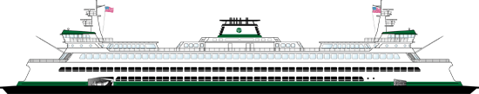
State Electric Vehicle Goals
50,000 EVs statewide by 2020
20% of state light-duty fleet each year
  State Efficiency and Environmental Performance (SEEP) Executive Order 18-01
  Expanded State contract choices
State and local government “extent practicable” standards

Slide 5
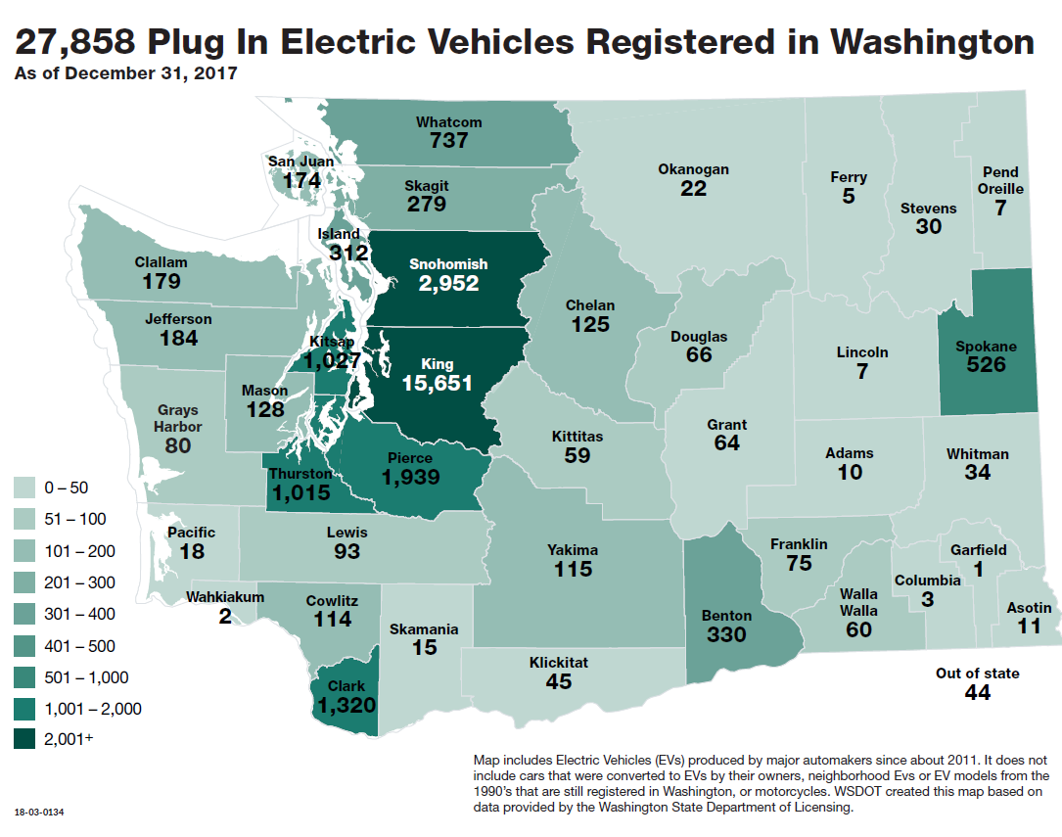

Slide 6
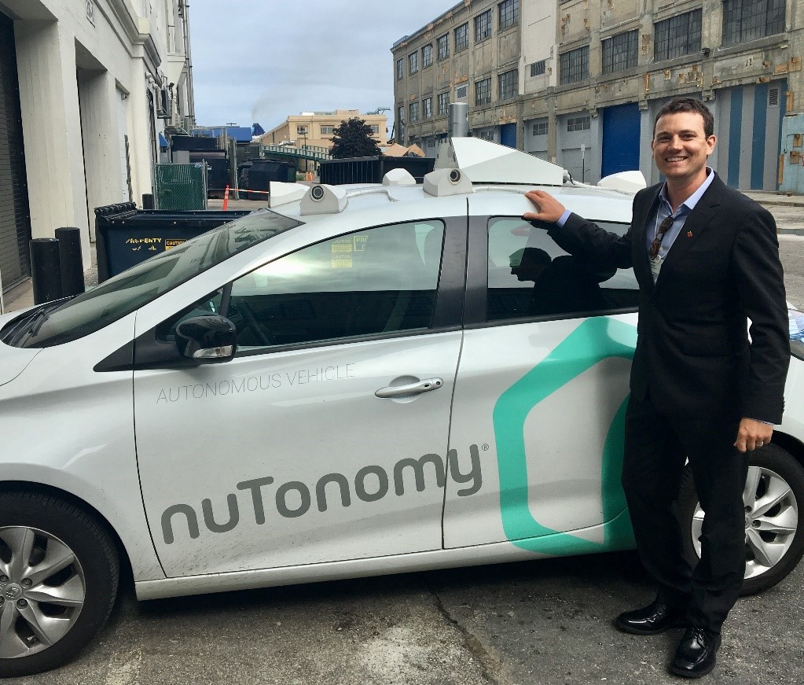
Leading the charge: Inslee promotes an electric transportation future
https://medium.com/wagovernor/leading-the-charge-inslee-promotes-an-electric-transportation-future-7be79bbf2cde

Slide 7
Possible 2019 Legislation
Utility authority to support EVs and infrastructure
Sales tax benefits for EV purchases
Clean fuel standard?
Additional funding for EV support?
Zero Emissions Vehicle (ZEV) mandate?
Technical assistance to local governments?

Slide 8
VW Settlement
State Settlement (already in motion)
  $12M for converting pre-2001 school buses to cleaner alt-fuel or diesel
  $9.75M for converting pre-2007 transit buses to electric
  $5.45M for replacing state gas/diesel vehicles with EVs – working to convert to infrastructure
  $1.2M for ports clean truck fund
Federal Settlement draft released

Slide 9
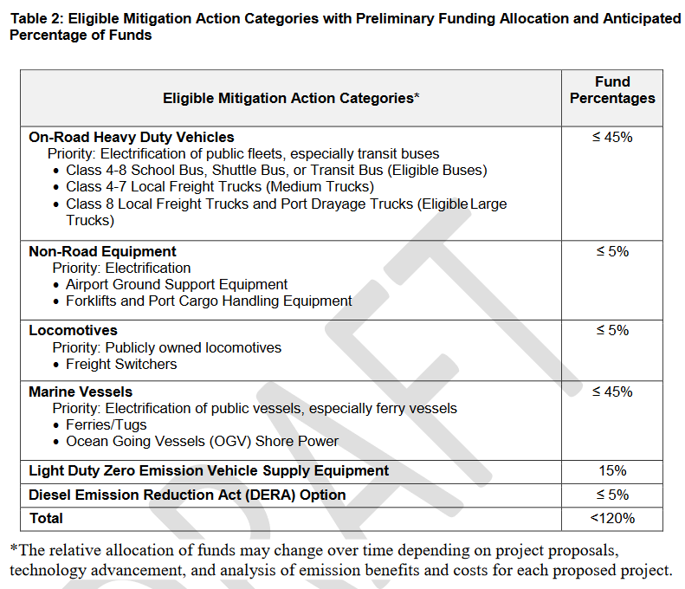
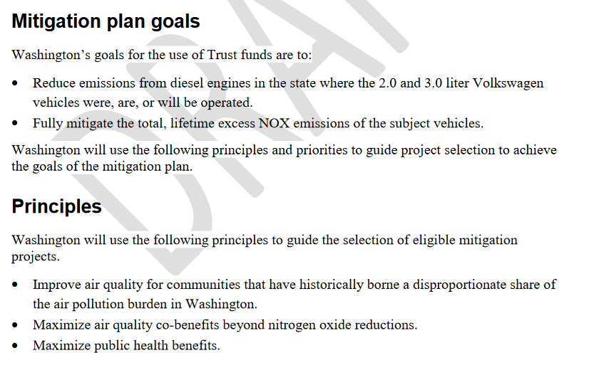
VW Settlement (Federal)
https://ecology.wa.gov/DOE/files/41/417a6510-a669-4a10-927d-4ebc02282f4a.pdf

Slide 10
Commerce Clean Energy Funds
Revolving loan fund for upfront costs for solar, energy efficiency, electric Class 4-8 and buses, EVSE
$11M Grid Modernization (September)
$4M Solar deployment
$8.6M in RD&D matching funds
https://www.commerce.wa.gov/growing-the-economy/energy/clean-energy-fund/
(also sign up for email updates)

Slide 11
Commerce Clean Energy Fund: Transportation Electrification
$7.9M in state funds (innovation)
<$3.1M in federal Recovery Act funds (deployment of established technologies)
Local governments or public or private retail electrical utilities
Priority to reducing top 200 hours of demand
Eligible technologies (including, not limited to):
  EV charging and open source control infrastructure, incl. inductive
  Low income, multi-unit EVs in urban settings
  V2G, including fleets
  EV fleet management with open source software
  Maritime electrification
Coordinate with VW Settlement

Slide 12
Other State Investments
WSDOT Electric Vehicle Infrastructure Pilot Program
  $1M in state funds, $1.5M private → 15 DCFC stations

Slide 13
Other State Investments
Electrify America
  Cycle 1 (through Q2 2019):
    12 DCFC banks (6 ports each) along I-5, I-90, and Seattle area
    18 level 2 locations in Puget Sound area
Alternative Fuel Infrastructure Corridor Coalition (w/ EPA)
  Develop strategy for alternative fuels opportunities for heavy duty

Slide 14


Presented by:
Tony Usibelli
tony.usibelli@commerce.wa.gov
360 725- 3110
Alan Kwan
360 725-3120
alan.kwan@commerce.wa.gov
http://www.commerce.wa.gov/growing-the-economy/energy/
www.commerce.wa.gov

