Slide 1
The Pacific Northwest Cleantech Economy
J. Thomas Ranken
CleanTech Alliance
www.CleanTechAlliance.org
@wacleantech
@jthomasranken

Slide 2
PROGRAM | 2013 | 2015 | 2017 | TOTAL
Grid Modernization | 15.0 | 13.0 | 11.0 | 39.0
Grants to Nonprofit Lenders | 15.0 | 13.2 | 0.0 | 28.2
Research, Development & Deployment | 6.0 | 10.0 | 7.9 | 23.9
Other | 0.0 | 3.8 | 27.3 | 31.0
Total | 36.00 | 40.0 | 46.1 | 122.1

Slide 3
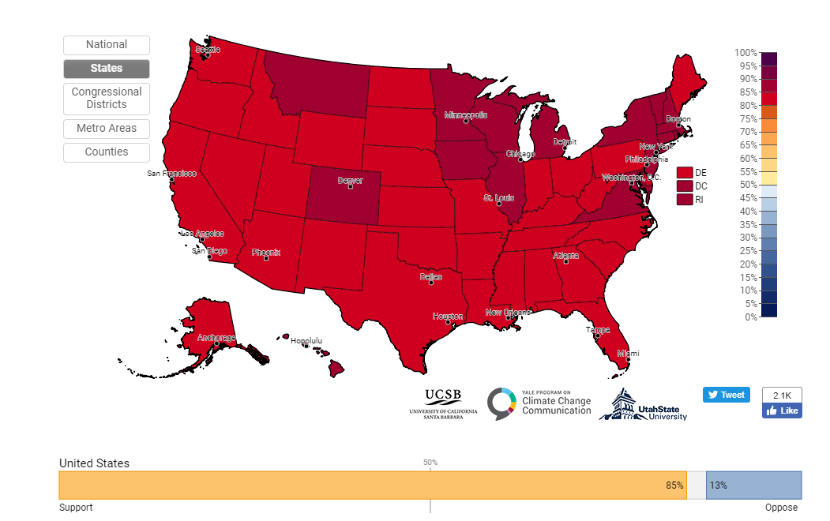
Estimated % of adults who support funding research into renewable energy sources, 2018

