Slide 1
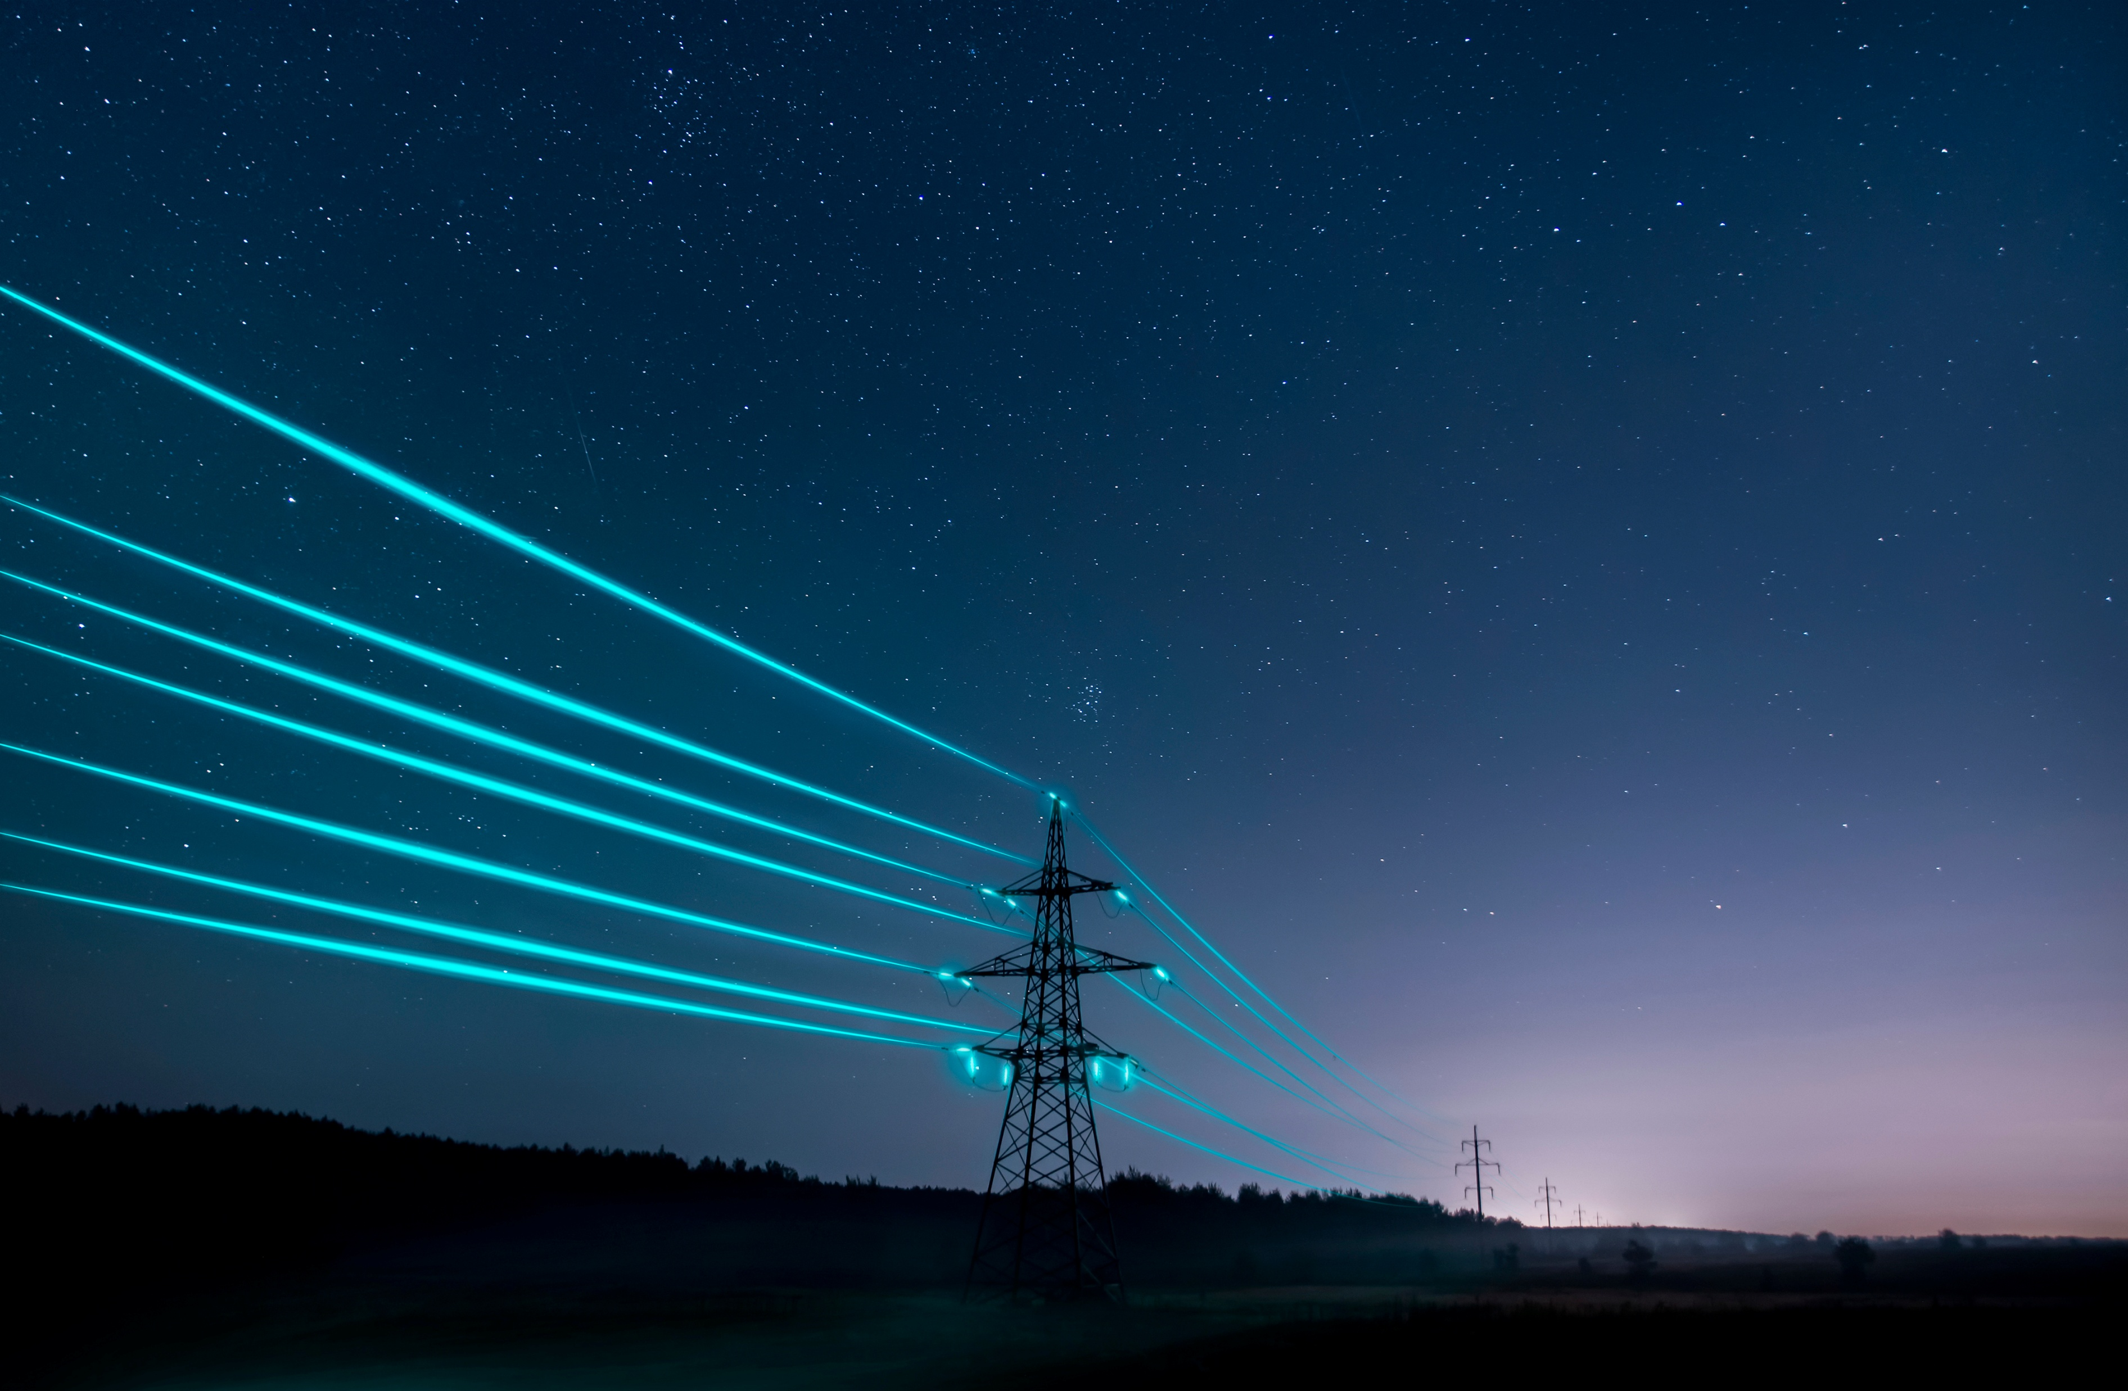



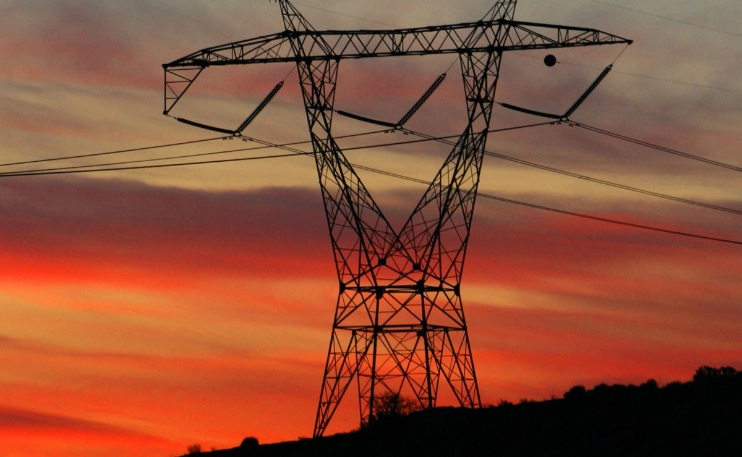
Subsurface Clean Energy Opportunities in the Pacific Northwest
& the Northwest Energy Shortfall
Annika Wallendahl | 11.5.2025
Geosyntec Consultants
Notes:
Earth pattern

Slide 2

Annika Wallendahl
Principal Engineer, PE, LG, MBA
Annika is a Principal Engineer with over 23 years experience. She is a leader in Geosyntec's nationwide energy transition, carbon advisory, and decarbonization teams. Annika is a licensed geologist and professional engineer in Washington State and supports clients across North America and Europe with planning and executing strategic decarbonization projects.
Based in Seattle Office
Notes:
Right-click on the headshot and choose “Change Picture” to update the picture.

Slide 3


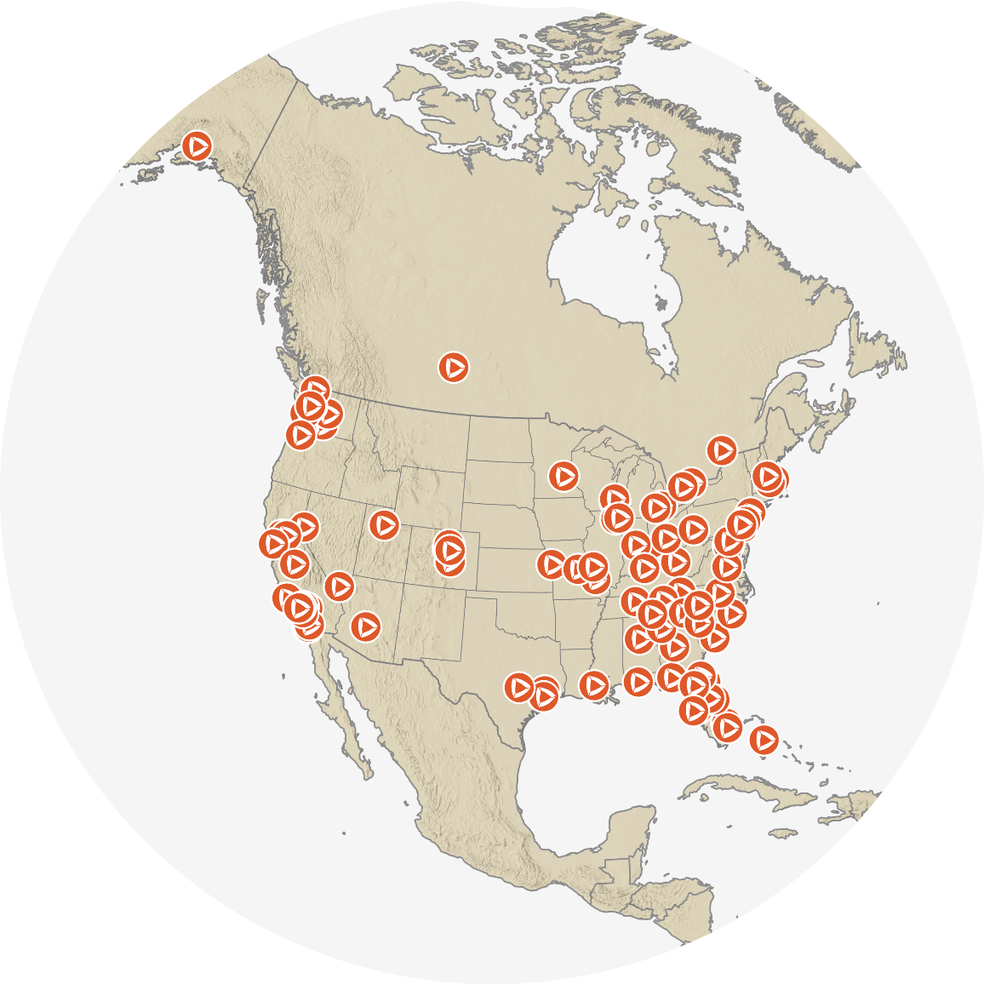
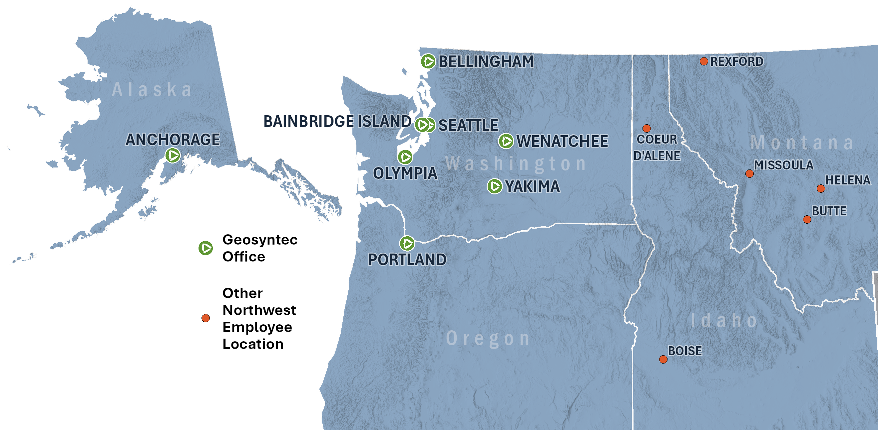
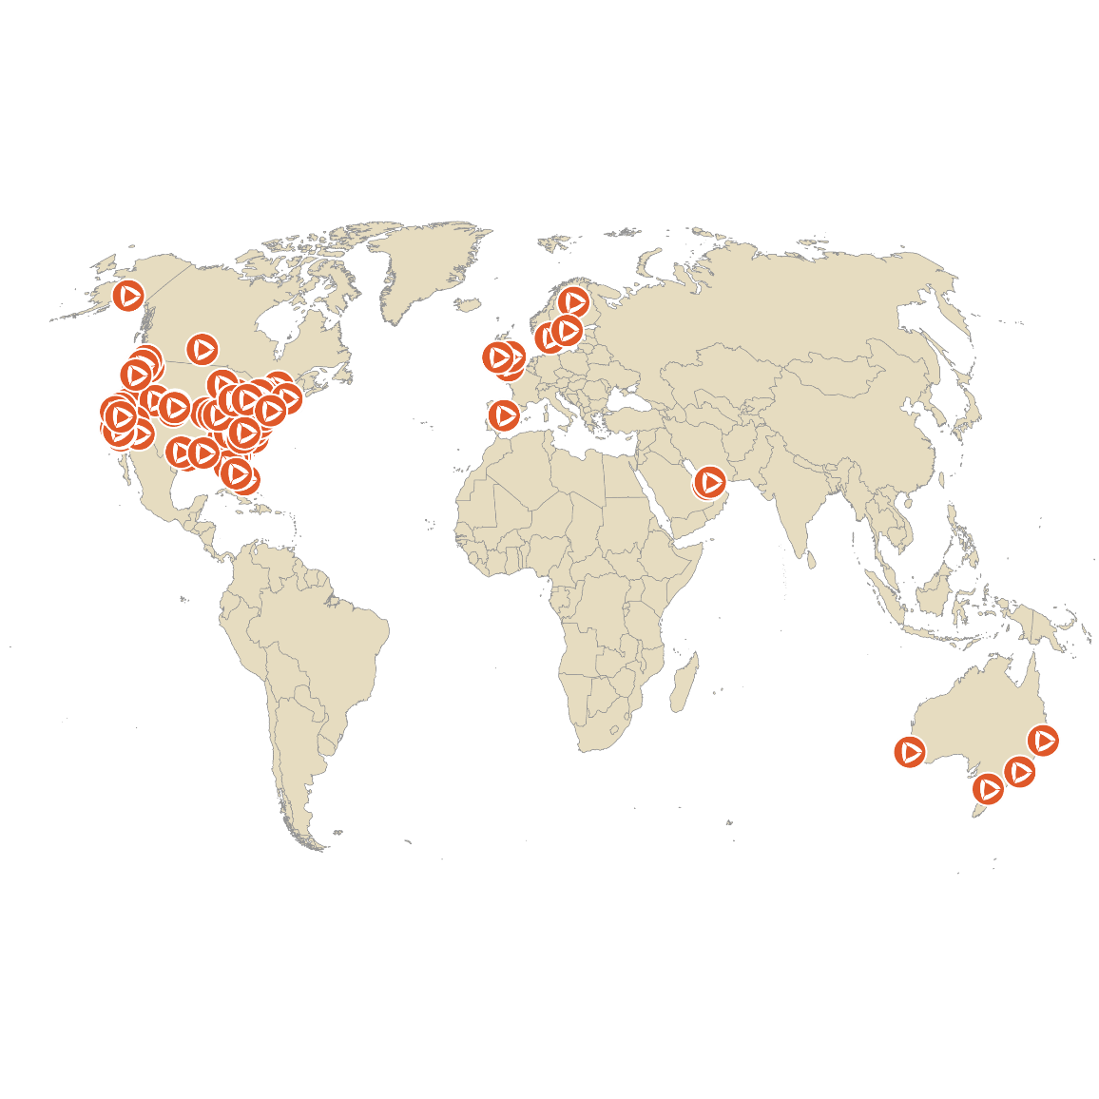
About Geosyntec
Founded 1983 Employees 2,600+ worldwide
NORTH AMERICA
GLOBAL

Slide 4
Agenda
Northwest Energy Shortfall
Clean Energy Solutions

Slide 5
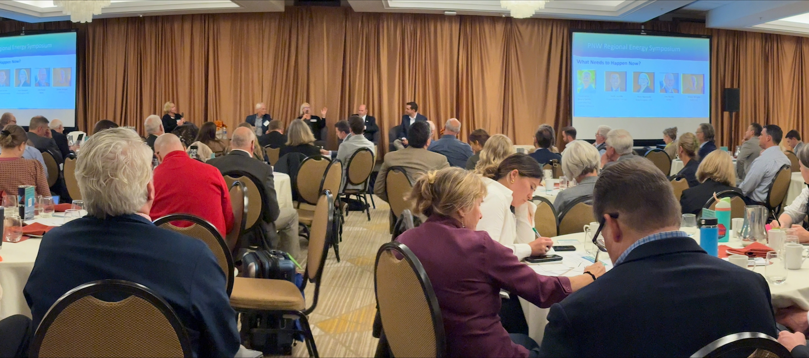
What is the Northwest Energy Shortfall?
Notes:
Regional Energy Symposium held October 9 in Portland
Symposium convened over 300 energy leaders, legislators and energy industry experts
Symposium was kickoff for collaborative resource adequacy planning between natural gas and electricity providers
Expect rolling blackouts starting January 2026 across the Northwest on highest load days (coldest winter days)

Slide 6
Energy Demand is Growing
NW energy demand expected to grow by 30% by 2030
Data center expansions are primary driver of load growth in region
Energy Production is Down
Hydroelectric generation down 24%
Fossil Fuel/Coal generation down due to retirements
Wholesale electricity generation blend relies on renewables – these don’t produce at nameplate capacity during cold snaps
Natural gas transmission and capacity is maxed on cold days

Slide 7
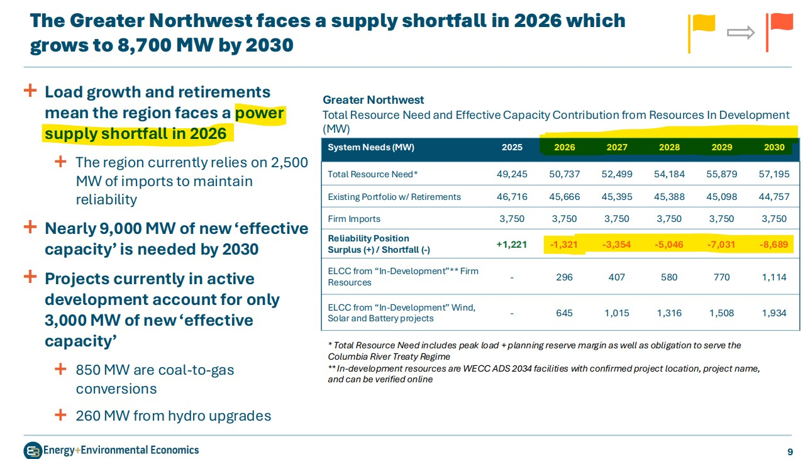
9 GW Energy Shortfall by 2030

Slide 8
What Resources are Coming Online?
NW utilities to add 29 GW of new resources by 2035
Mostly wind, solar, and battery resources
Battery energy storage system capacity projected to reach 18.8 GW by the end of 2025
38% increase from the 13.6 GW at the end of 2024
Renewable resources perform poorly in extreme cold
In bad conditions, 100 GW of nameplate capacity may produce <10 GW
Notes:
*BESS capacity listed is for Western Electricity Coordinating Council (WECC) area (excluding California ISO)

Slide 9
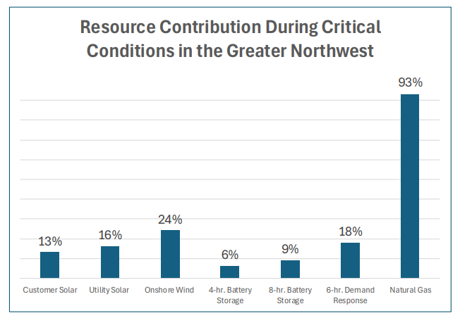
"Firm" Energy Resources are Needed
January 13-16, 2024 cold event exposed grid-wide vulnerability
Effective Load Carrying Capacity (ELCC%) is how a resource delivers during critical periods
NW needs to add more "firm" energy resources (high ELCC%)
Notes:
Marginal ELCC (Effective Load Carrying Capability) is a method for assessing a power resource's contribution to grid reliability by measuring the incremental benefit of adding one more unit of that resource class to the system. This approach accounts for diminishing returns, meaning that the reliability contribution of each additional unit of a resource (like solar or battery storage) decreases as more of that same type of resource is added to the grid. This is in contrast to the average ELCC method, which considers the overall average contribution of all resources of that type.

Slide 10
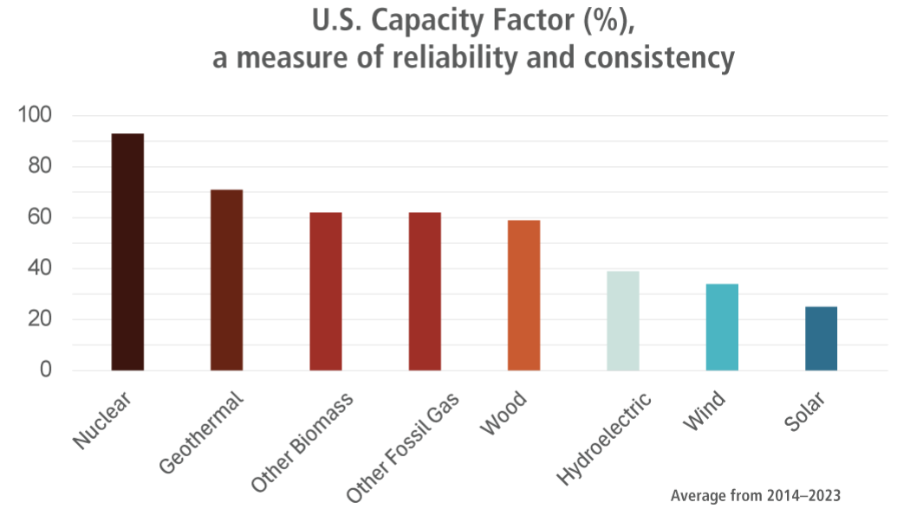
Clean Energy Resources are Reliable
Credit: WA DNR, The Washington Geothermal Experience

Slide 11
Northwest Needs More Clean Energy
Development of emerging clean energy technologies to commercial/grid scale is still critical.
However, to end the Northwest energy shortfall, we need to add more:
Distributed energy resources across the entire region
Firm energy resources that can come online quickly
Battery storage co-located with less firm energy resources
Also need to explore carbon management solutions, like subsurface carbon sequestration co-located with new fossil fuel/natural gas generating plants

Slide 12
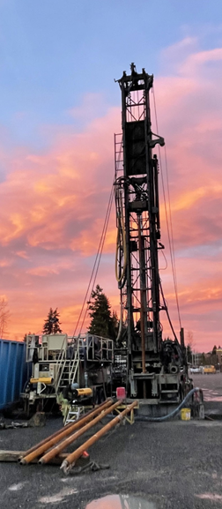
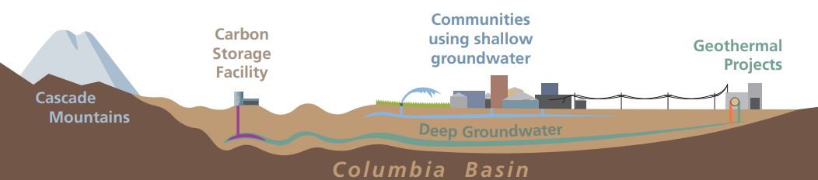
Subsurface Clean Energy Opportunities
Subsurface Opportunities
Thermal Energy Storage & Networks
Stimulated Geologic Hydrogen
Shallow and Deep Geothermal
Image Credit: WA DNR
Notes:
SB SB 6039 - 2023-24
Promoting the development of geothermal energy resources.
Agrivoltaics = 3.95 million amenable crop acres across WA State
https://energy.sandia.gov/programs/fossil-energy/subsurface-storage/geologic-hydrogen-capabilities/geologic-hydrogen/

Slide 13
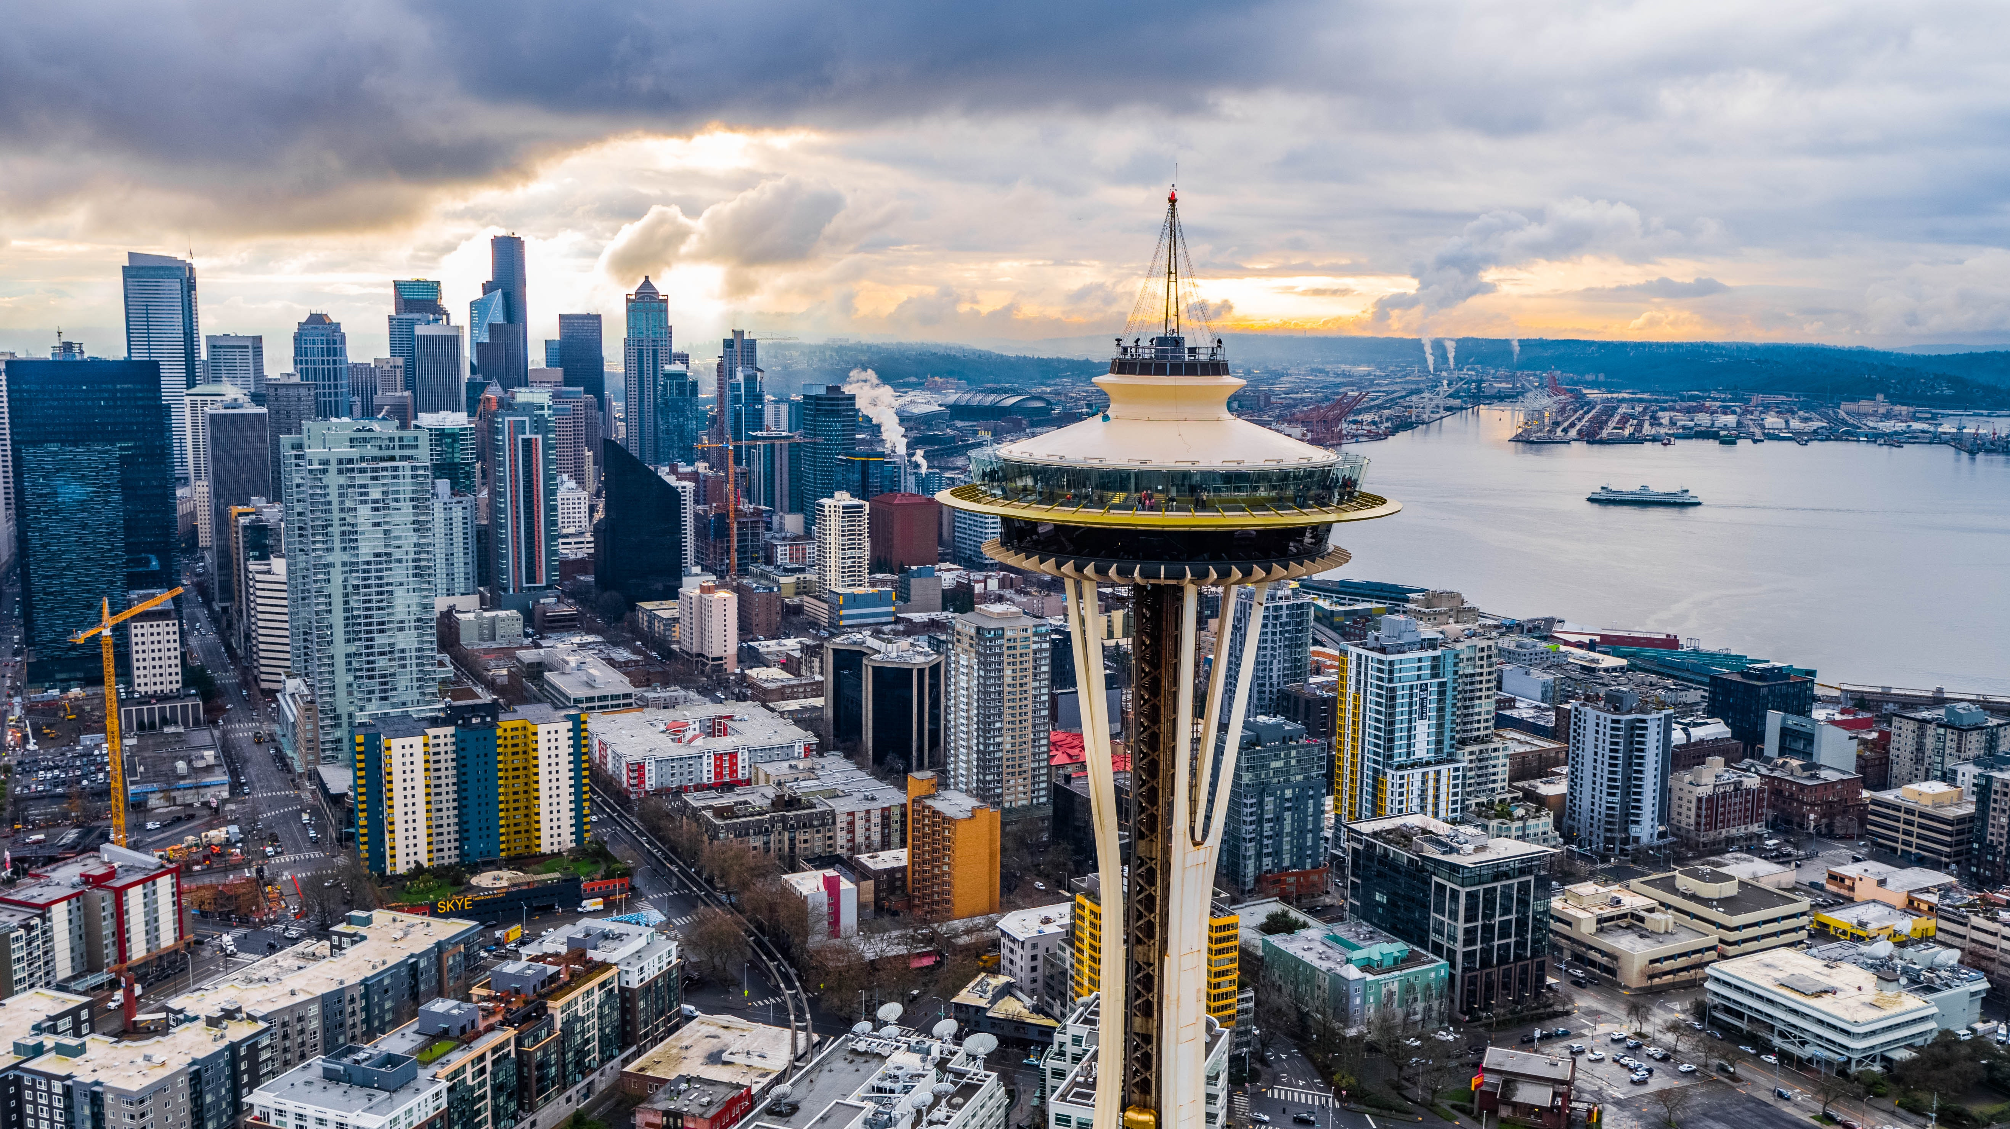
Why is
Low Temperature Geothermal
well suited to Washington?
Notes:
Change text as needed – but keep short. To change the photo, move the filled rectangle over slightly, then right-click on the background photo and choose “Change Picture” to choose a theme-appropriate image. Move the transparent rectangle back in place.
The background photo has a translucent screen over it. To change, background photo move the translucent screen slightly to the left or right, then right-click on the background photo and choose “Change Picture and choose a new photo.

Slide 14

Isabellah von Trapp
Senior Hydrogeologist, LHG
Isabellah is a licensed hydrogeologist who helps clients explore and develop the relationship between their water and energy systems. Her work includes water supply development, water rights permitting, aquifer characterization, as well as evaluating and implementing low temperature geothermal energy projects.
Based in Seattle Office
Notes:
Right-click on the headshot and choose “Change Picture” to update the picture.

Slide 15







Presentation Overview
Washington Geology
Feasibility
The Future
Geothermal Definitions
Hydrogeology 101
Ground Source Heat Pumps

Slide 16
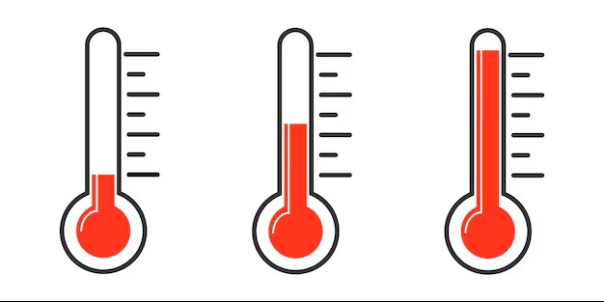
What Do We Mean By "Geothermal Energy"?
Geothermal energy works by harnessing heat from beneath the Earth's surface to generate electricity or provide heating and cooling, either through a direct heating system or a ground source heat pump.
LOW
MODERATE
HIGH
45-75° F
75-250° F
300-700° F
Ground Source Heat Pumps
Direct Use
Electricity Generation

Slide 17
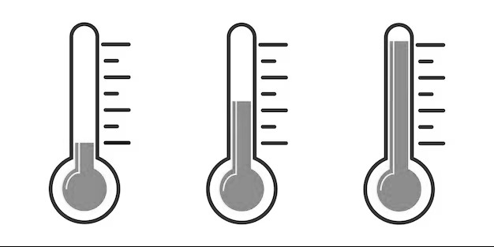
What Do We Mean By "Geothermal Energy"?
Geothermal energy works by harnessing heat from beneath the Earth's surface to generate electricity or provide heating and cooling, either through a direct heating system or a ground source heat pump.
LOW
MODERATE
HIGH
45-75° F
Ground Source Heat Pumps
Direct Use
Electricity Generation

Slide 18
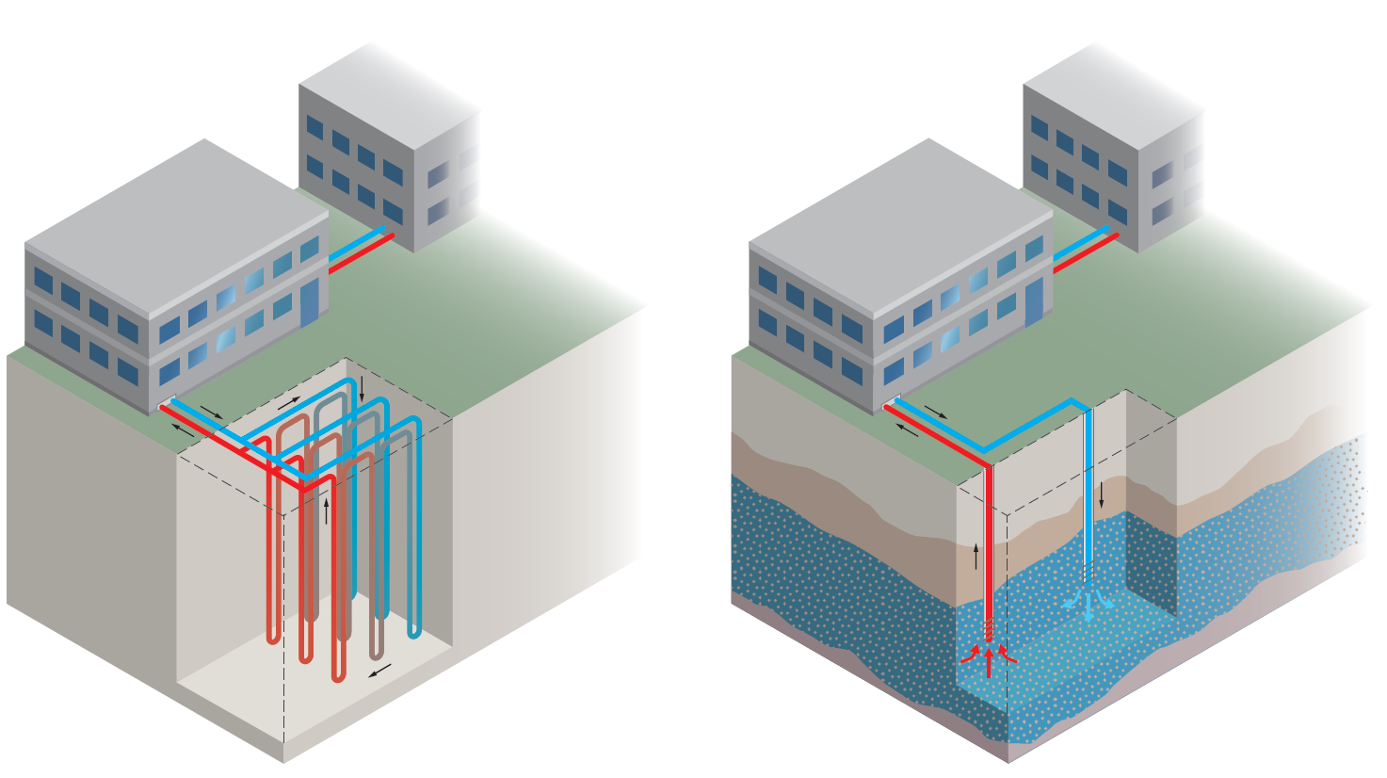
How Do Ground Source Heat Pumps Work?
Ground source heat pumps work by transferring energy between the ground and a building through borings or wells, using the Earth's stable underground temperature to efficiently heat and cool indoor spaces.
Closed-Loop
Open-Loop
Closed-Loop | Open-Loop
Can be installed anywhere No water right needed Large footprint required Significant costs at large-scale | Certain hydrogeologic conditions needed Water Right Permit / UIC Registration needed Smaller footprint required Economy of scale

Slide 19
Why Are Aquifers Important in GSHP Design?
An aquifer is an underground layer of water-bearing material. Aquifer transmissivity is a measure of an aquifer’s ability to transmit groundwater.
Water Pumped from Aquifer
Sand & Gravel
Fractured Bedrock
Closed-Loop Design
Open-Loop Design

Slide 20
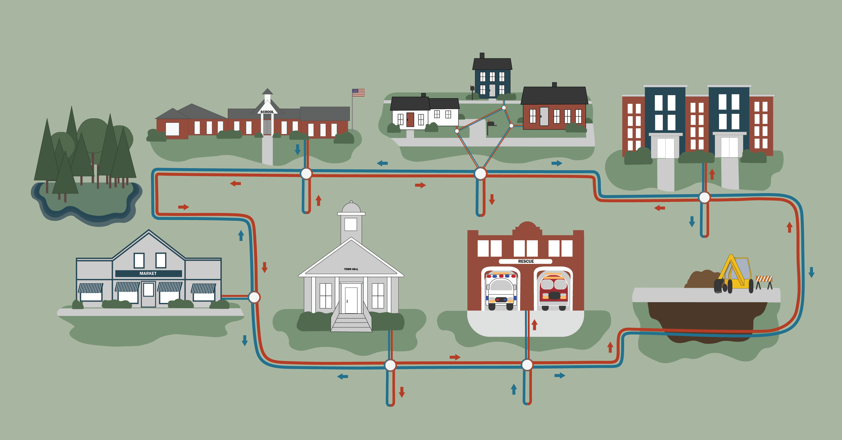

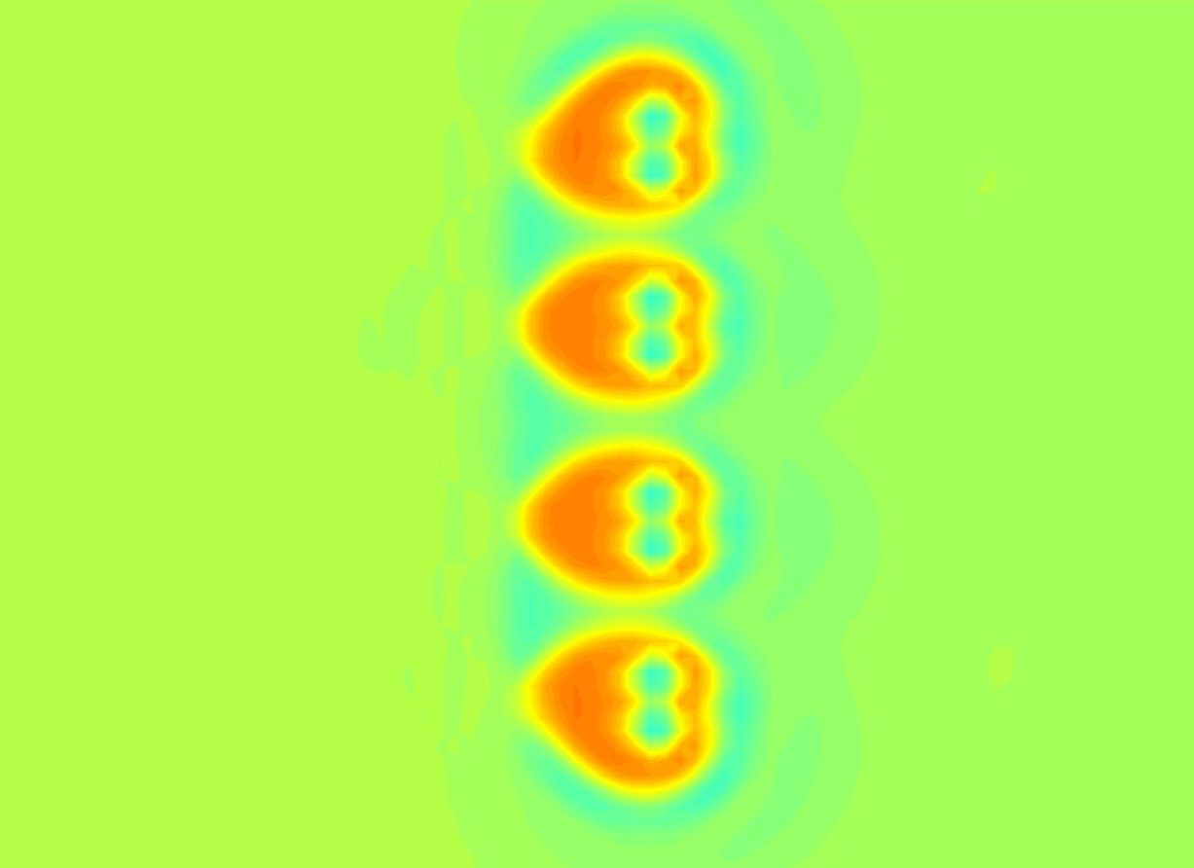
Is a Feasibility Study Necessary?
85° F
Temperature Impact Modeling
40° F
Vermont Community Thermal Networks
Supply Wells
Thermal Energy Network
Return Wells
Induced Gradient from Pumping
Natural Groundwater Flow Direction
Notes:
Add something about thermal energy network

Slide 21
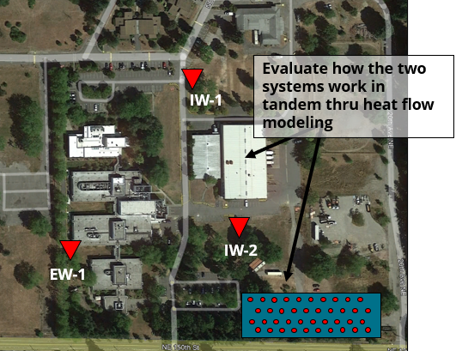
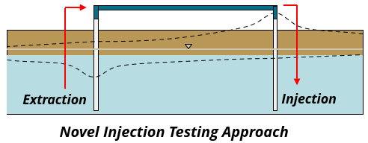
Washington State Public Health Lab
Shoreline, Washington
Selected technology to meet decarbonization goals
Centrally located within City limits
Constructed within past cleanup site (can be a constraint to UIC permitting)
Notes:
Make text-heavy slides a white background

Slide 22
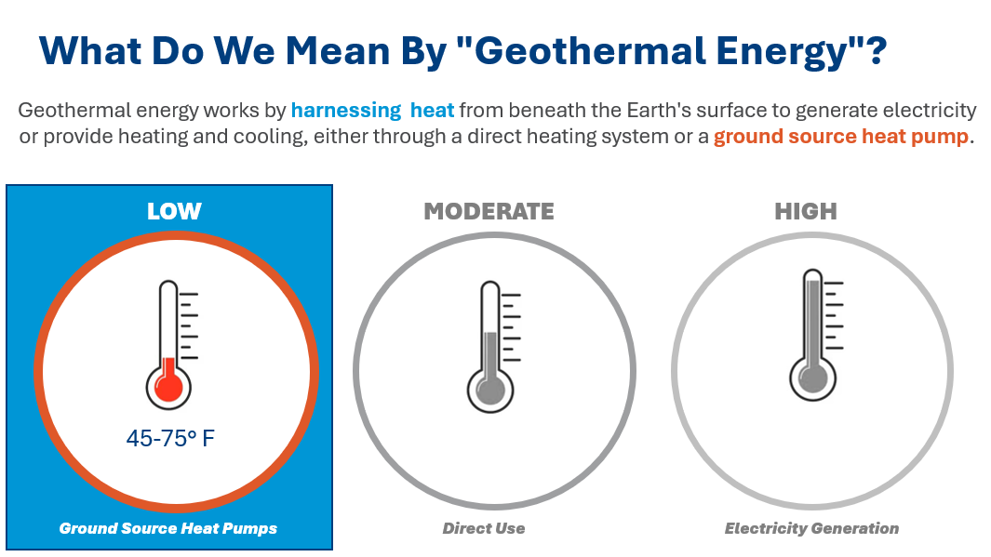
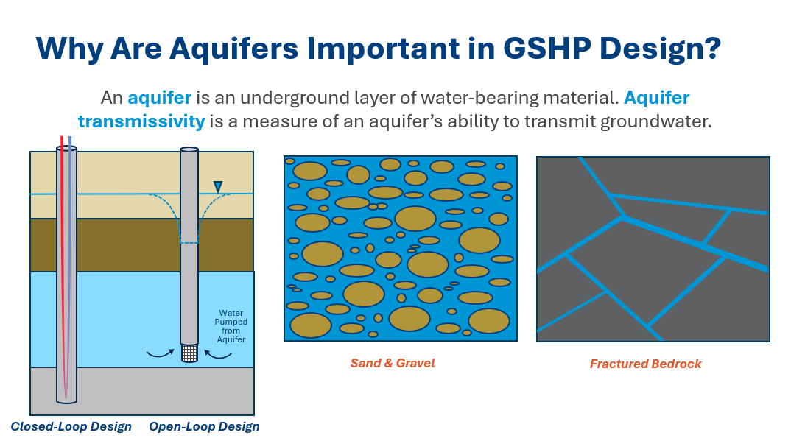
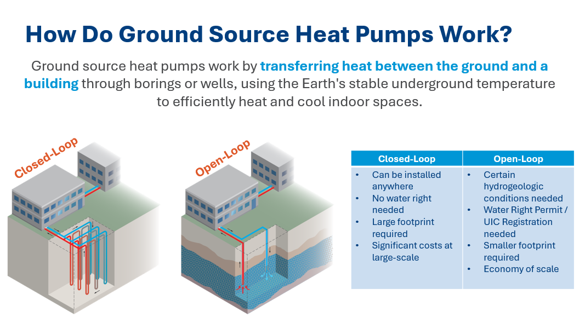

What Have We Learned?
OPPORTUNITY

Slide 23
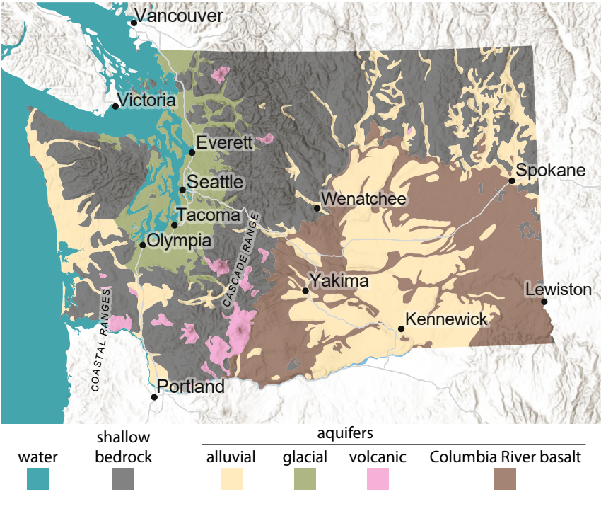
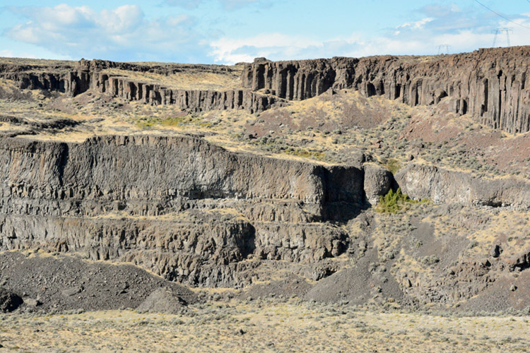
Why Washington?
Washington Geological Survey, May 2024

Slide 24
What’s NEXT ?

Slide 25


Questions?
Annika Wallendahl
Annika.Wallendahl @Geosyntec.com
Isabellah von Trapp
Isabellah.vonTrapp @Geosyntec.com
Ask Annika About:
Stimulated geologic hydrogen, carbon management, carbon sequestration
Ask Isabellah About: Ground source heat pump feasibility, design, permitting, construction
Notes:
Earth pattern

